Slide 1
FUTURE SUMMER SEMINARS 2018
August 14 “Rules for Radical Christians: Fighting Cultural Fire with the Love of Christ”
August 28 “Biblical Economics”—What the Bible Says about Stewardship
(Tuesday evenings at 7:00 p.m.)
hosperspca.org

Slide 2
Attachment Disorder:
Explanation? Excuse? How a ‘Diagnosis’ May Help or Hinder Sanctification.

Slide 3
WHY “SUMMER SEMINARS”?
1. Summer can be spiritually and intellectually dry.
2. Some subjects need to be addressed.
3. I need to study and comment on some subjects.

Slide 4
I. WHAT IS ATTACHMENT DISORDER?
Dr. John Bowlby, British psychiatrist, 1948.
Researched children dropped off at large sanitarium
Noted patterns developing among the “abandoned”
Stage One: Protest
Stage Two: Despair
Stage Three: Detachment
Avoidance of or Ambivalence toward parents
Replacing relationships with things, toys, etc.

Slide 5
I. WHAT IS ATTACHMENT DISORDER?
“Attachment Behavioral System”
If mother near and responsive—secure
If mother not near or responsive—anxious
The anxious child will attempt relationship-seeking maneuvers

Slide 6
I. WHAT IS ATTACHMENT DISORDER?
Bowlby’s “Relationship Styles” based on “self-dimension” and “other dimension”
The self dimension asks two questions:
1. Am I worthy of being loved?
2. Am I able to do what I need to get the love I need?
The other dimension asks two similar questions:
1. Are other people reliable and trustworthy?
2. Are people accessible and willing to respond when I need them?

Slide 7
I. WHAT IS ATTACHMENT DISORDER?
Four possible sets of answers:
1. I am worthy and capable and others are reliable and available. (+ +)
2. I am worthy and capable but others are not reliable or available. (+ –)
3. I am not worthy or capable, but others are reliable and available. (– +)
4. I am not worthy or capable and others are not reliable or available. (– –)

Slide 8
I. WHAT IS ATTACHMENT DISORDER?
Four “Relationship Styles”:
1. Secure (+ +)
2. Avoidant (+ –)
3. Ambivalent (– +)
4. Disorganized (– –)

Slide 9
I. WHAT IS ATTACHMENT DISORDER?
“Reactive Attachment Disorder”
(Mayo Clinic) RAD is “a rare but serious condition in which an infant or young child doesn't establish healthy attachments with parents or caregivers….It can start in infancy. There's little research on signs and symptoms of reactive attachment disorder beyond early childhood, and it remains uncertain whether it occurs in children older than 5 years.”

Slide 10
I. WHAT IS ATTACHMENT DISORDER?
“Reactive Attachment Disorder”
(Mayo Clinic) “Signs and symptoms may include: Unexplained withdrawal, fear, sadness or irritability, sad and listless appearance, not seeking comfort or showing no response when comfort is given, failure to smile, watching others closely but not engaging in social interaction, failing to ask for support or assistance, failure to reach out when picked up, (and) no interest in playing peekaboo or other interactive games.”

Slide 11
II. THE SPREAD OF ATTACHMENT THEORY.
Why has the popularity of attachment theory grown?
The rise in the number of non-traditional families.
A rise in abusive families and children in foster care.

Slide 12
II. THE SPREAD OF ATTACHMENT THEORY.
Growing interest in attachment theory among Christian psychologists
Tim Clinton & Gary Sibcy: Why You Do the Things You Do: The Secret to Healthy Relationships (2006)
Republished (2009) Attachments: Why You Love, Feel, and Act the Way you Do

Slide 13
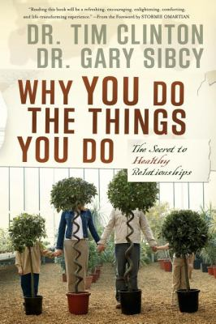
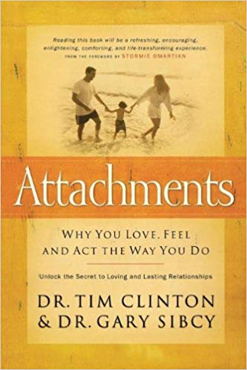

Slide 14
II. THE SPREAD OF ATTACHMENT THEORY.
Growing interest in attachment theory among Christian psychologists
Tim Clinton & Gary Sibcy: Why You Do the Things You Do: The Secret to Healthy Relationships (2006)
Republished (2009) Attachments: Why You Love, Feel, and Act the Way you Do
“The answer to why you feel, act and relate the way you do is found in your relationship style, which has roots in your childhood….In this transformational book, the authors use groundbreaking research to help you identify and define your first human connections. They’ve also developed four relationship styles that will shed light on why you do what you do—and how you can learn to love and be loved even better.”

Slide 15
III. CONCERNS ABOUT THE “CHRISTIAN” COUNSELING MOVEMENT.
SECULAR PSYCHOLOGY
Observations → Formation of Theories → Treatment
------------------ ------------------------------- ----------------------
Based only Secular/atheistic Calculated to
on natural assumptions/ “restore
revelation presuppositions function”

Slide 16
III. CONCERNS ABOUT THE “CHRISTIAN” COUNSELING MOVEMENT.
The Four Most Important Factors of Human Existence
1. God is and God made us for himself in his image.
2. Sin has ruined us—radically self-centered.
3. Christ alone redeems us with his blood - the cross
4. The Word and Spirit are the only real instruments of lasting change
ALL OF THESE COMPLETELY IGNORED BY SECULAR PSYCHOLOGY!

Slide 17
III. CONCERNS ABOUT THE “CHRISTIAN” COUNSELING MOVEMENT.
Secular Explanations for Dysfunction
1. Brain chemistry
2. Bad parenting
3. Both!
…because bad parenting can “rewire the brain”
(so it really all comes down to brain chemistry)

Slide 18
III. CONCERNS ABOUT THE “CHRISTIAN” COUNSELING MOVEMENT.
MANY “CHRISTIAN” COUNSELORS ARE TRAINED IN SECULAR PSYCHOLOGY
Observation → Formation of Theories → Treatment
------------------ ------------------------------- ----------------------
Based only Secular/atheistic Calculated to
on natural assumptions/ “restore
revelation presuppositions function”

Slide 19
III. CONCERNS ABOUT THE “CHRISTIAN” COUNSELING MOVEMENT.
“CHRISTIAN” PSYCHOLOGY
Observation → Formation of Theories → Treatment
------------------ ------------------------------- ----------------------
Based mainly Secular/atheistic Calculated to
on natural assumptions/ “restore
revelation presuppositions function”
(and some (“Sanitized” secular
Bible verses) theories)

Slide 20
III. CONCERNS ABOUT THE “CHRISTIAN” COUNSELING MOVEMENT.
BIBLICAL COUNSELING
Observation → Formation of Theories → Treatment
------------------ ------------------------------- ----------------------
Begins with Based on the four most Aimed at
God’s Word significant factors of restoring God-
(includes human existence: centered faith
insights from God, sin, the cross and obedience
natural of Christ, new life
revelation) through the Word and
Holy Spirit

Slide 21
III. CONCERNS ABOUT THE “CHRISTIAN” COUNSELING MOVEMENT.
“Christian” counselors Clinton and Sibcy adopt Bowlby’s secular assumptions with approval!
The self dimension asks two questions:
1. Am I worthy of being loved?
2. Am I able to do what I need to get the love I need?
The other dimension asks two similar questions:
1. Are other people reliable and trustworthy?
2. Are people accessible and willing to respond when I need them?

Slide 22
Clinton and Sibcy:
“So—what causes this trouble and friction in marriage? Some people blame it on things like crowded schedules, money pressures, communication problems, and midlife crises. Others target differences. She might be gregarious, he might be thoughtful; he might be plagued with fears, she might boldly push the envelope. They might have differing political opinions or biblical priorities. Every one of these differences—and more—can spark an argument, and every one can bring trouble and friction to a marriage.

Slide 23
“Difficulties in marriage also arise out of unresolved relational hurts. Arguments and misunderstandings flare up and die, but you never deal with the issues that cause all the flames in the first place. Then as the battles rage, those battles and the wounds they cause become issues in themselves, seriously marring the marital landscape. When you feel hurt and your feelings unnoticed, your wounds—many of which probably started as paper cuts—become deep and raw and produce pain that just doesn’t go away.” (p. 177)

Slide 24
Clinton and Sibcy:
“What causes trouble and friction in marriage?”
Answer: “crowded schedules, money pressures, communication problems, and unresolved relational hurts.”
James 4:1-3 (God’s Word)
“What causes quarrels and what causes fights among you?”
Answer: “Is it not this, that your passions are at war within you? 2 You desire and do not have, so you murder. You covet and cannot obtain, so you fight and quarrel. You do not have, because you do not ask. 3 You ask and do not receive, because you ask wrongly, to spend it on your passions.”

Slide 25
III. CONCERNS ABOUT THE “CHRISTIAN” COUNSELING MOVEMENT.
Whatever happened to sin?
Why ignore this fundamental dynamic of human nature?
Could it be that they started with secular theories and explanations but didn’t quite get all of the secular assumptions and presuppositions weeded out?

Slide 26
IV. THE PROBLEM WITH PSYCHOLOGICAL DIAGNOSES.
Medical Doctor Michael Emlet, Descriptions and Prescriptions: A Biblical Perspective on Psychiatric Diagnoses & Medications

Slide 27
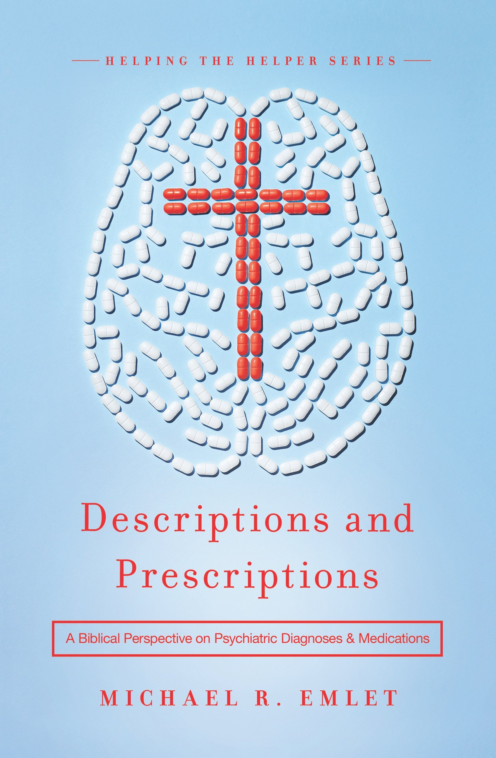

Slide 28
IV. THE PROBLEM WITH PSYCHOLOGICAL DIAGNOSES.
Emlet, Descriptions and Prescriptions
Psychiatric diagnoses are descriptions, not explanations.
Psychiatric diagnoses may “abnormalize the normal”
Some psychiatric diagnoses redefine behavior that Scripture would characterize primarily as sin.
Some psychiatric diagnoses are influenced by the culture.

Slide 29
IV. THE PROBLEM WITH PSYCHOLOGICAL DIAGNOSES.
Beware the “coveted victim status”!
1. Excusing negative/sinful behavior
a. I can’t help it.
b. You cannot correct or discipline me.
c. Don’t expect very much from me.
d. There must be some underlying cause to evil behavior.
2. Entitles to special treatment.

Slide 30
IV. THE PROBLEM WITH PSYCHOLOGICAL DIAGNOSES
Discerning reliance on “coveted victim status.”
1. “We are sinned against.”
2. “We often respond sinfully to being sinned against.”
…often exposes the root of the problem.

Slide 31
FUTURE SUMMER SEMINARS 2018
August 14 “Rules for Radical Christians: Fighting Cultural Fire with the Love of Christ”
August 28 “Biblical Economics”—What the Bible Says about Stewardship
(Tuesday evenings at 7:00 p.m.)
hosperspca.org

Slide 32
V. ATTACHMENT ISSUES FROM A BIBLICAL PERSPECTIVE
1. God made us for himself and in his own image.
God is a tri-unity! God is a community.
Relationships are essential to our nature as created in God’s image.
God made us for himself! We belong to him.
We do not belong to ourselves.
It’s not about our fulfillment or dysfunction.

Slide 33
V. ATTACHMENT ISSUES FROM A BIBLICAL PERSPECTIVE
2. Sin has ruined us.
Turned us radically self-centered.
Martin Luther “incurvatus in se”
a. There are no perfect parents.
b. All parents raise imperfect children.
c. When does sinful self-centeredness begin?
What does the Bible call responses like “avoidance” and “ambivalence”?
The Great Commandments: Love God and neighbor.

Slide 34
V. ATTACHMENT ISSUES FROM A BIBLICAL PERSPECTIVE
3. Christ alone redeems us with his blood.
Our Lord Jesus was abused, rejected, abandoned!
He was forsaken by his Father.
For us.
Here we find adoption, welcome, eternal dwellings.

Slide 35
V. ATTACHMENT ISSUES FROM A BIBLICAL PERSPECTIVE
4. The Word and Spirit alone bring lasting change.
Change must begin in the heart.
The unregenerate live only for self-interest.
The Holy Spirit re-orients us back to love for God and
neighbor.

Slide 36
VI. TREATMENT FOR ATTACHMENT DISORDERS FROM A BIBLICAL PERSPECTIVE
The Mayo Clinic (r.e.: Reactive Attachment Disorder):
“With treatment, children with reactive attachment disorder may develop more stable and healthy relationships with caregivers and others. Treatments for reactive attachment disorder include psychological counseling, parent or caregiver counseling and education, learning positive child and caregiver interactions, and creating a stable, nurturing environment.”

Slide 37
VI. TREATMENT FOR ATTACHMENT DISORDERS FROM A BIBLICAL PERSPECTIVE
Ephesians 6:4:
“Fathers, do not provoke your children to anger, but bring them up in the discipline and instruction of the Lord.”
Fathers must not neglect or abuse.
Fathers must ensure consistent, loving discipline.
Fathers are to provide a biblical worldview and interpretation of their world.
(Implication: Children are sinners from the outset, hard-wired toward self. Hence the need for discipline and instruction.)

Slide 38
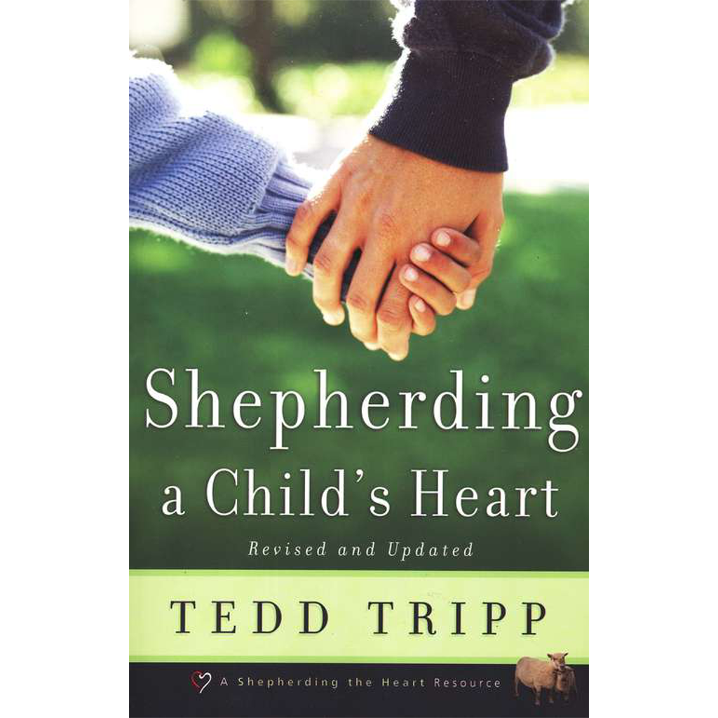

Slide 39
Should we be grateful for Dr. Bowlby’s research into attachments?

Slide 40
CONCLUSIONS
The greatest weakness of psychology: secular or Christian—
an inadequate view of sin.
Sin brings misery. People ask: “Why am I so miserable?”
Secular psychology can only offer three answers:
1. Brain chemistry
2. Bad parenting
3. Both
“Christian” psychology doesn’t get much further.
The explanations and proposed treatments are very similar.
These solutions are quite ineffective. Why continue them?

Slide 41
BIBLICAL COUNSELING
“Restoring Christ to counseling, and counseling to the church.”

Slide 42
FUTURE SUMMER SEMINARS 2018
August 14 “Rules for Radical Christians: Fighting Cultural Fire with the Love of Christ”
August 28 “Biblical Economics”—What the Bible Says about Stewardship
(Tuesday evenings at 7:00 p.m.)
hosperspca.org

