Slide 1
Hospers PCA Summer Seminars 2020
“The Roots of the (Moral) Revolution”
June 9: “Sigmund Freud’s Complicated Oedipus Complex” (Psychology)
June 23: “Margaret Mead’s Fantasy Island” (Anthropology)
July 21: “Alfred Kinsey’s Wild Ride (or Bogus Adventure?)” (Biology)
August 11: “Karl Barth’s Neo-Unorthodox Arrangement” (Theology)
(All Seminars on Tuesdays at 7:00 p.m.)
Notes:
Now we can be glad that most probably do not cheat or lie or fake their conclusions. In fact, the scientific method has a safeguard built into it from the start. Reliable data can only be gleaned from experiments that can be replicated, repeated with the same results. Anyone should be able to conduct the same experiment under the same conditions and achieve the same outcome. If you perform an experiment a thousand times and get the same results a thousand times, then the data is probably correct, even well established. If you get multiple, conflicting outcomes, then the data is not confirmed and needs more work.

Slide 2
Alfred Kinsey’s wild ride (or bogus adventure?)
The Roots of the (Moral) Revolution, Part 3

Slide 3
Psalm 119:129-136
Your testimonies are wonderful; therefore my soul keeps them.
The unfolding of your words gives light; it imparts understanding to the simple.
I open my mouth and pant, because I long for your commandments.
Turn to me and be gracious to me, as is your way with those who love your name.
Keep steady my steps according to your promise, and let no iniquity get dominion over me.
Redeem me from man’s oppression, that I may keep your precepts.
Make your face shine upon your servant, and teach me your statutes.
My eyes shed streams of tears, because people do not keep your law.
Notes:
Now we can be glad that most probably do not cheat or lie or fake their conclusions. In fact, the scientific method has a safeguard built into it from the start. Reliable data can only be gleaned from experiments that can be replicated, repeated with the same results. Anyone should be able to conduct the same experiment under the same conditions and achieve the same outcome. If you perform an experiment a thousand times and get the same results a thousand times, then the data is probably correct, even well established. If you get multiple, conflicting outcomes, then the data is not confirmed and needs more work.

Slide 4
INTRODUCTION
Ordinarily these summer seminars would each cover different, unrelated topics. But this year is unique.
The four seminars all deal with “The Roots of the (Moral) Revolution.”
We are examining the supposed intellectual giants who loaned seemingly scientific credence to the sexual revolution:
Sigmund Freud in psychology,
Margaret Mead in anthropology,
the unindicted sexual predator Alfred Kinsey in biology or sexology,
and finally the outlier, Karl Barth in theology.
Notes:
Now we can be glad that most probably do not cheat or lie or fake their conclusions. In fact, the scientific method has a safeguard built into it from the start. Reliable data can only be gleaned from experiments that can be replicated, repeated with the same results. Anyone should be able to conduct the same experiment under the same conditions and achieve the same outcome. If you perform an experiment a thousand times and get the same results a thousand times, then the data is probably correct, even well established. If you get multiple, conflicting outcomes, then the data is not confirmed and needs more work.

Slide 5
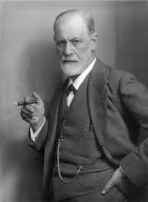
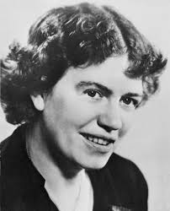
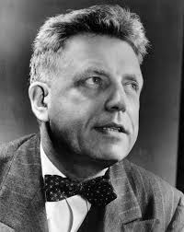
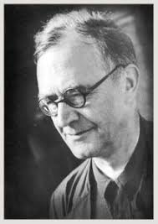
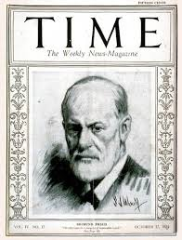
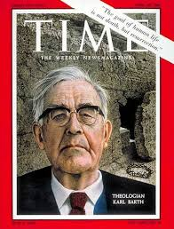

Slide 6
Each one of these is a foundation stone in his own right in the tearing down of the moral fabric of our time:
the shattering of innocence;
the sexual exploitation and human trafficking of women and children;
the explosive spread of sexually-transmitted diseases including the all-but forgotten AIDS epidemic;
the ubiquitous presence of obscenity and pornography now readily available on every smart phone and in every home with internet capabilities;
the dehumanization and objectification of millions of people reduced to mere bodies to be used for gratification;
the growing decline in the number of marriages as more and more young men are finding pornography and sex dolls or robots preferable to young women (talk about dehumanization!), leading many young women to turn to “halfway gay” relationships for love and companionship;
Notes:
Now we can be glad that most probably do not cheat or lie or fake their conclusions. In fact, the scientific method has a safeguard built into it from the start. Reliable data can only be gleaned from experiments that can be replicated, repeated with the same results. Anyone should be able to conduct the same experiment under the same conditions and achieve the same outcome. If you perform an experiment a thousand times and get the same results a thousand times, then the data is probably correct, even well established. If you get multiple, conflicting outcomes, then the data is not confirmed and needs more work.

Slide 7
creepy, cross-dressing men legally lurking about in women’s bathrooms and locker rooms or dominating “women’s” sports;
complete sexual confusion among young people;
the collapse of commitment in marriage and the destruction of the family, not to mention “gay marriage,” a true oxymoron or contradiction in terms;
and most seriously, the continuing horror, the holocaust of abortion on demand: the willful destruction of the most innocent human lives almost exclusively (in the upper 90 percentages of all abortions) as a matter of “choice” (read “convenience”).
Notes:
Now we can be glad that most probably do not cheat or lie or fake their conclusions. In fact, the scientific method has a safeguard built into it from the start. Reliable data can only be gleaned from experiments that can be replicated, repeated with the same results. Anyone should be able to conduct the same experiment under the same conditions and achieve the same outcome. If you perform an experiment a thousand times and get the same results a thousand times, then the data is probably correct, even well established. If you get multiple, conflicting outcomes, then the data is not confirmed and needs more work.

Slide 8
INTRODUCTION
If depression is mostly due to anger turned inward, I think I’m depressed.
Reading about the many bold lies promulgated by these frauds, Freud, Mead, Kinsey, and Barth, has led to deep frustration, partly because the willing majority eagerly accepted their unwarranted conclusions without question, and, it seems, by the slim turnout of these summer seminars, that nobody really cares.
Dr. Judith Reisman devoted the bulk of her life and professional career exposing the criminal fraud of Alfred Kinsey and his Kinsey Sex Institute in Bloomington, Indiana, and it mostly fell on deaf ears.
Oh, she testified at some hearings and published some shocking articles and books, but the world mostly just shrugged and moved on.
Notes:
Now we can be glad that most probably do not cheat or lie or fake their conclusions. In fact, the scientific method has a safeguard built into it from the start. Reliable data can only be gleaned from experiments that can be replicated, repeated with the same results. Anyone should be able to conduct the same experiment under the same conditions and achieve the same outcome. If you perform an experiment a thousand times and get the same results a thousand times, then the data is probably correct, even well established. If you get multiple, conflicting outcomes, then the data is not confirmed and needs more work.

Slide 9
INTRODUCTION
But perhaps the most vexing part of all of this is how the main ideas of these four pseudo-scholars were taken up into the cultural fabric and somehow became unassailable truths, the standard by which we judge all other matters.
Notes:
Now we can be glad that most probably do not cheat or lie or fake their conclusions. In fact, the scientific method has a safeguard built into it from the start. Reliable data can only be gleaned from experiments that can be replicated, repeated with the same results. Anyone should be able to conduct the same experiment under the same conditions and achieve the same outcome. If you perform an experiment a thousand times and get the same results a thousand times, then the data is probably correct, even well established. If you get multiple, conflicting outcomes, then the data is not confirmed and needs more work.

Slide 10
INTRODUCTION
Freud, for example, without any scientific proof or evidence, theorized that most mental illness, neurosis, was caused when the normal sexual desires (including a child’s desire to murder his father and commit incest with his mother, what he called the “Oedipus complex”) are forbidden or “repressed.”
The implication is that these sexual desires should always be acted on and satisfied. So traditional, biblical morality causes mental illness.
And even though later research decried his small sampling and debunked most of his theories, and even though Freud himself hated and wanted to murder his own father and carried on a decades-long adulterous, incestuous affair with his old wife’s snappy younger sister, their housekeeper and mother figure, never mind all that. People today still talk about “Oedipus complexes” or refer to people as “sexually repressed.”
Notes:
Now we can be glad that most probably do not cheat or lie or fake their conclusions. In fact, the scientific method has a safeguard built into it from the start. Reliable data can only be gleaned from experiments that can be replicated, repeated with the same results. Anyone should be able to conduct the same experiment under the same conditions and achieve the same outcome. If you perform an experiment a thousand times and get the same results a thousand times, then the data is probably correct, even well established. If you get multiple, conflicting outcomes, then the data is not confirmed and needs more work.

Slide 11
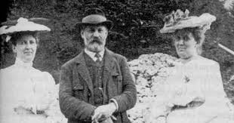

Slide 12
INTRODUCTION
Many today still think that traditional sexual morality probably causes mental illness.
The most moral-appearing man in the movie will probably turn out to be the real villain who is committing unspeakable acts.
Notes:
Now we can be glad that most probably do not cheat or lie or fake their conclusions. In fact, the scientific method has a safeguard built into it from the start. Reliable data can only be gleaned from experiments that can be replicated, repeated with the same results. Anyone should be able to conduct the same experiment under the same conditions and achieve the same outcome. If you perform an experiment a thousand times and get the same results a thousand times, then the data is probably correct, even well established. If you get multiple, conflicting outcomes, then the data is not confirmed and needs more work.

Slide 13
INTRODUCTION
And then there’s Margaret Mead, the young anthropologist sent to the dreamy South Seas island of Samoa specifically to find a culture where the common tumult of adolescence was absent.
Notes:
Now we can be glad that most probably do not cheat or lie or fake their conclusions. In fact, the scientific method has a safeguard built into it from the start. Reliable data can only be gleaned from experiments that can be replicated, repeated with the same results. Anyone should be able to conduct the same experiment under the same conditions and achieve the same outcome. If you perform an experiment a thousand times and get the same results a thousand times, then the data is probably correct, even well established. If you get multiple, conflicting outcomes, then the data is not confirmed and needs more work.

Slide 14
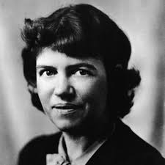
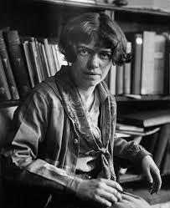
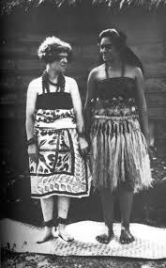
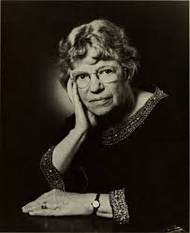
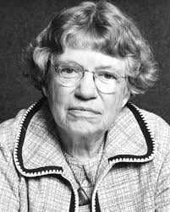

Slide 15
INTRODUCTION
She spent only eight brief months in Samoa, the first several simply learning the language.
She bunked with an American military family in an American military compound.
She never “went native” or lived in a Samoan village.
Notes:
Now we can be glad that most probably do not cheat or lie or fake their conclusions. In fact, the scientific method has a safeguard built into it from the start. Reliable data can only be gleaned from experiments that can be replicated, repeated with the same results. Anyone should be able to conduct the same experiment under the same conditions and achieve the same outcome. If you perform an experiment a thousand times and get the same results a thousand times, then the data is probably correct, even well established. If you get multiple, conflicting outcomes, then the data is not confirmed and needs more work.

Slide 16
INTRODUCTION
Yet when Margaret Mead returned to civilization, she wrote a novelistic account of her “research” called Coming of Age in Samoa which purported to reveal a completely peaceful culture with no crime or competition and absolutely no sexual restraint.
Notes:
Now we can be glad that most probably do not cheat or lie or fake their conclusions. In fact, the scientific method has a safeguard built into it from the start. Reliable data can only be gleaned from experiments that can be replicated, repeated with the same results. Anyone should be able to conduct the same experiment under the same conditions and achieve the same outcome. If you perform an experiment a thousand times and get the same results a thousand times, then the data is probably correct, even well established. If you get multiple, conflicting outcomes, then the data is not confirmed and needs more work.

Slide 18
INTRODUCTION
Young people were cavorting under every moonlit bush all night long, to the swaying of the palm trees in the gentle breezes and the sounds of the crashing surf all around them.
The next night they may switch partners, married or not, or experiment with same-sex encounters.
According to Mead “adultery was regarded as not very serious,” and “casual homosexual relations between [Samoan] girls never assumed any long-term importance.”
Notes:
Now we can be glad that most probably do not cheat or lie or fake their conclusions. In fact, the scientific method has a safeguard built into it from the start. Reliable data can only be gleaned from experiments that can be replicated, repeated with the same results. Anyone should be able to conduct the same experiment under the same conditions and achieve the same outcome. If you perform an experiment a thousand times and get the same results a thousand times, then the data is probably correct, even well established. If you get multiple, conflicting outcomes, then the data is not confirmed and needs more work.

Slide 19
INTRODUCTION
Mead did not include a single footnote in her book, and the scanty charts she provides at the end actually contradict her conclusions.
Oh, and the married Margaret Mead had committed adultery just before sailing for Samoa, and had placed her husband of two years on notice that she might abandon him if she found someone she loved more.
She was also in a homosexual relationship with one of her academic superiors. She could probably have titled her book: The Coming of Age of Margaret Mead.
Notes:
Now we can be glad that most probably do not cheat or lie or fake their conclusions. In fact, the scientific method has a safeguard built into it from the start. Reliable data can only be gleaned from experiments that can be replicated, repeated with the same results. Anyone should be able to conduct the same experiment under the same conditions and achieve the same outcome. If you perform an experiment a thousand times and get the same results a thousand times, then the data is probably correct, even well established. If you get multiple, conflicting outcomes, then the data is not confirmed and needs more work.

Slide 20
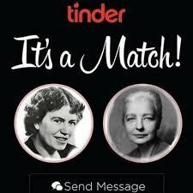

Slide 21
INTRODUCTION
Later, another anthropologist, Dr. Derek Freeman re-did all of her research and after spending years, not months in Samoa found that virtually every one of Mead’s conclusions was false.
She had overheard the bragging gossip of a couple of young native girls who later admitted that they hoaxed her, and that became the basis of her “conclusions.” That was the extent of her “research.”
But it was too little, too late.
The willing public ate it up, and her utterly fabricated tales of uninhibited natives frolicking through the night were eagerly accepted as scientific fact.
So a few more bits of false data were inserted into the cultural conscience: the reinforced “myth of the noble savage” (first proposed by the romantic philosopher Rousseau), the idea that rules and restrictions when it came to sex were bad, and that complete sexual freedom leads to peace and harmony in society.
Notes:
Now we can be glad that most probably do not cheat or lie or fake their conclusions. In fact, the scientific method has a safeguard built into it from the start. Reliable data can only be gleaned from experiments that can be replicated, repeated with the same results. Anyone should be able to conduct the same experiment under the same conditions and achieve the same outcome. If you perform an experiment a thousand times and get the same results a thousand times, then the data is probably correct, even well established. If you get multiple, conflicting outcomes, then the data is not confirmed and needs more work.

Slide 22
INTRODUCTION
And, again, we have to believe these things because they are “scientific.”
PhD researchers or MD psychiatrists like Mead and Freud solemnly swore that these things were true.
Never mind that Freud’s theories are debunked and dismissed today, people still believe his conclusion that sexual repression is bad and leads to mental illness.
Never mind that Mead’s conclusions were entirely falsified, that she was the completely willing victim of a hoax and possibly the worst researcher that the scholarly world has ever produced.
No, we still have to accept her conclusions that “adultery is no big deal,” that homosexuality is just a harmless phase, and that above all, everyone needs to be pairing up with some new lover each night under some waving palm tree with just a hint of salt on the warm ocean breeze.
We must! It’s “scientific!”
Notes:
Now we can be glad that most probably do not cheat or lie or fake their conclusions. In fact, the scientific method has a safeguard built into it from the start. Reliable data can only be gleaned from experiments that can be replicated, repeated with the same results. Anyone should be able to conduct the same experiment under the same conditions and achieve the same outcome. If you perform an experiment a thousand times and get the same results a thousand times, then the data is probably correct, even well established. If you get multiple, conflicting outcomes, then the data is not confirmed and needs more work.

Slide 23
INTRODUCTION
And then there was Alfred C. Kinsey.
Notes:
Now we can be glad that most probably do not cheat or lie or fake their conclusions. In fact, the scientific method has a safeguard built into it from the start. Reliable data can only be gleaned from experiments that can be replicated, repeated with the same results. Anyone should be able to conduct the same experiment under the same conditions and achieve the same outcome. If you perform an experiment a thousand times and get the same results a thousand times, then the data is probably correct, even well established. If you get multiple, conflicting outcomes, then the data is not confirmed and needs more work.

Slide 24
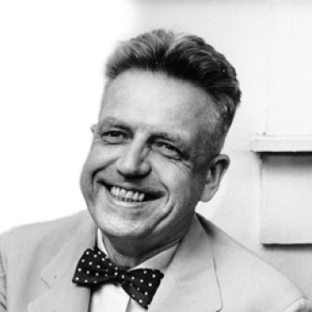
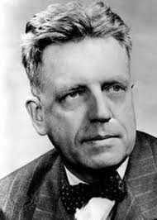
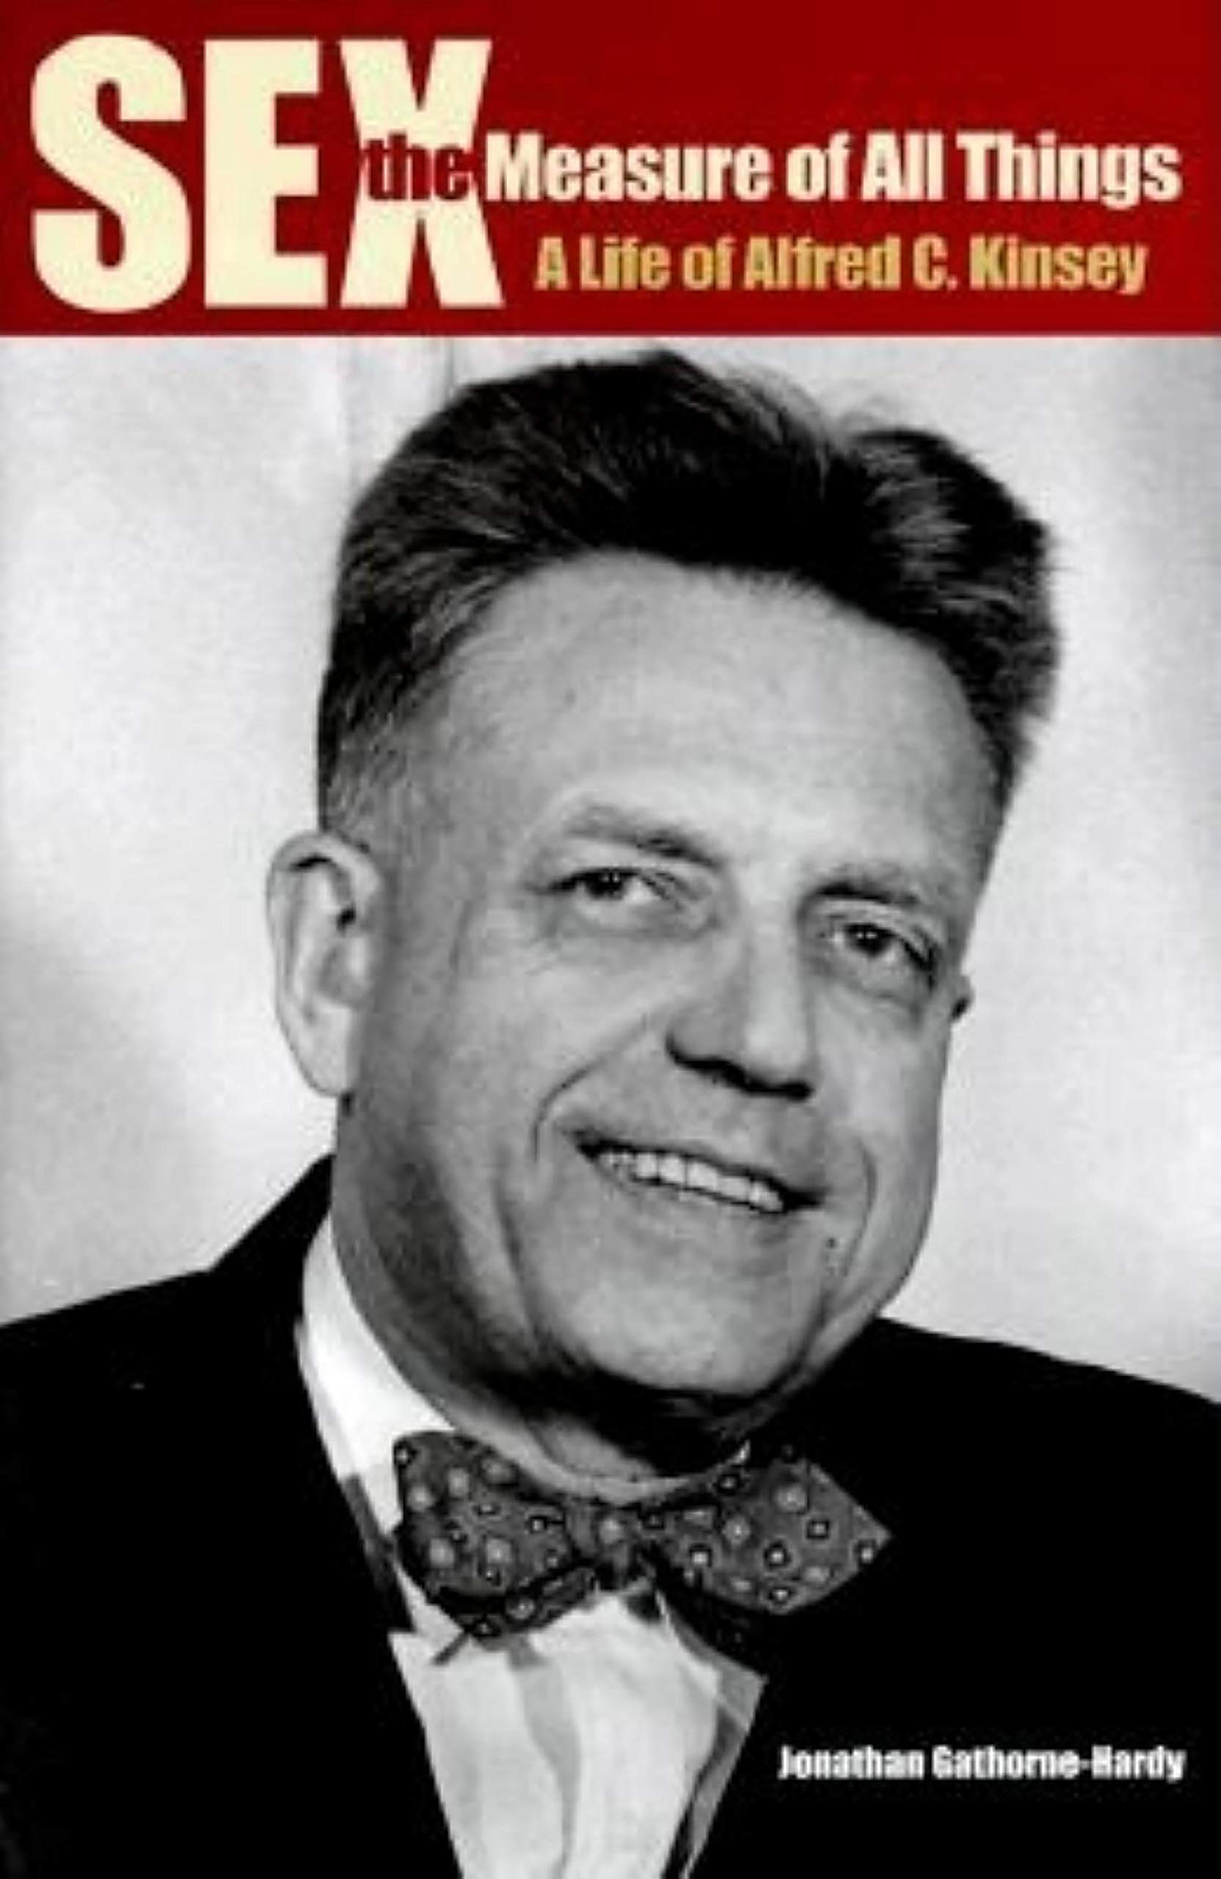

Slide 25
INTRODUCTION
In reading about his life, including the biography by the generally sympathetic James H. Jones, my overwhelming feeling was one of deep sadness and grief.
Certainly there was grief for his many victims, including his wife, Clara, who was either an almost robotically controlled pawn, or a demented monster herself.
And then there were his many graduate students at the Indiana University, attractive young men, many of them married, whom Kinsey seduced as their domineering PhD supervisor, men with whom he had frequent homosexual encounters, men whom he filmed in various sex acts in his notorious pornography studio in the attic of his home near campus, men who coaxed their wives into becoming actors and performers for Kinsey’s pornographic films, all in the name of “research,” of course.
Notes:
Now we can be glad that most probably do not cheat or lie or fake their conclusions. In fact, the scientific method has a safeguard built into it from the start. Reliable data can only be gleaned from experiments that can be replicated, repeated with the same results. Anyone should be able to conduct the same experiment under the same conditions and achieve the same outcome. If you perform an experiment a thousand times and get the same results a thousand times, then the data is probably correct, even well established. If you get multiple, conflicting outcomes, then the data is not confirmed and needs more work.

Slide 26
INTRODUCTION
In Kinsey’s sex institute on the campus itself, he had constructed a large room, heavily sound proofed to muffle the screams of people tortured during his sado-masochistic experiments.
Then there were the young, female students at Indiana University whom Kinsey humiliated who were practically forced to become some of the subjects of Kinsey’s tens of thousands of interviews, who were pressed into talking about their sex lives including the description, and perhaps examination, of their genitals, you know, “research.”
And then there were the many hundreds of children who were molested by Kinsey and his research team or under his direction.
Notes:
Now we can be glad that most probably do not cheat or lie or fake their conclusions. In fact, the scientific method has a safeguard built into it from the start. Reliable data can only be gleaned from experiments that can be replicated, repeated with the same results. Anyone should be able to conduct the same experiment under the same conditions and achieve the same outcome. If you perform an experiment a thousand times and get the same results a thousand times, then the data is probably correct, even well established. If you get multiple, conflicting outcomes, then the data is not confirmed and needs more work.

Slide 27
INTRODUCTION
But it doesn’t stop there.
Because, with the publication of Kinsey’s two books on sex in males (1948) and later sex in females (1953), his duplicitous conclusions were rapidly disseminated.
In truth, you and I are among Kinsey’s victims. Our views on sexual purity have been influenced and not in a good way.
You and I must fight the constantly prevailing winds of sexual impurity and debauchery, and many of our friends and family members have been devastated by sexual sins.
Billy Graham accused Alfred Kinsey of doing more to undermine morality than any other American. Okay, Freud was Austrian, Barth was Swiss, and Mead’s influence was probably more subtle, so Dr. Graham was probably right.
Notes:
Now we can be glad that most probably do not cheat or lie or fake their conclusions. In fact, the scientific method has a safeguard built into it from the start. Reliable data can only be gleaned from experiments that can be replicated, repeated with the same results. Anyone should be able to conduct the same experiment under the same conditions and achieve the same outcome. If you perform an experiment a thousand times and get the same results a thousand times, then the data is probably correct, even well established. If you get multiple, conflicting outcomes, then the data is not confirmed and needs more work.

Slide 28
INTRODUCTION
But I’m getting ahead of myself. So let me attempt to do four things in our remaining time.
First, I will give a brief sketch of Kinsey’s life, because it is very relevant to his later actions.
Next, we will examine the supposed scientific method of his so-called “research,” much of which involved criminal activity.
Then we will investigate some of the fallout from his “reports.”
And finally, I want to propose some conclusions of my own.
Notes:
Now we can be glad that most probably do not cheat or lie or fake their conclusions. In fact, the scientific method has a safeguard built into it from the start. Reliable data can only be gleaned from experiments that can be replicated, repeated with the same results. Anyone should be able to conduct the same experiment under the same conditions and achieve the same outcome. If you perform an experiment a thousand times and get the same results a thousand times, then the data is probably correct, even well established. If you get multiple, conflicting outcomes, then the data is not confirmed and needs more work.

Slide 29
I. KINSEY’S BACKGROUND AND LIFE
Alfred C. Kinsey (1894-1956) was the son of Alfred S. Kinsey, and that tells us something.
The senior Kinsey was a frustrated man.
He had managed to climb into the middle class through self-education. He became a lab instructor at a small engineering college in New Jersey, but lacking the academic degree, he could rise no further.
He was considered quite moralistic. His family were staunch members of the Methodist Church, though at one point his biographer speaks of his “Calvinistic” beliefs.
His two concerns for his older son and namesake was that Alfred C. Kinsey grow up to be a moral young man, and that he become an engineer with a degree, something that had eluded the senior Kinsey.
In other words, he wanted his son to follow in his footsteps and fulfill his unrealized dream.
Notes:
Now we can be glad that most probably do not cheat or lie or fake their conclusions. In fact, the scientific method has a safeguard built into it from the start. Reliable data can only be gleaned from experiments that can be replicated, repeated with the same results. Anyone should be able to conduct the same experiment under the same conditions and achieve the same outcome. If you perform an experiment a thousand times and get the same results a thousand times, then the data is probably correct, even well established. If you get multiple, conflicting outcomes, then the data is not confirmed and needs more work.

Slide 30
I. KINSEY’S BACKGROUND AND LIFE
The son dutifully sought to comply. But he was plagued with a childhood illness that prevented him from competing with other boys.
His biographer hints that this inadequacy produced two results. First, young Kinsey became an over-achiever.
And second, feeling inadequate around the more aggressive, sports-oriented boys, he became a homosexual.
Eventually the childhood illness cleared up, and Kinsey grew tall and handsome.
Notes:
Now we can be glad that most probably do not cheat or lie or fake their conclusions. In fact, the scientific method has a safeguard built into it from the start. Reliable data can only be gleaned from experiments that can be replicated, repeated with the same results. Anyone should be able to conduct the same experiment under the same conditions and achieve the same outcome. If you perform an experiment a thousand times and get the same results a thousand times, then the data is probably correct, even well established. If you get multiple, conflicting outcomes, then the data is not confirmed and needs more work.

Slide 31
I. KINSEY’S BACKGROUND AND LIFE
Kinsey’s father became a leader of and pressed his son into two moralistic organizations.
Kinsey Jr. joined the Boy Scouts and eventually became one of the few “eagle scouts” in the nation.
He also plunged into work with the YMCA, the Young Men’s Christian Association.
Both the Scouts and the YMCA stressed outdoor camping as character building, and it was probably on these many outings that young Kinsey advanced in his same sex attraction.
Kinsey also became a Sunday School teacher at church and gave moralistic speeches for the YMCA.
Notes:
Now we can be glad that most probably do not cheat or lie or fake their conclusions. In fact, the scientific method has a safeguard built into it from the start. Reliable data can only be gleaned from experiments that can be replicated, repeated with the same results. Anyone should be able to conduct the same experiment under the same conditions and achieve the same outcome. If you perform an experiment a thousand times and get the same results a thousand times, then the data is probably correct, even well established. If you get multiple, conflicting outcomes, then the data is not confirmed and needs more work.

Slide 32
I. KINSEY’S BACKGROUND AND LIFE
But we can add two more “M’s” to young Kinsey’s contradictory moralism and male-attraction:
masturbation and masochism.
Early in life Kinsey became what we would describe today as a “sex addict.”
And yet the shame and contradiction of his moralism and his self-pleasuring lead him to punish himself with self-inflicted pain at the same time.
Notes:
Now we can be glad that most probably do not cheat or lie or fake their conclusions. In fact, the scientific method has a safeguard built into it from the start. Reliable data can only be gleaned from experiments that can be replicated, repeated with the same results. Anyone should be able to conduct the same experiment under the same conditions and achieve the same outcome. If you perform an experiment a thousand times and get the same results a thousand times, then the data is probably correct, even well established. If you get multiple, conflicting outcomes, then the data is not confirmed and needs more work.

Slide 33
I. KINSEY’S BACKGROUND AND LIFE
Now this is pretty icky, so you can cover your ears for about fifteen seconds if you would like.
There is a fascinating account told by Kinsey’s younger brother, Gary, who many years later met the subsequent owner of their childhood home in Hoboken, New Jersey.
The younger brother told the owner about Alfred’s secret hiding place in the attic of their home.
The new owner found the place and discovered a thin brush handle that Kinsey had inserted into his male organ to cause pain while he did his thing.
Kinsey’s sympathetic biographer, Jones, concludes: “By late adolescence, if not before, Kinsey’s behavior was clearly pathological, satisfying every criterion of sexual perversion.” (Reisman, Sabotage, 37)
Notes:
Now we can be glad that most probably do not cheat or lie or fake their conclusions. In fact, the scientific method has a safeguard built into it from the start. Reliable data can only be gleaned from experiments that can be replicated, repeated with the same results. Anyone should be able to conduct the same experiment under the same conditions and achieve the same outcome. If you perform an experiment a thousand times and get the same results a thousand times, then the data is probably correct, even well established. If you get multiple, conflicting outcomes, then the data is not confirmed and needs more work.

Slide 35
I. KINSEY’S BACKGROUND AND LIFE
Kinsey’s other great passion in life was the outdoors and studying biology through observing creatures in the wild and collecting many specimens.
And he was a very bright student, graduating high school at the top of his class, supposedly a model student, a prime example of a highly religious, highly moral young man. He didn’t even date girls.
To please his father, he enrolled in the engineering college where his father had been a lab instructor for many years. But there he ran into a problem.
This Eagle Scout, valedictorian of his class barely made a passing grade. He hated engineering. He wanted to study biology.
Notes:
Now we can be glad that most probably do not cheat or lie or fake their conclusions. In fact, the scientific method has a safeguard built into it from the start. Reliable data can only be gleaned from experiments that can be replicated, repeated with the same results. Anyone should be able to conduct the same experiment under the same conditions and achieve the same outcome. If you perform an experiment a thousand times and get the same results a thousand times, then the data is probably correct, even well established. If you get multiple, conflicting outcomes, then the data is not confirmed and needs more work.

Slide 36
I. KINSEY’S BACKGROUND AND LIFE
After two years, he enraged is father by rebelling against his wishes. He dropped out of the engineering school in New Jersey and became a student at Bowdoin College in the state of Maine, a top school in biology.
His father disowned him, financially and otherwise.
Kinsey Jr. begged student aid at the college, won a small scholarship, and worked his way through his last years of his undergraduate studies.
He graduated at the top of his program there as well, and was accepted into the prestigious Bussey Institute at Harvard University in Boston.
Notes:
Now we can be glad that most probably do not cheat or lie or fake their conclusions. In fact, the scientific method has a safeguard built into it from the start. Reliable data can only be gleaned from experiments that can be replicated, repeated with the same results. Anyone should be able to conduct the same experiment under the same conditions and achieve the same outcome. If you perform an experiment a thousand times and get the same results a thousand times, then the data is probably correct, even well established. If you get multiple, conflicting outcomes, then the data is not confirmed and needs more work.

Slide 37
I. KINSEY’S BACKGROUND AND LIFE
While at Harvard, Kinsey joined a liberal Congregational church.
His biographer, Jones, describes the religion as “secular evangelicalism” which aimed at “social reform.” Kinsey was being trained to reform society.
In college and graduate school Kinsey was a loner and misfit, unsociable, and this served him well as he continued to be an overachiever and workaholic.
He had to prove himself.
Notes:
Now we can be glad that most probably do not cheat or lie or fake their conclusions. In fact, the scientific method has a safeguard built into it from the start. Reliable data can only be gleaned from experiments that can be replicated, repeated with the same results. Anyone should be able to conduct the same experiment under the same conditions and achieve the same outcome. If you perform an experiment a thousand times and get the same results a thousand times, then the data is probably correct, even well established. If you get multiple, conflicting outcomes, then the data is not confirmed and needs more work.

Slide 38
I. KINSEY’S BACKGROUND AND LIFE
The academic dean of the Bussey School was a man named W. M. Wheeler, a world renowned author and scholar, and an atheist.
Notes:
Now we can be glad that most probably do not cheat or lie or fake their conclusions. In fact, the scientific method has a safeguard built into it from the start. Reliable data can only be gleaned from experiments that can be replicated, repeated with the same results. Anyone should be able to conduct the same experiment under the same conditions and achieve the same outcome. If you perform an experiment a thousand times and get the same results a thousand times, then the data is probably correct, even well established. If you get multiple, conflicting outcomes, then the data is not confirmed and needs more work.

Slide 39
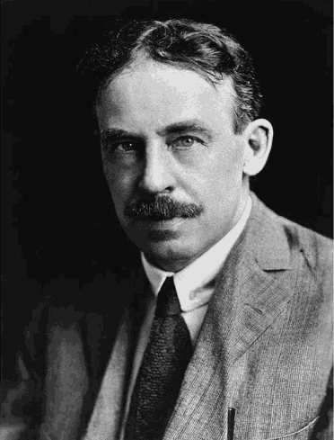

Slide 40
I. KINSEY’S BACKGROUND AND LIFE
Kinsey’s biographer, Jones, suggests that Wheeler became a substitute father to Kinsey.
His time at Harvard completed his break from his real father, and he became an atheist himself, rejecting the traditional (he would say “repressed”) morality of his father.
Upon receiving his doctorate, Kinsey accepted a job as biology professor at the small, Midwestern Indiana University in Bloomington.
And he was a man on a mission.
It was to destroy the prevailing morality of the day and replace it with complete sexual freedom. Kinsey now had a degree and a platform, both to act out his personal sexual fantasies, but also to overturn the prevailing morality of his day which had condemned him.
Notes:
Now we can be glad that most probably do not cheat or lie or fake their conclusions. In fact, the scientific method has a safeguard built into it from the start. Reliable data can only be gleaned from experiments that can be replicated, repeated with the same results. Anyone should be able to conduct the same experiment under the same conditions and achieve the same outcome. If you perform an experiment a thousand times and get the same results a thousand times, then the data is probably correct, even well established. If you get multiple, conflicting outcomes, then the data is not confirmed and needs more work.

Slide 41
I. KINSEY’S BACKGROUND AND LIFE
Kinsey quickly married the first girl he dated, Clara MacMillen.
Notes:
Now we can be glad that most probably do not cheat or lie or fake their conclusions. In fact, the scientific method has a safeguard built into it from the start. Reliable data can only be gleaned from experiments that can be replicated, repeated with the same results. Anyone should be able to conduct the same experiment under the same conditions and achieve the same outcome. If you perform an experiment a thousand times and get the same results a thousand times, then the data is probably correct, even well established. If you get multiple, conflicting outcomes, then the data is not confirmed and needs more work.

Slide 42
I. KINSEY’S BACKGROUND AND LIFE
Her parents were indifferent toward religion.
She described them as “inactive Protestants.”
Clara described herself as a “free thinker,” and she worried that Kinsey might be “too churchy.”
After the wedding, Kinsey took his new wife on a honeymoon: a days-long, grueling mountain hike in the snow, forcing her to march into exhaustion.
The marriage was not consummated for months.
Eventually Clara was sent to the doctor and with some adjustments, the marriage was completed.
But if Kinsey hoped that marriage would cure his homosexual desires, he was mistaken.
Notes:
Now we can be glad that most probably do not cheat or lie or fake their conclusions. In fact, the scientific method has a safeguard built into it from the start. Reliable data can only be gleaned from experiments that can be replicated, repeated with the same results. Anyone should be able to conduct the same experiment under the same conditions and achieve the same outcome. If you perform an experiment a thousand times and get the same results a thousand times, then the data is probably correct, even well established. If you get multiple, conflicting outcomes, then the data is not confirmed and needs more work.

Slide 43
I. KINSEY’S BACKGROUND AND LIFE
Kinsey’s biographer, Jones, points out that as Kinsey lost his religious beliefs they were replaced with a new religion: science. Kinsey became convinced that science was “the best hope of mankind.”
Kinsey was an active proponent of “eugenics,” breeding unwanted traits out of the human race by sterilizing “undesirables,” a program that was forced upon thousands of people, mostly young women, in the early decades of the 1900s.
In this he was in complete sympathy with Margaret Sanger, the founder of Planned Parenthood, the patron saint of abortion on demand, another eugenicist.
Notes:
Now we can be glad that most probably do not cheat or lie or fake their conclusions. In fact, the scientific method has a safeguard built into it from the start. Reliable data can only be gleaned from experiments that can be replicated, repeated with the same results. Anyone should be able to conduct the same experiment under the same conditions and achieve the same outcome. If you perform an experiment a thousand times and get the same results a thousand times, then the data is probably correct, even well established. If you get multiple, conflicting outcomes, then the data is not confirmed and needs more work.

Slide 44
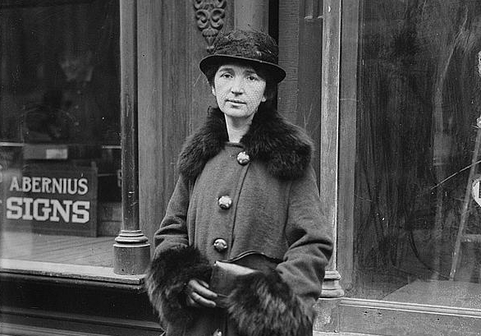

Slide 45
I. KINSEY’S BACKGROUND AND LIFE
Kinsey utterly rejected religion.
He sought to raise his children toward secularism. He also wanted them to be quite free in their thoughts about sexuality.
For example, Kinsey regularly shaved in the nude while his young daughter watched him.
I think this is actually a felony according to Iowa law, “indecent exposure” and “contributing to the delinquency of a minor.”
On their camping trips, the whole family would often disrobe and bathe together in streams in the nude.
Notes:
Now we can be glad that most probably do not cheat or lie or fake their conclusions. In fact, the scientific method has a safeguard built into it from the start. Reliable data can only be gleaned from experiments that can be replicated, repeated with the same results. Anyone should be able to conduct the same experiment under the same conditions and achieve the same outcome. If you perform an experiment a thousand times and get the same results a thousand times, then the data is probably correct, even well established. If you get multiple, conflicting outcomes, then the data is not confirmed and needs more work.

Slide 46
I. KINSEY’S BACKGROUND AND LIFE
Kinsey carefully selected and groomed candidates as his graduate students, all young, attractive, white, Anglo-Saxon men who accompanied him on his nationwide field trips.
Notes:
Now we can be glad that most probably do not cheat or lie or fake their conclusions. In fact, the scientific method has a safeguard built into it from the start. Reliable data can only be gleaned from experiments that can be replicated, repeated with the same results. Anyone should be able to conduct the same experiment under the same conditions and achieve the same outcome. If you perform an experiment a thousand times and get the same results a thousand times, then the data is probably correct, even well established. If you get multiple, conflicting outcomes, then the data is not confirmed and needs more work.

Slide 47
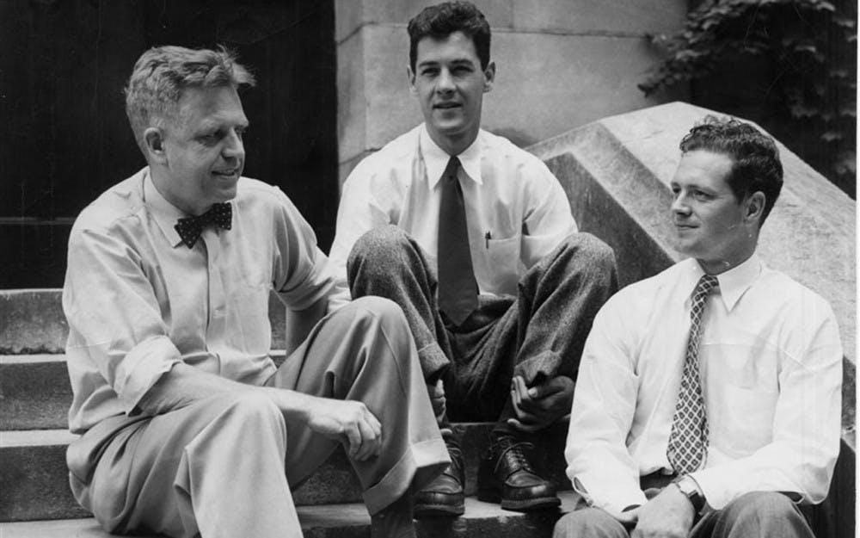

Slide 48
I. KINSEY’S BACKGROUND AND LIFE
He had the odd habit of walking around the camp naked.
He required his men to bathe or shower everyday while he watched.
Kinsey would direct the talk around the campfire at night to graphic discussions of sex techniques, often ending in group, well, you know.
He was clearly seducing these young men, some willingly, some under coercion as their domineering supervisor.
At a single word from Kinsey, they could be fired from their position, no degree, and no questions asked.
As rewards to the compliant, he would offer the sexual services of his wife, Clara.
Notes:
Now we can be glad that most probably do not cheat or lie or fake their conclusions. In fact, the scientific method has a safeguard built into it from the start. Reliable data can only be gleaned from experiments that can be replicated, repeated with the same results. Anyone should be able to conduct the same experiment under the same conditions and achieve the same outcome. If you perform an experiment a thousand times and get the same results a thousand times, then the data is probably correct, even well established. If you get multiple, conflicting outcomes, then the data is not confirmed and needs more work.

Slide 49
I. KINSEY’S BACKGROUND AND LIFE
After they had graduated, Kinsey kept up with several of his “stable” of young men and frequently begged them to come visit and to stay in his home. Some complied.
One student named Osmond Breland came for a visit with his wife.
What happened is unknown, but over fifty years later, his wife, Nellie Breland finally said of Kinsey,
“He was a dirty old man. He really hurt us. We were just kids from Mississippi. We didn’t know anything.”
After one visit, they never returned.
Notes:
Now we can be glad that most probably do not cheat or lie or fake their conclusions. In fact, the scientific method has a safeguard built into it from the start. Reliable data can only be gleaned from experiments that can be replicated, repeated with the same results. Anyone should be able to conduct the same experiment under the same conditions and achieve the same outcome. If you perform an experiment a thousand times and get the same results a thousand times, then the data is probably correct, even well established. If you get multiple, conflicting outcomes, then the data is not confirmed and needs more work.

Slide 50
I. KINSEY’S BACKGROUND AND LIFE
In recent years, many Hollywood movie producers have come under fire for the so-called “casting couch.”
Attractive, aspiring young actresses would be delivered to these reprehensible predators and promised roles or even careers if they would act out sexually for them and with them.
Then they were cast, not in movies, but cast aside.
Harvey Weinstein has been arrested for such behavior.
Notes:
Now we can be glad that most probably do not cheat or lie or fake their conclusions. In fact, the scientific method has a safeguard built into it from the start. Reliable data can only be gleaned from experiments that can be replicated, repeated with the same results. Anyone should be able to conduct the same experiment under the same conditions and achieve the same outcome. If you perform an experiment a thousand times and get the same results a thousand times, then the data is probably correct, even well established. If you get multiple, conflicting outcomes, then the data is not confirmed and needs more work.

Slide 51
I. KINSEY’S BACKGROUND AND LIFE
But Alfred Kinsey had his “casting tent or sleeping bag” and seduced many young men with the promise of academic degrees.
And yet he is one of the architects of the current sexual revolution.
(He also was a pornographic film producer of sorts, so the analogy to Weinstein is even closer.)
Notes:
Now we can be glad that most probably do not cheat or lie or fake their conclusions. In fact, the scientific method has a safeguard built into it from the start. Reliable data can only be gleaned from experiments that can be replicated, repeated with the same results. Anyone should be able to conduct the same experiment under the same conditions and achieve the same outcome. If you perform an experiment a thousand times and get the same results a thousand times, then the data is probably correct, even well established. If you get multiple, conflicting outcomes, then the data is not confirmed and needs more work.

Slide 52
I. KINSEY’S BACKGROUND AND LIFE
After a changing of the guard in the old administration at Indiana University, including a new, young, bachelor president (a suspected homosexual) and the retirement of several of the older faculty, Kinsey became the rising star. And he saw his opportunity.
He volunteered to teach the class on marriage (actually on sex education) to the undergrad students. Kinsey’s main work had been in entomology, the study of insects. But he felt himself completely qualified to teach on human sexuality.
The administration agreed, and, in fact, gave Kinsey free reign over just about everything.
It was in this context that Kinsey began his so-called sex research. It started with hundreds, eventually many thousands of detailed sexual interviews or “sex histories.” He was ostensibly surveying the general public about their views toward sex and their sexual practices.
Notes:
Now we can be glad that most probably do not cheat or lie or fake their conclusions. In fact, the scientific method has a safeguard built into it from the start. Reliable data can only be gleaned from experiments that can be replicated, repeated with the same results. Anyone should be able to conduct the same experiment under the same conditions and achieve the same outcome. If you perform an experiment a thousand times and get the same results a thousand times, then the data is probably correct, even well established. If you get multiple, conflicting outcomes, then the data is not confirmed and needs more work.

Slide 53
I. KINSEY’S BACKGROUND AND LIFE
"Voyeurism” is a condition in which one finds sexual gratification in secretly watching people in or listening to people describe intimate situations. Kinsey was clearly a voyeur.
Eventually, Kinsey received lucrative research grants from the National Research Council and the Rockefeller Foundation, and the Kinsey Sex Institute was born on the campus of Indiana University.
From there, Kinsey and his team of young, attractive, white Anglo-Saxon men began to take the sex histories of anyone who was willing, conduct experiments in sexual practices, and to produce mountains of pornographic pictures and films, most in which they themselves were the movie stars.
Notes:
Now we can be glad that most probably do not cheat or lie or fake their conclusions. In fact, the scientific method has a safeguard built into it from the start. Reliable data can only be gleaned from experiments that can be replicated, repeated with the same results. Anyone should be able to conduct the same experiment under the same conditions and achieve the same outcome. If you perform an experiment a thousand times and get the same results a thousand times, then the data is probably correct, even well established. If you get multiple, conflicting outcomes, then the data is not confirmed and needs more work.

Slide 54
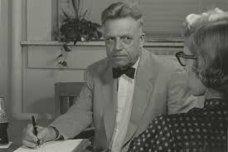
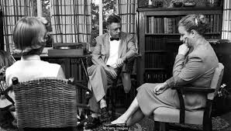

Slide 55
I. KINSEY’S BACKGROUND AND LIFE
Kinsey’s wife was fully aware of all of this, and she would periodically appear in the attic offering dry towels and fresh baked cookies for the frolicking “researchers.”
According to many reports, his wife was also one of Kinsey’s team of porn stars.
Kinsey sent some of his performers to Clara’s bed: he himself had discontinued relations with her after their last child’s birth.
Notes:
Now we can be glad that most probably do not cheat or lie or fake their conclusions. In fact, the scientific method has a safeguard built into it from the start. Reliable data can only be gleaned from experiments that can be replicated, repeated with the same results. Anyone should be able to conduct the same experiment under the same conditions and achieve the same outcome. If you perform an experiment a thousand times and get the same results a thousand times, then the data is probably correct, even well established. If you get multiple, conflicting outcomes, then the data is not confirmed and needs more work.

Slide 56
I. KINSEY’S BACKGROUND AND LIFE
After conducting thousands of sex histories Kinsey came out with is first book shortly after the close of World War II.
Sexual Behavior in the Human Male appeared in 1948 and was swept off the shelves by eager readers.
It was widely discussed.
Five years later, the companion volume Sexual Behavior in the Human Female arrived in 1953.
Nothing like this had ever been attempted before, and curious readers were enthralled.
Notes:
Now we can be glad that most probably do not cheat or lie or fake their conclusions. In fact, the scientific method has a safeguard built into it from the start. Reliable data can only be gleaned from experiments that can be replicated, repeated with the same results. Anyone should be able to conduct the same experiment under the same conditions and achieve the same outcome. If you perform an experiment a thousand times and get the same results a thousand times, then the data is probably correct, even well established. If you get multiple, conflicting outcomes, then the data is not confirmed and needs more work.

Slide 57
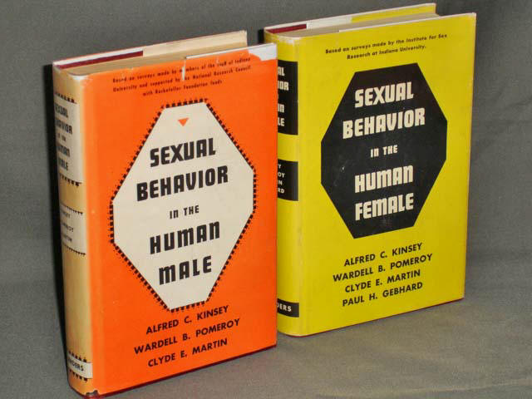

Slide 58
I. KINSEY’S BACKGROUND AND LIFE
Here are some of Kinsey’s claims:
Male
67-98% had premarital sex
68% had premarital sex by the age of eighteen
69% of white males had at least one experience with a prostitute
50% of husbands were adulterers
10-37% sometimes commit homosexual acts
14% performed and 30% received homosexual oral sex with climax at least once
46% engaged in heterosexual and/or homosexual activities or “reacted to” both sexes in the course of their adult lives (bisexual)
95% are sex offenders (admit to committing sex crimes)
Notes:
Now we can be glad that most probably do not cheat or lie or fake their conclusions. In fact, the scientific method has a safeguard built into it from the start. Reliable data can only be gleaned from experiments that can be replicated, repeated with the same results. Anyone should be able to conduct the same experiment under the same conditions and achieve the same outcome. If you perform an experiment a thousand times and get the same results a thousand times, then the data is probably correct, even well established. If you get multiple, conflicting outcomes, then the data is not confirmed and needs more work.

Slide 59
I. KINSEY’S BACKGROUND AND LIFE
Female
50% had premarital sex; of these 66-77% had no regrets
26% committed adultery by age 40
25% commit adultery, and another 17% “wanted or would consider” committing adultery (over 40% in total)
28% had homosexual experience for over three years.
1,753 females had premarital sex but “only 44 females” ever had a venereal disease
Of 4,441 women interviewed, none were ever harmed by rape
So the proffered conclusion was basically that “everybody’s doing it and nobody’s getting hurt by it”: little or no venereal disease, nobody is being hurt by rape, and lots of people dabbling with homosexuality with no ill effect.
So what’s the problem?
Notes:
Now we can be glad that most probably do not cheat or lie or fake their conclusions. In fact, the scientific method has a safeguard built into it from the start. Reliable data can only be gleaned from experiments that can be replicated, repeated with the same results. Anyone should be able to conduct the same experiment under the same conditions and achieve the same outcome. If you perform an experiment a thousand times and get the same results a thousand times, then the data is probably correct, even well established. If you get multiple, conflicting outcomes, then the data is not confirmed and needs more work.

Slide 60
Hospers PCA Summer Seminars 2020
“The Roots of the (Moral) Revolution”
June 9: “Sigmund Freud’s Complicated Oedipus Complex” (Psychology)
June 23: “Margaret Mead’s Fantasy Island” (Anthropology)
July 21: “Alfred Kinsey’s Wild Ride (or Bogus Adventure?)” (Biology)
August 11: “Karl Barth’s Neo-Unorthodox Arrangement” (Theology)
(All Seminars on Tuesdays at 7:00 p.m.)
Notes:
Now we can be glad that most probably do not cheat or lie or fake their conclusions. In fact, the scientific method has a safeguard built into it from the start. Reliable data can only be gleaned from experiments that can be replicated, repeated with the same results. Anyone should be able to conduct the same experiment under the same conditions and achieve the same outcome. If you perform an experiment a thousand times and get the same results a thousand times, then the data is probably correct, even well established. If you get multiple, conflicting outcomes, then the data is not confirmed and needs more work.

Slide 61
II. KINSEY’S “RESEARCH” METHODS
The main critique of Kinsey, and this is across the board from Christians and secularists alike, is the skewing of Kinsey’s sampling.
It was widely known that Kinsey’s vast number of interviews that led to his statistical findings were from four groups that were not exactly in the mainstream.
1. One group of those surveyed included volunteers.
Now that might seem normal until you remember that these people were being interviewed about the intimate details of their sex lives, and this was in the 1940s.
Most people did not willingly do so.
By soliciting volunteers instead of a random sampling, the data was clearly skewed in the direction of those who were on the edge sexually and liked to talk about their sexual exploits.
Notes:
Now we can be glad that most probably do not cheat or lie or fake their conclusions. In fact, the scientific method has a safeguard built into it from the start. Reliable data can only be gleaned from experiments that can be replicated, repeated with the same results. Anyone should be able to conduct the same experiment under the same conditions and achieve the same outcome. If you perform an experiment a thousand times and get the same results a thousand times, then the data is probably correct, even well established. If you get multiple, conflicting outcomes, then the data is not confirmed and needs more work.

Slide 62
II. KINSEY’S “RESEARCH” METHODS
2. A second disproportionate group of those sampled were those who were serving long-term prison sentences.
Kinsey’s researchers found a “captive audience” there, and again, people who were clearly not in the mainstream.
Many of these were sex offenders.
Others, faced with never seeing a woman again, turned to homosexual encounters, as is common in prison settings.
Notes:
Now we can be glad that most probably do not cheat or lie or fake their conclusions. In fact, the scientific method has a safeguard built into it from the start. Reliable data can only be gleaned from experiments that can be replicated, repeated with the same results. Anyone should be able to conduct the same experiment under the same conditions and achieve the same outcome. If you perform an experiment a thousand times and get the same results a thousand times, then the data is probably correct, even well established. If you get multiple, conflicting outcomes, then the data is not confirmed and needs more work.

Slide 63
II. KINSEY’S “RESEARCH” METHODS
3. A third group was among deviants, especially homosexuals and prostitutes, both of which practices were illegal in the day.
Kinsey advertised for volunteers in homosexual magazines.
He spent most of his weekends driving to Chicago to meet with and interview both homosexuals and prostitutes, many of whom were eager to talk at length about their secret world, which the homosexual Kinsey was eager to explore for himself.
Notes:
Now we can be glad that most probably do not cheat or lie or fake their conclusions. In fact, the scientific method has a safeguard built into it from the start. Reliable data can only be gleaned from experiments that can be replicated, repeated with the same results. Anyone should be able to conduct the same experiment under the same conditions and achieve the same outcome. If you perform an experiment a thousand times and get the same results a thousand times, then the data is probably correct, even well established. If you get multiple, conflicting outcomes, then the data is not confirmed and needs more work.

Slide 64
II. KINSEY’S “RESEARCH” METHODS
4. And the fourth group is represented by those he did NOT interview, namely the millions of young men who, as part of “the greatest generation,” were off engaging in combat during World War II.
Notes:
Now we can be glad that most probably do not cheat or lie or fake their conclusions. In fact, the scientific method has a safeguard built into it from the start. Reliable data can only be gleaned from experiments that can be replicated, repeated with the same results. Anyone should be able to conduct the same experiment under the same conditions and achieve the same outcome. If you perform an experiment a thousand times and get the same results a thousand times, then the data is probably correct, even well established. If you get multiple, conflicting outcomes, then the data is not confirmed and needs more work.

Slide 66
II. KINSEY’S “RESEARCH” METHODS
Kinsey was able to secure military deferrals for his many, young, attractive, male, Anglo-Saxon, white researchers by having his superiors in the university declare his sex research was “vital to the national interest.”
So while millions of healthy, normal, courageous young men were off in combat, Kinsey was interviewing what remained behind, many of whom were draft dodgers like Kinsey’s “researchers.”
Notes:
Now we can be glad that most probably do not cheat or lie or fake their conclusions. In fact, the scientific method has a safeguard built into it from the start. Reliable data can only be gleaned from experiments that can be replicated, repeated with the same results. Anyone should be able to conduct the same experiment under the same conditions and achieve the same outcome. If you perform an experiment a thousand times and get the same results a thousand times, then the data is probably correct, even well established. If you get multiple, conflicting outcomes, then the data is not confirmed and needs more work.

Slide 67
II. KINSEY’S “RESEARCH” METHODS
Another problem with his research methods was that he kept his raw data under lock and key.
Nobody except his loyal researchers was ever permitted to see the original notes of the interviews.
Margaret Mead had described a peaceful, crime-free island paradise which owed its bliss and harmony to absolute, anything goes, sexual freedom.
But she produced no supporting data to prove her conclusions. In her case, though, the data was in the open for anyone to follow up on, which Derek Freeman did, and then found that none of her conclusions fit the facts, none.
Notes:
Now we can be glad that most probably do not cheat or lie or fake their conclusions. In fact, the scientific method has a safeguard built into it from the start. Reliable data can only be gleaned from experiments that can be replicated, repeated with the same results. Anyone should be able to conduct the same experiment under the same conditions and achieve the same outcome. If you perform an experiment a thousand times and get the same results a thousand times, then the data is probably correct, even well established. If you get multiple, conflicting outcomes, then the data is not confirmed and needs more work.

Slide 68
II. KINSEY’S “RESEARCH” METHODS
But nobody could check Kinsey’s data because he kept it all hidden. Only a few loyal outsiders have ever been permitted to examine his sex histories.
As one writer put it, “It would be like the inventor of the microscope, Antony Van Leeuwenhoek, refusing to let anyone else look, but demanding they merely take his word on what he reportedly saw through the lens.” Why not let others look?
Secrecy usually implies hiding something that you don’t want others to see.
Some things are coming to light by the reports of some of the principle witness and even participants.
Perhaps what they were hiding was Kinsey’s own sexual deviancy, his voyeurism and exhibitionism, his homosexual seducing of his students, and his pornography studio in his infamous attic.
Notes:
Now we can be glad that most probably do not cheat or lie or fake their conclusions. In fact, the scientific method has a safeguard built into it from the start. Reliable data can only be gleaned from experiments that can be replicated, repeated with the same results. Anyone should be able to conduct the same experiment under the same conditions and achieve the same outcome. If you perform an experiment a thousand times and get the same results a thousand times, then the data is probably correct, even well established. If you get multiple, conflicting outcomes, then the data is not confirmed and needs more work.

Slide 69
II. KINSEY’S “RESEARCH” METHODS
Another problem with Kinsey is that he seems to confuse what people do with what people should do.
If a majority of men commit adultery, then adultery must be good and should be permitted.
If about half of all women enjoy premarital sex, most without guilt, then it must be right.
For Kinsey, “Is” means “ought.”
Notes:
Now we can be glad that most probably do not cheat or lie or fake their conclusions. In fact, the scientific method has a safeguard built into it from the start. Reliable data can only be gleaned from experiments that can be replicated, repeated with the same results. Anyone should be able to conduct the same experiment under the same conditions and achieve the same outcome. If you perform an experiment a thousand times and get the same results a thousand times, then the data is probably correct, even well established. If you get multiple, conflicting outcomes, then the data is not confirmed and needs more work.

Slide 70
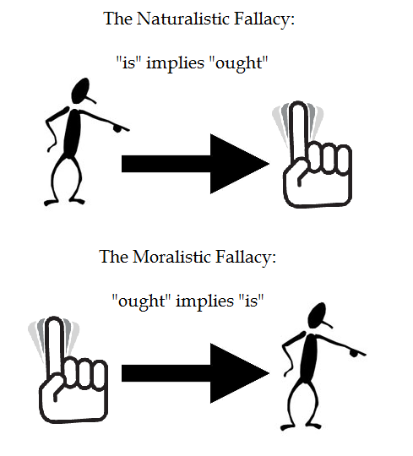

Slide 71
II. KINSEY’S “RESEARCH” METHODS
But as a sex addict himself, Kinsey would be highly interested in pushing the data to represent widespread sexual practices of every kind as common and normal so that “is” = “ought.”
Notes:
Now we can be glad that most probably do not cheat or lie or fake their conclusions. In fact, the scientific method has a safeguard built into it from the start. Reliable data can only be gleaned from experiments that can be replicated, repeated with the same results. Anyone should be able to conduct the same experiment under the same conditions and achieve the same outcome. If you perform an experiment a thousand times and get the same results a thousand times, then the data is probably correct, even well established. If you get multiple, conflicting outcomes, then the data is not confirmed and needs more work.

Slide 72
II. KINSEY’S “RESEARCH” METHODS
The greatest problem with Kinsey’s report, though seems to have eluded people for decades.
Kinsey’s reports on male and female sexuality also give data on the sexual practices of children, especially their response times to sexual stimulation by adults.
So Kinsey’s researchers were sexually stimulating children as young as two months old and observing their responses.
Notes:
Now we can be glad that most probably do not cheat or lie or fake their conclusions. In fact, the scientific method has a safeguard built into it from the start. Reliable data can only be gleaned from experiments that can be replicated, repeated with the same results. Anyone should be able to conduct the same experiment under the same conditions and achieve the same outcome. If you perform an experiment a thousand times and get the same results a thousand times, then the data is probably correct, even well established. If you get multiple, conflicting outcomes, then the data is not confirmed and needs more work.

Slide 74
II. KINSEY’S “RESEARCH” METHODS
Dr. Judith Reisman reprints a table from one of Kinsey’s reports and comments:
“For this allegedly scientific Table 32, Kinsey’s ‘researchers’ observed 1,888 boys (‘from five months of age to adolescence’) and timed them with a ‘second hand or stopwatch’ while they were being ‘erotically stimulated’ in order to determine the ‘duration of stimulation before climax.’ Make no mistake: Each ‘case’ represents a helpless child who was criminally stimulated, observed, and timed by sex offenders for Kinsey! This table lists 188 children who were stimulated by pederast employees who observed children’s reactions, timed them, and followed this abuse by keeping copious pederastic interpretive notes.”
Notes:
Now we can be glad that most probably do not cheat or lie or fake their conclusions. In fact, the scientific method has a safeguard built into it from the start. Reliable data can only be gleaned from experiments that can be replicated, repeated with the same results. Anyone should be able to conduct the same experiment under the same conditions and achieve the same outcome. If you perform an experiment a thousand times and get the same results a thousand times, then the data is probably correct, even well established. If you get multiple, conflicting outcomes, then the data is not confirmed and needs more work.

Slide 75
II. KINSEY’S “RESEARCH” METHODS
“The abusers could definitely have been Kinsey, Pomeroy, Martin, Gebhard, and/or others hired for their team. In an audio-taped interview, Paul Gebhard later acknowledged that they asked child rapists to get data on child orgasm, use stopwatches, ‘take notes….time it and report back to us….’” (Reisman, Sabotage, 27).
This is nothing less than aiding and abetting, if not actually performing, child sexual abuse, all in the name of “scientific research.”
Oh, and of course, none of these children were harmed by these rapes, according to Kinsey’s data.
Notes:
Now we can be glad that most probably do not cheat or lie or fake their conclusions. In fact, the scientific method has a safeguard built into it from the start. Reliable data can only be gleaned from experiments that can be replicated, repeated with the same results. Anyone should be able to conduct the same experiment under the same conditions and achieve the same outcome. If you perform an experiment a thousand times and get the same results a thousand times, then the data is probably correct, even well established. If you get multiple, conflicting outcomes, then the data is not confirmed and needs more work.

Slide 76
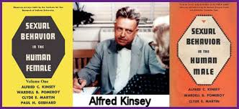

Slide 77
III. THE FALLOUT OF KINSEY’S REPORTS.
Alfred Kinsey was a man on a mission, driven to overthrow the reigning sexual morality of his day which he imagined had caused him great harm due to the guilt he felt over his sexual addiction and homosexual attraction.
“I seem abnormal. So I must find or create data that shows me to be normal and the rest of the world to be abnormal, sexually repressed.” And this is precisely what he did.
Kinsey invited, coaxed, browbeat, slandered, and ridiculed a straitlaced culture into joining him in his sexual sickness.
He could not have done it alone, of course.
One of his chief cheerleaders was Hugh Hefner, the creator of the Playboy pornographic industry.
Notes:
Now we can be glad that most probably do not cheat or lie or fake their conclusions. In fact, the scientific method has a safeguard built into it from the start. Reliable data can only be gleaned from experiments that can be replicated, repeated with the same results. Anyone should be able to conduct the same experiment under the same conditions and achieve the same outcome. If you perform an experiment a thousand times and get the same results a thousand times, then the data is probably correct, even well established. If you get multiple, conflicting outcomes, then the data is not confirmed and needs more work.

Slide 79
III. THE FALLOUT OF KINSEY’S REPORTS.
Prior to Kinsey’s Male report in 1948 few men were actually serial fornicators. Not even Hugh Hefner was.
The first woman Hefner had sex with was the woman he later married. He was twenty-two.
But it was Kinsey’s report that changed his views.
He saw himself as Kinsey’s “populist.”
“Hefner recognized Kinsey as the incontrovertible word of the new God based on the new holy writ—demonstrable evidence. Kinsey would add a dash of scientific truth to the Playboy mix.” (Reisman, Sabotage, 105.)
Notes:
Now we can be glad that most probably do not cheat or lie or fake their conclusions. In fact, the scientific method has a safeguard built into it from the start. Reliable data can only be gleaned from experiments that can be replicated, repeated with the same results. Anyone should be able to conduct the same experiment under the same conditions and achieve the same outcome. If you perform an experiment a thousand times and get the same results a thousand times, then the data is probably correct, even well established. If you get multiple, conflicting outcomes, then the data is not confirmed and needs more work.

Slide 80
III. THE FALLOUT OF KINSEY’S REPORTS.
The British medical journal the Lancet concluded that Kinsey,
“ ‘an otherwise harmless student of the gall wasp, has left his former co-workers some explaining to do. The books launched the so-called sexual revolution, an era of sexual license’ that brought a booming global trade in electronic pornography; annual international sex trafficking of up to eight hundred thousand women and children; domestic sex trafficking/ prostitution/ stripping in the millions; unprecedented sexual violence against women and children; rampant eroticism in pop culture; high rates of unwed pregnancies; abortion on demand; skyrocketing rates of addiction to sex, pornography, and illicit drugs; failed marriages; widespread impotence; lost careers; financial ruin; sexually transmitted diseases; and death.”
Notes:
Now we can be glad that most probably do not cheat or lie or fake their conclusions. In fact, the scientific method has a safeguard built into it from the start. Reliable data can only be gleaned from experiments that can be replicated, repeated with the same results. Anyone should be able to conduct the same experiment under the same conditions and achieve the same outcome. If you perform an experiment a thousand times and get the same results a thousand times, then the data is probably correct, even well established. If you get multiple, conflicting outcomes, then the data is not confirmed and needs more work.

Slide 81
III. THE FALLOUT OF KINSEY’S REPORTS.
Kinsey died in 1956 at the age of sixty-two, of complications of a disease of the testicles called “orchitis.”
It is commonly caused by a sexually transmitted disease.
So if he has been dead for over sixty years, why bother talking about him?
It’s obviously because of the lingering legacy of his lies.
You would not have to think about it long to find many of your friends and relatives who have been wounded and scarred by the sexual revolution.
And it was the compounded lies of those pseudo-scholars like Freud, Mead, and the unindicted sexual predator and child sexual abuser, Alfred C. Kinsey
Notes:
Now we can be glad that most probably do not cheat or lie or fake their conclusions. In fact, the scientific method has a safeguard built into it from the start. Reliable data can only be gleaned from experiments that can be replicated, repeated with the same results. Anyone should be able to conduct the same experiment under the same conditions and achieve the same outcome. If you perform an experiment a thousand times and get the same results a thousand times, then the data is probably correct, even well established. If you get multiple, conflicting outcomes, then the data is not confirmed and needs more work.

Slide 83
III. THE FALLOUT OF KINSEY’S REPORTS.
The Kinsey Institute at Indiana University is still going strong with its vast collection of pornography and its still carefully-guarded secrets about its founder.
They could not bear the guilt of their sexual sins, so they invited everyone to join them.
Misery loves company.
Immorality is excused by the claim that “everybody’s doing it,” even if everybody is clearly not doing it.
Notes:
Now we can be glad that most probably do not cheat or lie or fake their conclusions. In fact, the scientific method has a safeguard built into it from the start. Reliable data can only be gleaned from experiments that can be replicated, repeated with the same results. Anyone should be able to conduct the same experiment under the same conditions and achieve the same outcome. If you perform an experiment a thousand times and get the same results a thousand times, then the data is probably correct, even well established. If you get multiple, conflicting outcomes, then the data is not confirmed and needs more work.

Slide 84
III. THE FALLOUT OF KINSEY’S REPORTS.
Kinsey was indeed a driven man, a man on a mission.
He rebelled against his father’s morality and determined to overthrow the sexual morality of an entire culture. He found a quite willing audience.
From our vantage point some seventy years later, he seems to have succeeded beyond his wildest dreams.
That is, if you can consider the destruction of families, widespread sexual abuse, epidemics of sexually transmitted diseases, oceans of misery, and the destruction of over sixty-million unborn children, if you can call that “success.”
One reviewer of Jones’ biography of Kinsey noted that Kinsey “poured his life into his work and made his ‘science’ serve his appetites.” But, of course, that’s not science at all.
Notes:
Now we can be glad that most probably do not cheat or lie or fake their conclusions. In fact, the scientific method has a safeguard built into it from the start. Reliable data can only be gleaned from experiments that can be replicated, repeated with the same results. Anyone should be able to conduct the same experiment under the same conditions and achieve the same outcome. If you perform an experiment a thousand times and get the same results a thousand times, then the data is probably correct, even well established. If you get multiple, conflicting outcomes, then the data is not confirmed and needs more work.

Slide 85
III. THE FALLOUT OF KINSEY’S REPORTS.
E. Michael Jones notes that “There are ultimately only two alternatives in the intellectual life: either one conforms desire to the truth or one conforms truth to desire.” (11)
For decades Sigmund Freud carried on an incestuous, adulterous affair with his wife’s more vivacious younger sister, appalling by any standard.
What did he do with his guilt? He created a psychological (scientific) theory to excuse it. He was only acting out a previously unresolved “Oedipus complex.” Psychology (science) saves the day!
Margaret Mead carried on a homosexual relationship for decades and committed adultery against her husband.
What did she do with her guilt? She invented a free and easy society that was better off by relaxing and discarding any and all sexual restrictions. Problem solved. Anthropology (science) to the rescue!
Notes:
Now we can be glad that most probably do not cheat or lie or fake their conclusions. In fact, the scientific method has a safeguard built into it from the start. Reliable data can only be gleaned from experiments that can be replicated, repeated with the same results. Anyone should be able to conduct the same experiment under the same conditions and achieve the same outcome. If you perform an experiment a thousand times and get the same results a thousand times, then the data is probably correct, even well established. If you get multiple, conflicting outcomes, then the data is not confirmed and needs more work.

Slide 86
III. THE FALLOUT OF KINSEY’S REPORTS.
And here, Alfred Kinsey was tormented as a sex addict, a masochist with controllable homosexual desires and fantasies.
What did he do with his guilt?
Kinsey “discovered” in his “research” that most people are like him, not like those upstanding moral frauds he had met in church or the Boy Scouts or in the YMCA.
He had proved that he was normal, not them.
Biology, sexology (science) declared him normal and the rest of the world sick, unhealthy, repressed.
Notes:
Now we can be glad that most probably do not cheat or lie or fake their conclusions. In fact, the scientific method has a safeguard built into it from the start. Reliable data can only be gleaned from experiments that can be replicated, repeated with the same results. Anyone should be able to conduct the same experiment under the same conditions and achieve the same outcome. If you perform an experiment a thousand times and get the same results a thousand times, then the data is probably correct, even well established. If you get multiple, conflicting outcomes, then the data is not confirmed and needs more work.

Slide 87
IV. OBSERVATIONS AND REFLECTIONS
1. Moralism does not work.
The unregenerate heart will always find a way to rebel, to find gratification.
None of Kinsey’s participation in the Boy Scouts, the YMCA, or in his moralistic church had any lasting positive impact on his soul.
We should remember Paul’s warning against trusting in moralism from Colossians 2:23: “These [artificial, man-made rules] have indeed an appearance of wisdom in promoting self-made religion and asceticism and severity to the body, but they are of no value in stopping the indulgence of the flesh.”
The truth is that when Kinsey met the atheist dean at Harvard who lived for sinful pleasure, Kinsey did not need much coaxing to join him.
Notes:
Now we can be glad that most probably do not cheat or lie or fake their conclusions. In fact, the scientific method has a safeguard built into it from the start. Reliable data can only be gleaned from experiments that can be replicated, repeated with the same results. Anyone should be able to conduct the same experiment under the same conditions and achieve the same outcome. If you perform an experiment a thousand times and get the same results a thousand times, then the data is probably correct, even well established. If you get multiple, conflicting outcomes, then the data is not confirmed and needs more work.

Slide 88
IV. OBSERVATIONS AND REFLECTIONS
Sadly, the moralistic Kinsey Senior, Kinsey’s father also took the plunge into immorality.
He abandoned his wife of forty years, secured a quickie divorce in Reno, and took up with a younger woman.
By Kinsey Junior’s logic and according to his research, that should have been a good thing which Kinsey should have applauded. But he reacted only with loathing toward his father.
Notes:
Now we can be glad that most probably do not cheat or lie or fake their conclusions. In fact, the scientific method has a safeguard built into it from the start. Reliable data can only be gleaned from experiments that can be replicated, repeated with the same results. Anyone should be able to conduct the same experiment under the same conditions and achieve the same outcome. If you perform an experiment a thousand times and get the same results a thousand times, then the data is probably correct, even well established. If you get multiple, conflicting outcomes, then the data is not confirmed and needs more work.

Slide 89
IV. OBSERVATIONS AND REFLECTIONS
Moralism made young Kinsey into what Jesus called a “whitewashed tomb.” (Matt. 23:27)
He looked clean and shiny on the outside. His future wife, Clara, even worried that he might be “too churchy.”
But eventually, the dead men’s bones spilled out of the tomb, and the rottenness infected the whole world.
Jesus never called us to try to spread moralism.
He called us to proclaim the gospel and make disciples of all nations.
The Moral Majority of the 1980s made this mistake. So did the political efforts of the Focus on the Family organization.
All to no avail, because moralism does not work.
Notes:
Now we can be glad that most probably do not cheat or lie or fake their conclusions. In fact, the scientific method has a safeguard built into it from the start. Reliable data can only be gleaned from experiments that can be replicated, repeated with the same results. Anyone should be able to conduct the same experiment under the same conditions and achieve the same outcome. If you perform an experiment a thousand times and get the same results a thousand times, then the data is probably correct, even well established. If you get multiple, conflicting outcomes, then the data is not confirmed and needs more work.

Slide 90
IV. OBSERVATIONS AND REFLECTIONS
2. The “culture” probably never was “Christian.”
It may have been more closely adherent to a Judeo-Christian ethic for a time. But the transformation of the soul through the regenerating work of the Holy Spirit was largely absent in most people.
And I worry that not much of this gospel outreach is taking place.
I hear a lot about politics from Christians or about moral issues.
But what I hear little about is evangelism, proclaiming the good news of the gospel, the only news by which someone can be born again with a new heart and a new love for Christ and his holiness.
In my opinion, we need to be less concerned about re-capturing the culture and get about the business of sharing the gospel and making disciples.
Notes:
Now we can be glad that most probably do not cheat or lie or fake their conclusions. In fact, the scientific method has a safeguard built into it from the start. Reliable data can only be gleaned from experiments that can be replicated, repeated with the same results. Anyone should be able to conduct the same experiment under the same conditions and achieve the same outcome. If you perform an experiment a thousand times and get the same results a thousand times, then the data is probably correct, even well established. If you get multiple, conflicting outcomes, then the data is not confirmed and needs more work.

Slide 91
IV. OBSERVATIONS AND REFLECTIONS
I sincerely doubt that anyone in the New Testament church harbored the hope of “capturing the culture.”
Instead, they set about planting churches and making disciples as Jesus had commanded them.
And, remarkably, after less than three centuries, they captured the culture.
The Roman Emperor Constantine declared for Christ.
Scholars debate whether that change helped or hindered the church. It ended persecution. But it also saw the influx of many nominal Christians, and the church in time became compromised, distracted, and weakened.
Notes:
Now we can be glad that most probably do not cheat or lie or fake their conclusions. In fact, the scientific method has a safeguard built into it from the start. Reliable data can only be gleaned from experiments that can be replicated, repeated with the same results. Anyone should be able to conduct the same experiment under the same conditions and achieve the same outcome. If you perform an experiment a thousand times and get the same results a thousand times, then the data is probably correct, even well established. If you get multiple, conflicting outcomes, then the data is not confirmed and needs more work.

Slide 92
IV. OBSERVATIONS AND REFLECTIONS
So even though we need to be absolutely certain that this whole sexual revolution is an unmitigated disaster for those caught up in it, it really should not be our focus.
What it surely will do is produce misery, pain, and brokenness, and the church does have a ready answer and remedy for the brokenness of sin, if only we are courageous enough and patient enough to come alongside the wounded and bring them the hope of Christ.
Notes:
Now we can be glad that most probably do not cheat or lie or fake their conclusions. In fact, the scientific method has a safeguard built into it from the start. Reliable data can only be gleaned from experiments that can be replicated, repeated with the same results. Anyone should be able to conduct the same experiment under the same conditions and achieve the same outcome. If you perform an experiment a thousand times and get the same results a thousand times, then the data is probably correct, even well established. If you get multiple, conflicting outcomes, then the data is not confirmed and needs more work.

Slide 93
IV. OBSERVATIONS AND REFLECTIONS
3. In some ways we can see Kinsey himself as a parable or microcosm of the culture itself.
If the culture had been thoroughly Christian, it would have been immune to his influence and would have seen right through his bogus reports.
Judith Reisman is a bit too romantic and nostalgic about the pre-Kinsey culture. In her view, the vast majority of all Americans were upstanding, morally pure, and disinterested in sexual sin. Then Kinsey dropped his two atomic bombs, his doctored reports on male and then female sexuality, and “morally upstanding” Americans were suddenly transformed into sex-crazed deviants overnight.
Kinsey rebelled against a strict morality, and he only led the way for people who were already champing at the bit to follow him. His one rebellion opened the floodgate.

Slide 94
IV. OBSERVATIONS AND REFLECTIONS
4. Personally, I don’t completely discount Kinsey’s findings.
I am a Calvinist, one who takes the Bible’s teaching seriously.
The Bible is clear: all unregenerate humans are enslaved to sin and self.
The variety of sin that may be popular at the moment may change: greed, lust, pride, malice, cruelty, jealousy, but it’s always there.
If the sinful heart cannot have one form of wicked gratification, it will move on to the next.
But it must find gratification of some sort, for the unregenerate heart is empty, devoid of life, and must find something to fill it.
Notes:
Now we can be glad that most probably do not cheat or lie or fake their conclusions. In fact, the scientific method has a safeguard built into it from the start. Reliable data can only be gleaned from experiments that can be replicated, repeated with the same results. Anyone should be able to conduct the same experiment under the same conditions and achieve the same outcome. If you perform an experiment a thousand times and get the same results a thousand times, then the data is probably correct, even well established. If you get multiple, conflicting outcomes, then the data is not confirmed and needs more work.

Slide 95
IV. OBSERVATIONS AND REFLECTIONS
That’s why there is no end in sight to the sexual revolution.
It begins with premarital sex, and when that becomes passé, one has to move on to promiscuous sex, then extramarital sex, then homosex, then group sex, then trans-sex, then trans-species sex.
And it never ends. It cannot end because the sinful heart is empty and cannot be satisfied.
As St. Augustine famously prayed, though in a different context: “You have made us for Yourself and our hearts are restless until they rest in You.”
Notes:
Now we can be glad that most probably do not cheat or lie or fake their conclusions. In fact, the scientific method has a safeguard built into it from the start. Reliable data can only be gleaned from experiments that can be replicated, repeated with the same results. Anyone should be able to conduct the same experiment under the same conditions and achieve the same outcome. If you perform an experiment a thousand times and get the same results a thousand times, then the data is probably correct, even well established. If you get multiple, conflicting outcomes, then the data is not confirmed and needs more work.

Slide 96
IV. OBSERVATIONS AND REFLECTIONS
5. I will probably get into trouble for this, but Kinsey (and Freud, and Mead) clearly demonstrate that we cannot trust “science,” or at least some who claim to speak for “science.”
These seemingly sober scientists like Freud, Mead, and Kinsey all cooked the books and fudged the numbers.
Let’s see, if you ask a hundred active homosexuals if they have ever had any homosexual experience you will get a positive response from one hundred out of one hundred.
That’s pretty close to what Kinsey did.
Or if you ask a hundred working prostitutes if they have ever had premarital or extramarital sex with anyone, well, same thing.
Notes:
Now we can be glad that most probably do not cheat or lie or fake their conclusions. In fact, the scientific method has a safeguard built into it from the start. Reliable data can only be gleaned from experiments that can be replicated, repeated with the same results. Anyone should be able to conduct the same experiment under the same conditions and achieve the same outcome. If you perform an experiment a thousand times and get the same results a thousand times, then the data is probably correct, even well established. If you get multiple, conflicting outcomes, then the data is not confirmed and needs more work.

Slide 97
IV. OBSERVATIONS AND REFLECTIONS
Kinsey’s sampling virtually guaranteed his results.
But then he was not interested in finding the truth: he wanted to change the sexual mores of the culture.
Even the atheist Christopher Hitchens declared of Kinsey that his seemingly objective “scrutiny” “may conceal motives of less than scientific purity,” an enormous understatement.
Notes:
Now we can be glad that most probably do not cheat or lie or fake their conclusions. In fact, the scientific method has a safeguard built into it from the start. Reliable data can only be gleaned from experiments that can be replicated, repeated with the same results. Anyone should be able to conduct the same experiment under the same conditions and achieve the same outcome. If you perform an experiment a thousand times and get the same results a thousand times, then the data is probably correct, even well established. If you get multiple, conflicting outcomes, then the data is not confirmed and needs more work.

Slide 98
IV. OBSERVATIONS AND REFLECTIONS
That being said, the scientific method is basically sound.
If you can create an experiment under controlled conditions and if anyone who repeats your experiment can get the same result, then that fact is well taken.
But what we need to keep asking about someone’s “data, findings, and conclusions” is the question: “Is that really scientific?”
One of the founders of Greenpeace, an environmentalist organization, Dr. Patrick Moore, notes that when people refer to “a consensus of environmentalists” and their views, “consensus” is not science.
In real science, if a thing is true, it’s true, and it doesn’t take a “consensus” to back it up. “Consensus” is in the realm of “opinion,” not fact.
Facts are true even if nobody believes them, if there is no “consensus.”
Notes:
Now we can be glad that most probably do not cheat or lie or fake their conclusions. In fact, the scientific method has a safeguard built into it from the start. Reliable data can only be gleaned from experiments that can be replicated, repeated with the same results. Anyone should be able to conduct the same experiment under the same conditions and achieve the same outcome. If you perform an experiment a thousand times and get the same results a thousand times, then the data is probably correct, even well established. If you get multiple, conflicting outcomes, then the data is not confirmed and needs more work.

Slide 99
IV. OBSERVATIONS AND REFLECTIONS
We are all for science. I love science.
I enjoy air conditioning, antibiotics, cooking food, distance running, and gardening, and all of these are enabled or aided by science!
But when pseudo-science, unproven theories or skewed samples are used to bully people into accepting mere opinions, that’s not science.
We should be angry when this kind of deception takes place, especially if, in the case of the sexual revolution, these deceptions create real harm to our fellow humans, especially the young, weak, and vulnerable, including the unborn.
Notes:
Now we can be glad that most probably do not cheat or lie or fake their conclusions. In fact, the scientific method has a safeguard built into it from the start. Reliable data can only be gleaned from experiments that can be replicated, repeated with the same results. Anyone should be able to conduct the same experiment under the same conditions and achieve the same outcome. If you perform an experiment a thousand times and get the same results a thousand times, then the data is probably correct, even well established. If you get multiple, conflicting outcomes, then the data is not confirmed and needs more work.

Slide 100
IV. OBSERVATIONS AND REFLECTIONS
6. And finally, we should say a word about Christian ministry to those ensnared in the sexual revolution. Here’s an important question when it comes to sexual sins.
Should we be personally disgusted by aberrant sexual practices?
If, for example, one finds homosexual acts offensive, one is regularly accused of being “homophobic,” literally “afraid of homosexual activity.”
Whoever coined that word was an evil genius.
The implication is that “if I find homosexual activity morally wrong and morally offensive, then there is something wrong with me.
I have this unnatural fear of something that is normal and good and that others find wonderful. And so, it’s my problem. I need therapy.”
(Of course, a holy God finds all sin morally wrong and morally offensive, worthy of eternal damnation. Does God need therapy?)
Notes:
Now we can be glad that most probably do not cheat or lie or fake their conclusions. In fact, the scientific method has a safeguard built into it from the start. Reliable data can only be gleaned from experiments that can be replicated, repeated with the same results. Anyone should be able to conduct the same experiment under the same conditions and achieve the same outcome. If you perform an experiment a thousand times and get the same results a thousand times, then the data is probably correct, even well established. If you get multiple, conflicting outcomes, then the data is not confirmed and needs more work.

Slide 101
IV. OBSERVATIONS AND REFLECTIONS
But this is, of course, a confusion of categories.
It is not a matter of fear, but of repulsion.
I am not afraid of vomit or raw sewage, for example, but I find them disgusting and they make me ill.
If someone enjoyed wallowing in vomit or raw sewage, well, they need help.
So it isn’t a matter of fear.
Homosexual activity doesn’t scare me. I’m not homophobic, but I am homo-offended. And godly Christians should be offended by any sin and find it morally repulsive, as God does!
Notes:
Now we can be glad that most probably do not cheat or lie or fake their conclusions. In fact, the scientific method has a safeguard built into it from the start. Reliable data can only be gleaned from experiments that can be replicated, repeated with the same results. Anyone should be able to conduct the same experiment under the same conditions and achieve the same outcome. If you perform an experiment a thousand times and get the same results a thousand times, then the data is probably correct, even well established. If you get multiple, conflicting outcomes, then the data is not confirmed and needs more work.

Slide 102
IV. OBSERVATIONS AND REFLECTIONS
Are you disgusted by the sexual abuse of children? Or are you just pedophiliophobic?
How do you feel about cannibalism? Does the thought really turn your stomach, or are you just cannibalismophobic?
What do you think of homicide? Are you morally repulsed by it? No, you’re probably just afraid of dead bodies, murderophobic.
Do you see the trick? If you love what God loves and strive for moral purity, and if you hate sin as God hates sin, then you are mentally ill.
You have sinophobia.
Notes:
Now we can be glad that most probably do not cheat or lie or fake their conclusions. In fact, the scientific method has a safeguard built into it from the start. Reliable data can only be gleaned from experiments that can be replicated, repeated with the same results. Anyone should be able to conduct the same experiment under the same conditions and achieve the same outcome. If you perform an experiment a thousand times and get the same results a thousand times, then the data is probably correct, even well established. If you get multiple, conflicting outcomes, then the data is not confirmed and needs more work.

Slide 103
IV. OBSERVATIONS AND REFLECTIONS
So how does the Christian reach out to those enslaved to sexual sins when the desire to do so is dismissed as bigotry, as judgmentalism, as hatred, homophobia, or transphobia, etc.?
We have to “love the sinner and hate the sin.” We must be willing to condemn the sin for the sinner’s sake. And then we must go, sinner to sinner, and extend the hope and grace of Christ that has found us and saved us in our sin.
We must replace anger with brokenness, and haughtiness with humbleness, for we fellow sinners who have been given grace in Christ. But we must not minimize sin.
We must grieve sin and seek to help people leave a life of sin for a new life of joy in Christ.
Psalm 119:136: “My eyes shed streams of tears, because people do not keep your law.”
Notes:
Now we can be glad that most probably do not cheat or lie or fake their conclusions. In fact, the scientific method has a safeguard built into it from the start. Reliable data can only be gleaned from experiments that can be replicated, repeated with the same results. Anyone should be able to conduct the same experiment under the same conditions and achieve the same outcome. If you perform an experiment a thousand times and get the same results a thousand times, then the data is probably correct, even well established. If you get multiple, conflicting outcomes, then the data is not confirmed and needs more work.

Slide 104
Alfred Kinsey apparently was raised in a moralistic church
with law but no gospel,
with guilt but no grace,
with condemnation but no Christ.
And in the end he became
a maestro of manipulation,
a master of iniquity,
and a monster of sexual abuse.
In the final seminar we will meet an example of the precise opposite in the last of the pioneers of the sexual revolution, Karl Barth, an experiment in a Christianity with a “gospel” and no law.

Slide 105
Hospers PCA Summer Seminars 2020
“The Roots of the (Moral) Revolution”
June 9: “Sigmund Freud’s Complicated Oedipus Complex” (Psychology)
June 23: “Margaret Mead’s Fantasy Island” (Anthropology)
July 21: “Alfred Kinsey’s Wild Ride (or Bogus Adventure?)” (Biology)
August 11: “Karl Barth’s Neo-Unorthodox Arrangement” (Theology)
(All Seminars on Tuesdays at 7:00 p.m.)

