Slide 1
FUTURE SUMMER SEMINARS FOR 2016
July 26 “L.G.B.Transgender: What’s All This Fuss about Bathrooms and Locker Rooms?”
August 9 “Marriage Tune-Up (1): Expectations and Empty Love Tanks”
August 16 “Marriage Tune-Up (2): Sexual Pleasure in Marriage”
(All seminars are at the church and begin at 7:00 p.m.)

Slide 2
BIBILICAL ANGER MANAGEMENT:
Quick to Listen, Slow to Speak,
and Slow to Become Angry

Slide 3
Introduction
Is there anyone that you wish were here right now?

Slide 8
Introduction
Is there anyone that you wish were here right now?
Why do you wish they were here?

Slide 9
Introduction
Some people enjoy being angry!
1. Anger makes me feel something.
2. Anger motivates others.

Slide 11
Introduction
Some people enjoy being angry!
1. Anger makes me feel something.
2. Anger motivates others.
3. Anger justifies me.

Slide 12
Introduction
Some basics about anger:
1. The Bible has much to say about anger
2. God himself gets angry—often!

Slide 14
Introduction
Some basics about anger:
1. The Bible has much to say about anger
2. God himself gets angry—often!
3. Satan is also quite angry.

Slide 15
I. LIES ABOUT ANGER
1. “Anger is something inside me.”

Slide 17
I. LIES ABOUT ANGER
1. “Anger is something inside me.”
2. “It’s okay to be angry at God.”
3. “My big problem is anger at myself.”

Slide 18
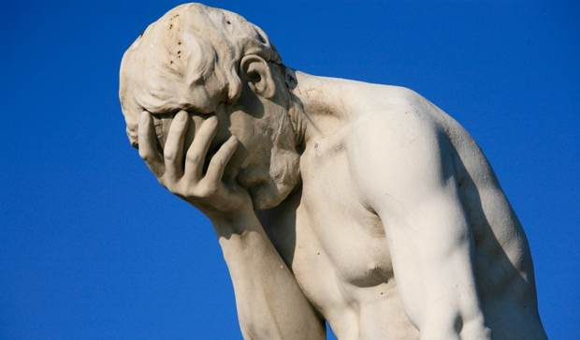

Slide 19
II. THE DEFINITION OF ANGER
“Our anger is our whole-personed, active response of negative moral judgment against perceived evil.”
Robert D.Jones, Uprooting Anger

Slide 21
II. THE DEFINITION OF ANGER
1. It is an active response.
2. It is a whole-personed response.
3. It is a response against something.
4. It involves a negative moral judgment.
5. It involves a perceived evil.

Slide 22
II. THE DEFINITION OF ANGER
“Our anger is our whole-personed, active response of negative moral judgment against perceived evil.”
Robert D.Jones, Uprooting Anger

Slide 23
II. THE DEFINITION OF ANGER
Two other aspects of anger:
1. The Bible speaks of three kinds of anger:
Divine anger
Human righteous anger
Human unrighteous anger
2. Human righteous anger…is rare. Elements of righteous anger include:
a. A reaction against actual sin.
b. A focus on God and his kingdom, rights, and concerns
c. It is accompanied by other godly qualities and expresses itself in godly ways.

Slide 24
III. DEALING WITH ANGER GOD’S WAY
1. God does not instruct us to vent our anger, nor to find constructive ways to channel our anger. God says, “Get rid of it!” “Put it to death.”

Slide 25
“The acts of the sinful nature are obvious: sexual immorality, impurity and debauchery; idolatry and witchcraft; hatred, discord, jealousy, fits of rage, selfish ambition, dissensions, factions and envy; drunkenness, orgies, and the like. I warn you, as I did before, that those who live like this will not inherit the kingdom of God.” (Galatians 5:19-21)

Slide 26
“Get rid of all bitterness, rage and anger, brawling and slander, along with every form of malice. Be kind and compassionate to one another, forgiving each other, just as in Christ God forgave you.” (Ephesians 4:31-2)

Slide 27
“Put to death, therefore, whatever belongs to your earthly nature: sexual immorality, impurity, lust, evil desires and greed, which is idolatry. Because of these, the wrath of God is coming. You used to walk in these ways, in the life you once lived. But now you must rid yourselves of all such things as these: anger, rage, malice, slander, and filthy language from your lips. Do not lie to each other, since you have taken off your old self with its practices and have put on the new self, which is being renewed in knowledge in the image of its Creator.” (Colossians 3:5-10)

Slide 28
III. DEALING WITH ANGER GOD’S WAY
1. God does not instruct us to vent our anger, nor to find constructive ways to channel our anger. God says, “Get rid of it!” “Put it to death.”
2. Unrighteous anger is evil and must be rooted out and destroyed.
3. This can only come through the Holy Spirit’s renewing our mind according to God’s Word.

Slide 29
IV. A BIBLICAL CASE STUDY ON ANGER
The story of Jonah

Slide 30
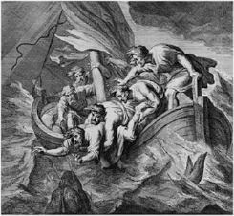

Slide 31
IV. A BIBLICAL CASE STUDY ON ANGER
The story of Jonah
1. Jonah was not afraid to go to Nineveh.
2. Jonah was afraid that God might spare Nineveh.
3. When God does spare Nineveh, Jonah was angry.
4. When God withered the vine, Jonah was angry.

Slide 32
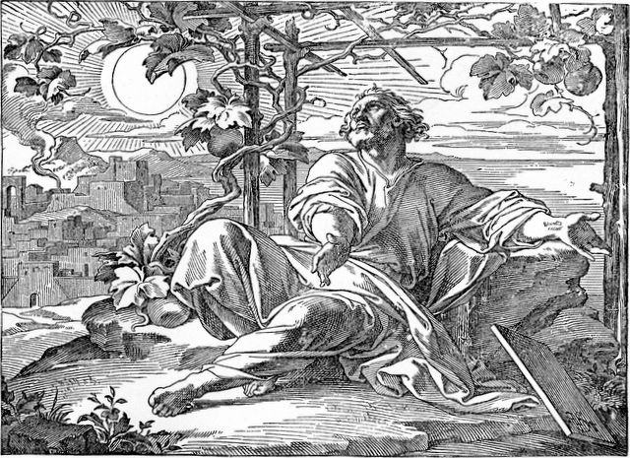

Slide 33
IV. A BIBLICAL CASE STUDY ON ANGER
Applications from Jonah’s story:
1. Jonah’s anger was not righteous anger.
2. Jonah was a believer.
3. Jonah’s sinful anger was rebellion against God.
4. Even though Jonah knew a lot about God, Jonah did not really know God.
“1 But Jonah was greatly displeased and became angry. 2 He prayed to the LORD, "O LORD, is this not what I said when I was still at home? That is why I was so quick to flee to Tarshish. I knew that you are a gracious and compassionate God, slow to anger and abounding in love, a God who relents from sending calamity.” (4:1-2)

Slide 34
V. HOW PEOPLE CHANGE
1. Most people follow their emotions today.
2. God has also given us minds and wills.
3. These three are not to be separated in salvation.
4. The Holy Spirit’s purpose in salvation is not to destroy our human faculties, but to renew them.
5. Primacy is placed on renewing the mind.

Slide 35
“1 “I appeal to you therefore, brothers, by the mercies of God, to present your bodies as a living sacrifice, holy and acceptable to God, which is your spiritual worship. 2 Do not be conformed to this world, but be transformed by the renewal of your mind, that by testing you may discern what is the will of God, what is good and acceptable and perfect. 3 For by the grace given to me I say to everyone among you not to think of himself more highly than he ought to think, but to think with sober judgment, each according to the measure of faith that God has assigned.” (Romans 12:1-3)

Slide 36
V. HOW PEOPLE CHANGE
“God’s truth engages the mind, which enflames the affections, which empowers the will for obedience and service.”

Slide 37
VI. ENGAGING THE MIND FOR CHANGE
Truths about God:
1. God is sovereign over all.
2. God is good toward all, but especially toward his people.
3. God is perfectly wise in all things.
” And we know that for those who love God all things work together for good, for those who are called according to his purpose.” (Romans 8:28)

Slide 38
VI. ENGAGING THE MIND FOR CHANGE
Truths about Ourselves:
1. We are sinners (and so terribly self-centered).
2. We are surrounded by sinners.

Slide 39
VII. ANGER DEFEATING RESPONSES
1. Understanding and trust
2. Submission to God
3. Repentance from sinful, self-centered attitudes and actions.
4. Thankfulness to God
5. Obedience to God’s revealed will in Scripture

Slide 40
FUTURE SUMMER SEMINARS FOR 2016
July 26 “L.G.B.Transgender: What’s All This Fuss about Bathrooms and Locker Rooms?”
August 9 “Marriage Tune-Up (1): Expectations and Empty Love Tanks”
August 16 “Marriage Tune-Up (2): Sexual Pleasure in Marriage”
(All seminars are at the church and begin at 7:00 p.m.)

