Slide 1
BIBLICAL MERCY MINISTRY: Dependency or Development?

Slide 2
Introduction
“Please Stop Feeding the Able Poor”
“Mission Trips: Helping Others or Helping Ourselves?”
“Biblical Mercy Ministry: Dependency of Development”

Slide 3
I. Development vs. Dependency
“Relief”

Slide 4
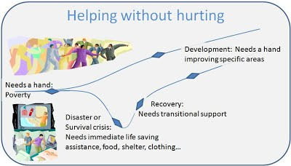

Slide 5
I. Development vs. Dependency
“Relief”
“Recovery”
“Development”

Slide 6
II. The Origin of Mercy Ministry
The “Church Growth Movement”

Slide 8
II. The Origin of Mercy Ministry
The “Church Growth Movement”
Robert H. Schuller
“Felt Needs”

Slide 10
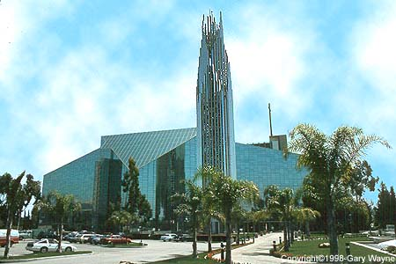

Slide 11
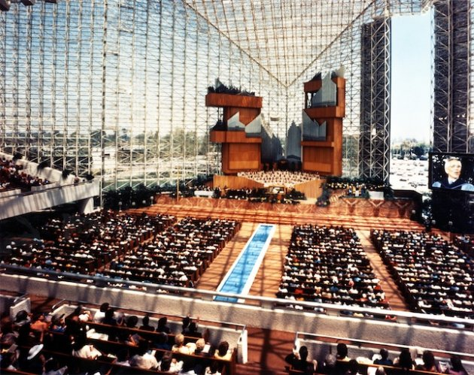

Slide 12
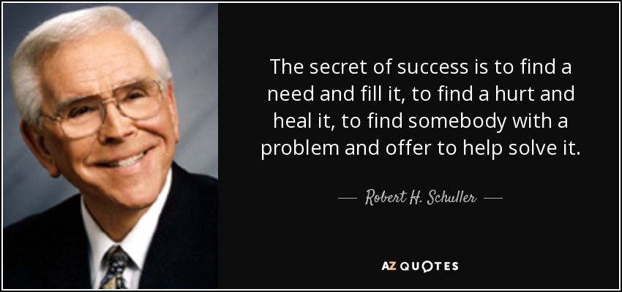

Slide 13
Matthew 6:31-33
“Therefore do not be anxious, saying, ‘What shall we eat?’ or ‘What shall we drink?’ or ‘What shall we wear?’ 32 For the Gentiles seek after all these things, and your heavenly Father knows that you need them all. 33 But seek first the kingdom of God and his righteousness, and all these things will be added to you.”

Slide 14
II. The Origin of Mercy Ministry
The “Church Growth Movement”
Robert H. Schuller
“Felt Needs”
Humanistic Psychology
Self-Esteem
Self-Fulfillment
Self-Actualization

Slide 15
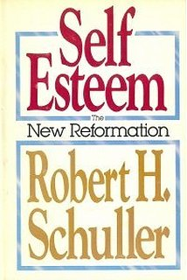

Slide 16
II. The Origin of Mercy Ministry
The “Church Growth Movement”
Robert H. Schuller
“Felt Needs”
Humanistic Psychology
Self-Esteem
Self-Fulfillment
Self-Actualization

Slide 18
II. The Origin of Mercy Ministry
The “Church Growth Movement”
Robert H. Schuller
“Felt Needs”
Humanistic Psychology
Self-Esteem
Self-Fulfillment
Self-Actualization
But while I’m seeking self-esteem, is it possible I am using the needy to feed my ego?

Slide 19
III. “Biblical” Mercy Ministry?
Almost no biblical support for any mercy ministry to those outside the church.
Zero biblical support for mercy ministry to those outside the church as a strategy for church growth.
Outside mercy ministry in the Old Testament?

Slide 20
Micah 6:8
“He has told you, O man, what is good; and what does the LORD require of you but to do justice, and to love kindness, and to walk humbly with your God?”

Slide 21
Amos 5:24
“But let justice roll down like waters, and righteousness like an ever-flowing stream.”

Slide 22
III. “Biblical” Mercy Ministry?
Almost no biblical support for any mercy ministry to those outside the church.
Zero biblical support for mercy ministry to those outside the church as strategy for church growth.
Outside mercy ministry in the Old Testament?
Calls for justice and care for the poor was for those in Israel!
Jonah?
“Welcome the stranger and sojourner?”

Slide 23
III. “Biblical” Mercy Ministry?
God’s Old Testament strategy: Bless his people and draw the nations to himself through them.

Slide 24
2 Chronicles 9:5-9
“5 And she said to the king, “The report was true that I heard in my own land of your words and of your wisdom, 6 but I did not believe the reports until I came and my own eyes had seen it. And behold, half the greatness of your wisdom was not told me; you surpass the report that I heard. 7 Happy are your wives! Happy are these your servants, who continually stand before you and hear your wisdom! 8 Blessed be the LORD your God, who has delighted in you and set you on his throne as king for the LORD your God! Because your God loved Israel and would establish them forever, he has made you king over them, that you may execute justice and righteousness.”

Slide 25
III. “Biblical” Mercy Ministry?
God’s Old Testament strategy: Bless his people and draw the nations to himself through them.
New Testament? The church is to go to all nations.

Slide 26
III. “Biblical” Mercy Ministry?
Do we find any New Testament strategy of expansion through mercy ministry to outsiders?
Not in the book of Acts
Not in the example of Jesus
Not in the Epistles
The one possible exception: Jesus’ parable of the Good Samaritan
Does the Bible forbid Christians from mercy ministry to non-Christians?

Slide 27
IV. Restoring the Biblical Model
While there is little biblical emphasis on mercy ministry to outsiders, there is great emphasis on caring for those inside the church!
Jesus: “I will build my church.”
Jesus: “Make disciples of all nations.”

Slide 29
IV. Restoring the Biblical Model
While there is little biblical emphasis on mercy ministry to outsiders, there is great emphasis on caring for those inside the church!
Jesus: “I will build my church.”
Jesus: “Make disciples of all nations.”
In the New Testament God calls us to go to all nations, but what do we send? The Church!

Slide 30
IV. Restoring the Biblical Model
But not just any church. We need CSA churches.
“Can’t-Stay-Away Churches”

Slide 31
Acts 2:42-47
“And they devoted themselves to the apostles’ teaching and fellowship, to the breaking of bread and the prayers. 43 And awe came upon every soul, and many wonders and signs were being done through the apostles. 44 And all who believed were together and had all things in common. 45 And they were selling their possessions and belongings and distributing the proceeds to all, as any had need. 46 And day by day, attending the temple together and breaking bread in their homes, they received their food with glad and generous hearts, 47 praising God and having favor with all the people. And the Lord added to their number day by day those who were being saved.”

Slide 32
Acts 4:32-35
“Now the full number of those who believed were of one heart and soul, and no one said that any of the things that belonged to him was his own, but they had everything in common. 33 And with great power the apostles were giving their testimony to the resurrection of the Lord Jesus, and great grace was upon them all. 34 There was not a needy person among them, for as many as were owners of lands or houses sold them and brought the proceeds of what was sold 35 and laid it at the apostles’ feet, and it was distributed to each as any had need.”

Slide 33
Acts 5:12-16
“Now many signs and wonders were regularly done among the people by the hands of the apostles. And they were all together in Solomon’s Portico. 13 None of the rest dared join them, but the people held them in high esteem. 14 And more than ever believers were added to the Lord, multitudes of both men and women, 15 so that they even carried out the sick into the streets and laid them on cots and mats, that as Peter came by at least his shadow might fall on some of them. 16 The people also gathered from the towns around Jerusalem, bringing the sick and those afflicted with unclean spirits, and they were all healed.”

Slide 34
IV. Restoring the Biblical Model
But not just any church. We need CSA churches.
“Can’t-Stay-Away Churches”
What is true wealth? Healthy relationships:
With God
With others
With yourself
With the rest of God’s creation (material goods)
But without reconciliation to God, can we be considered wealthy at all?

Slide 35
Mark 8:36
“For what does it profit a man to gain the whole world and forfeit his life?”

Slide 36
IV. Restoring the Biblical Model
We all want the same thing: truly, biblically wealthy people. The question is strategy.
If we start with mercy ministry it’s very difficult to transition to gospel ministry. Why?
Mercy ministry brings applause and approval.
Evangelism brings anger and disapproval.
God’s Word calls us to plant CSA churches.

Slide 37
Matthew 5:14-16
“You are the light of the world. A city set on a hill cannot be hidden. 15 Nor do people light a lamp and put it under a basket, but on a stand, and it gives light to all in the house. 16 In the same way, let your light shine before others, so that they may see your good works and give glory to your Father who is in heaven.”

Slide 38
IV. Restoring the Biblical Model
We all want the same thing: truly, biblically wealthy people. The question is strategy.
If we start with mercy ministry it’s very difficult to transition to gospel ministry. Why?
Mercy ministry brings applause and approval.
Evangelism brings anger and disapproval.
God’s Word calls us to plant CSA churches.
What is “a city set on a hill”?

Slide 39
V. Forming CSA Churches
Our most pressing need is to adopt Jesus’ strategy and build up CSA churches.

Slide 40
The Belgic Confession 29 (1551)
“The marks, by which the true Church is known, are these: if the pure doctrine of the gospel is preached therein; if she maintains the pure administration of the sacraments as instituted by Christ; if church discipline is exercised in punishing of sin: in short, if all things are managed according to the pure Word of God, all things contrary thereto corrected, and Jesus Christ acknowledged as the only Head of the Church.”

Slide 41
V. Forming CSA Churches
Our most pressing need is to adopt Jesus’ strategy and build up CSA churches. How?
1. The pure preaching of the Word of God.
The authority of the Word
The sufficiency of the Word
2. The right administration of the Sacraments.
Baptism
The Lord’s Supper
3. The exercise of church discipline.
“Disciplined,” “make disciples”.
Honest feedback leads to growth in discipleship

