Slide 1
Christianity VS. Self- Esteem
The Origins of the Religion of Selfism

Slide 8
The Continual Need for Reformation in the Church
The church is formed by the Word
The church is de-formed by the world
The church must be continually re-formed by the Word of God

Slide 9
Christianity vs. Self-Esteem?
Christianity: “If anyone would come after me, let him deny himself and take up his cross and follow me.” Jesus (Mk. 8:34)
Vs.
Self-esteem: “Self is the highest good. Self is all you really have, so you must prize self above all else.”

Slide 10
Christianity vs. Self-Esteem?
THESIS: The religion of selfism, the dominant religion in North America today, has no basis in science or rational foundation, and is not only a pathetic replacement for Christianity, but is the root and source of untold interpersonal problems and mental disorders. At its feet we rightly lay many if not most of the social ailments of our day, most tragically the disruption of the family, and a good share of the world’s misery and pain as well, and most seriously, the neutering and co-opting of the church and its vital message of hope in Jesus Christ.
Notes:
The religion of selfism, the dominant religion in North America today, has no basis in science nor rational foundation, and is not only a pathetic replacement for Christianity, but is the root and source of untold interpersonal problems and mental disorders. At its feet we rightly lay many if not most of the social ailments of our day, most tragically the disruption of the family, and a good share of the world’s misery and pain to boot, and most seriously of all, the neutering and co-opting of the church and its vital message of hope in Jesus Christ

Slide 11
For further reading:
Paul Vitz, Psychology as Religion: The Cult of Self-Worship
Don Matzat, Christ-Esteem: Where the Search for Self-Esteem Ends
Christopher Lasch, The Culture of Narcissism
Neil Postman, Amusing Ourselves to Death: Public Discourse in an Age of Show Business
Neal Gabler, Life: the Movie—How Entertainment Conquered Reality

Slide 12
Our Study Outline:
I. THE BIBLICAL VIEW OF HUMANITY AND HUMAN WORTH
THE REINVENTION OF THE SELF
THE GROWTH OF SELFISM, ESPECIALLY ITS INCURSION INTO THE CHURCH
THE FALLOUT OF SELFISM
THE WAY BACK: HOW WE CAN REFORM THE CHURCH AND ESCAPE THE TYRANNY OF SELF

Slide 13
I. The Biblical View of Humanity and Self-Worth
Humanity: the crown of God’s creation
Human worth: intrinsic or derived?
Human beings have no value apart from their Maker. Negative worth—“in Adam.”
God was not obligated to save anyone
The hook that ensnared our first parents was that they could achieve intrinsic worth: “You will be like God.”

Slide 14
II. The Reinvention of the Self
How does one find hope while “in Adam”?
Ludwig Feuerbach (1804-1872)
The Essence of Christianity (1841)

Slide 15
Ludwig Feuerbach
German Philosopher (1804-1872)
The Essence of Christianity (1841)

Slide 16
II. The Reinvention of the Self
How does one find hope while “in Adam”?
Ludwig Feuerbach (1804-1872)
The Essence of Christianity (1841)
Attacked the divinity of Jesus Christ and the existence of God.
Man’s selfless love for man is salvation
Homo homini Deus ist—Man’s God is MAN
“This is the turning point of world history!”

Slide 17
II. The Reinvention of the Self
Feuerbach’s influence
Marx, Nietzsche, Huxley, John Stuart Mill, Freud and Dewey
Marx, Nietzsche, and Freud influenced:
Eric Fromm (1900-80) & Rollo May (1904-94)
Mill, Huxley and Dewey influenced:
Carl Rogers (1902-1987)
Abraham Maslow (1908-1970)

Slide 18
Carl Rogers
American Psychologist (1902-1987)
Non-Directive, Client-Centered Therapy
Unconditional Positive Regard

Slide 19
II. The Reinvention of the Self
Carl Rogers
Raised in conservative Protestantism
Went to Union Seminary to study for the ministry—encountered liberalism
Left Christianity
Transferred to Teachers College at NYC
Influenced by John Dewey (Feuerbach)
Graduated PhD 1928

Slide 20
II. The Reinvention of the Self
Carl Rogers
Personality theory based on the innate goodness and primacy of the self
Goal of therapy: to help the person get in touch with the repressed self
Result: self-understanding, integration, more functional, more unique, self-expressive, accepting, able to cope with the problems of life

Slide 21
II. The Reinvention of the Self
Carl Rogers
In other words: the goal is to assist you to get in touch with your wonderful self and your feelings, the true, pure, and always good and wholesome reflection of the self, and to free you to become the wonderful person you were meant to be.

Slide 22
Abraham Maslow
American Psychologist (1908-1970)
“Hierarchy of Human Needs”

Slide 23
II. The Reinvention of the Self
Abraham Maslow
Raised in Brooklyn, graduated from University of Wisconsin, taught at Columbia Teachers College NYC
Selfist theory similar to Rogers
More interested in human motivation
“Hierarchy of Human Needs”

Slide 24
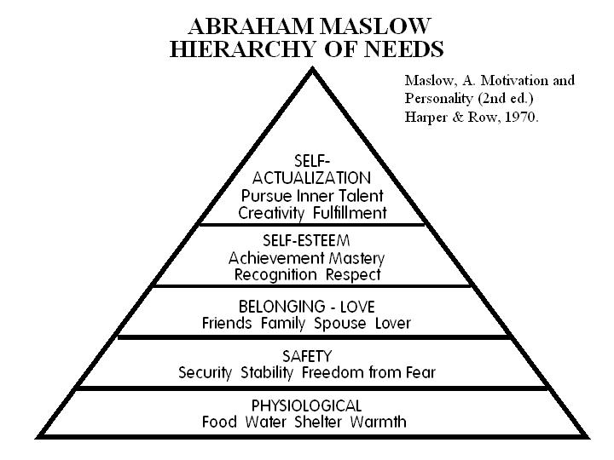

Slide 25
II. The Reinvention of the Self
Abraham Maslow
“Hierarchy of Human Needs”
Common to all people
Most basic needs must be met first: physiological and safety needs
Next needs for belonging and love
Then self-esteem and status
Highest need “Self-Actualization”

Slide 26
II. The Reinvention of the Self
“The Self-Actualized Person”
Aware of and comfortable with reality
Accepting self and others
Sponaneity
An autonomous self, independent of culture and tradition
Creativity
Having “peak experiences”
Democratic, egalitarian, humanitarian values

Slide 27
II. The Reinvention of the Self
“Four Tenants of Selfist Religion”
All people are completely good at heart
All that is negative and evil is external. Bad things come from “out there;” only good things from “in here.”
One’s highest duty is to discover and celebrate the self. Find yourself, get in touch with your feelings, self-actualization.
Restraint, rules, inflexible laws (most religion) is bad, a distraction from self.

Slide 28
II. The Reinvention of the Self
“Three Observations”
There is no “scientific” basis for selfism. Selfism is often considered scientific, while Christianity is superstition.
Selfism is pervasive today, having virtually captured every aspect of popular culture.
Biblically speaking, self is the enemy that keeps us from Christ. Selfism re-arms our enemy and makes Christ the servant of self.

Slide 29
III. The Growth of Selfism
Through public education and the popular media, selfism has largely captured the culture today.
Though Christianity stands in direct opposition to selfism, there is a growing chorus in the church today that has begun to echo the selfist line.
This development first came through Christian heretics who substituted selfist ideology for Christian truth.

Slide 30
Harry Emerson Fosdick
American Baptist Preacher (1878-1969)
As I See Religion (1932)
On Being a Real Person (1943)

Slide 31
III. The Growth of Selfism
Leaders of “Christian” Selfism
Harry Emerson Fosdick, Baptist preacher in New York City/Union Seminary.
1932 As I See Religion— “The divine origin…and endless possibilities of each personality…constitute the genius of Christianity.”
1943 On Being a Real Person— “To be a person…perpetual becoming…. wholeness….get yourself together…sin is to be chaotic and confused….Maturity is integration…in creative work.”

Slide 32
Norman Vincent Peale
American Preacher (1898-1993)
The Power of Positive Thinking (1952)
Guideposts Magazine (ongoing)

Slide 33
III. The Growth of Selfism
Leaders of “Christian” Selfism
Norman Vincent Peale, Positive Thinking approach to life’s problems.
1937, Peale declared: “The greatest day in any individual’s life is when he begins for the first time to realize himself.”
1952, The Power of Positive Thinking. (opening words): “Believe in yourself! Have faith in your abilities!...self-confidence leads to self-realization and successful achievement.”

Slide 34
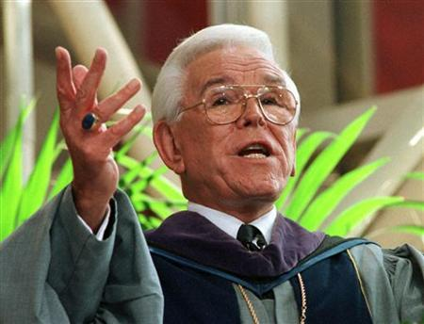
Robert H. Schuller
American Preacher (1926-)
“Possibility Thinking”
Self-Esteem: The New Reformation (1982)

Slide 35
III. The Growth of Selfism
Leaders of “Christian” Selfism
Robert H. Schuller, Possibility Thinking approach to life’s problems.
1982, Self-Esteem: The New Reformation.
“Self-esteem, then, or ‘pride in being a human being’ is the single greatest need facing the human race today.”
“I strongly suggest that self-love is the ultimate will of man; that what you really want more than anything else in the world is the awareness that you are a worthy person.”

Slide 36
III. The Growth of Selfism
Leaders of “Christian” Selfism
Robert H. Schuller, Possibility Thinking approach to life’s problems.
1982, Self-Esteem: The New Reformation.
“Do not fear pride: the easiest job God has is to humble us. God’s almost impossible task is to keep us believing every hour of every day how great we are as his sons and daughters on planet earth.”

Slide 37
James C. Dobson
Psychologist, Author, Broadcaster (1936-)
“Focus on the Family”
Hide or Seek: How to Build Self-Esteem in Your Child (1974)

Slide 38
III. The Growth of Selfism
Leaders of “Christian” Selfism
James C. Dobson, Psychologist and founder of Focus on the Family.
1974, Hide or Seek: How to Build Self-Esteem in Your Child.
“The matter of personal worth is not only the concern of those who lack it. In a real sense, the health of an entire society depends on the ease with which its individual members can gain personal acceptance.” (Continued)

Slide 39
III. The Growth of Selfism
Leaders of “Christian” Selfism
James C. Dobson, Psychologist and founder of Focus on the Family.
1974, Hide or Seek: How to Build Self-Esteem in Your Child.
“Thus, whenever the keys of self-esteem are seemingly out of reach for a large percentage of the people, as in twentieth-century America, then widespread “mental illness,” neuroticism, hatred, alcoholism, drug abuse, violence, and social disorder will certainly occur. Personal worth is not something human beings are free to take or leave. We must have it, and when it is unattainable, everybody suffers.” (20-21)

Slide 40
Joel Osteen
Pastor, Author, Speaker (1963-)
Lakewood Community Church
Your Best Life Now (2004)
Become a Better You (2007)
It’s Your Time (2009)

Slide 41
III. The Growth of Selfism
Leaders of “Christian” Selfism
Joel Osteen, Author and Pastor of Lakewood Community Church, the largest Church in North America.

Slide 44
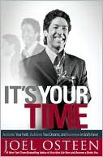

Slide 45
IV. The Fallout of Selfism
Is the lack of “self-esteem” the problem?
Lewis Smedes, Love Within Limits (1989)
“I have seen a hit man of the Mafia who says ‘I feel very good about myself.’ I have talked to prostitutes who have felt very good about themselves, and I’m not judging them, but I have talked to saints who felt very badly about themselves. The crux in this whole business is not whether we feel good about ourselves, though that is important, but what is the truth about ourselves?”

Slide 46
IV. The Fallout of Selfism
If the only reason we run from God is a poor self-esteem, why don’t those with high self esteem all become Christians?
William Kirk Kilpatrick, Psychologist, Selfism Critic
“Like the rich man who will have such a hard time getting into heaven, his riches protect him from the knowledge of how utterly dependent on God he is. In the same way the man who is brimful of self-esteem is unable to see how utterly broken he is, how we all are.”

Slide 47
IV. The Fallout of Selfism
What if our real problem is not a lack of self-esteem but pride?
David Myers, Psychology Prof, Hope College
“[W]hat an intriguing irony it is that so many Christian writers are now echoing the old prophets of humanistic psychology at the very time that research psychologists are amassing new data concerning the pervasiveness of pride. Indeed it is the orthodox theologians, not the humanistic psychologists, who seem closest to the truth that is glimpsed by social psychology.”

Slide 48
IV. The Fallout of Selfism
What if self-esteem is not the cure but the root of many problems?
The breakdown of relationships as people are turned inward.
Crumbling marriages as spouses go off to “find themselves,” and the resultant neglect of children.
Slavery to self as people are trapped “in Adam” with no escape.

Slide 49
V. The Way Back
We must reassert the biblical worldview of sin and grace.
We must root out selfism in the church and in our lives.

Slide 50
V. The Way Back
Unassailable “Truths”?
“Believe in yourself”
“Follow your heart”
“Unconditional love”
“People are basically good”
“Positive or possibility thinking”
“The power of enthusiasm”
“The infinite worth of the human soul”

Slide 51
Paul Vitz, Psychology as Religion: The Cult of Self-Worship
“It should be obvious—though it has apparently not been so to many—that the relentless and single-minded search for and glorification of the self is at direct cross-purposes with the Christian injunction to lose the self. Certainly Jesus Christ neither lived nor advocated a life that would qualify by today’s standards as ‘self-actualized.’ For the Christian, the self is the problem, not the potential paradise. Understanding this problem involves an awareness of sin, especially the sin of pride; correcting this condition requires the practice of such unself-actualized states as contrition and penitence, humility, obedience, and trust in God.”

Slide 52
V. The Way Back
We must reassert the biblical worldview of sin and grace.
We must root out selfism in the church and in our lives.
We must replace self with the Son of God.
We must reengage with true Christian community.

Slide 53
The Next Summer Seminar
Real Love is Better than Unconditional!
Tuesday, July 22, 2014, 7:00 p.m.
Hospers PCA Church
ALL ARE WELCOME!

