Slide 1
God’s Guidance:
Does God Require Me to Discern His Personal Will for My Life?

Slide 2
Why Summer Seminars?
Summer can be an intellectual and spiritual wasteland.
There are many subjects that cry out to be addressed.
I often find important matters to address—where do I fit them in?

Slide 3
Introduction: Three Stories
Jack—stalled.
John—stalemated.
Jen—strange!

Slide 4
I. CONFUSION ABOUT GOD’S GUIDANCE.
Unbiblical teaching creates real problems.
Why all the confusion?
I do not doubt anyone’s sincerity.
The problem comes from confused teaching.

Slide 5
FOR FURTHER READING…
Kevin DeYoung, Just Do Something.
Bruce Waltke, Finding God’s Will: a Pagan Notion?
R.C. Sproul: Following Christ.
Sinclair Ferguson: Discovering God’s Will
J.I. Packer: Hot Tub Religion.
*Garry Friesen: Decision Making and the Will of God: A Biblical Alternative to the Traditional View

Slide 6
II. THE WILLS OF GOD.
God’s Decretive/Secret Will.

Slide 7
Ephesians 1:3-12
“³Blessed be the God and Father of our Lord Jesus Christ, who has blessed us in Christ with every spiritual blessing in the heavenly places, ⁴even as he chose us in him before the foundation of the world, that we should be holy and blameless before him. In love ⁵he predestined us for adoption through Jesus Christ, according to the purpose of his will, ⁶to the praise of his glorious grace, with which he has blessed us in the Beloved. ⁷In him we have redemption through his blood, the forgiveness of our trespasses, according to the riches of his grace, ⁸which he lavished upon us, in all wisdom and insight ⁹making known to us the mystery of his will, according to his purpose, which he set forth in Christ ¹⁰as a plan for the fullness of time, to unite all things in him, things in heaven and things on earth.
¹¹In him we have obtained an inheritance, having been predestined according to the purpose of him who works all things according to the counsel of his will, ¹²so that we who were the first to hope in Christ might be to the praise of his glory.

Slide 8
Westminster Shorter Catechism:
Q. 7. What are the decrees of God?
A. The decrees of God are, his eternal purpose, according to the counsel of his will, whereby, for his own glory, he hath foreordained whatsoever comes to pass.

Slide 9
II. THE WILLS OF GOD.
God’s Decretive/Secret Will.
God’s Preceptive/Revealed Will.

Slide 10
1 Thessalonians 4:3:
“For this is the will of God….”

Slide 11
1 Thessalonians 4:3:
“For this is the will of God… your sanctification: that you abstain from sexual immorality….”
Decretive will?
Preceptive will!

Slide 12
II. THE WILLS OF GOD.
God’s Decretive/Secret Will.
God’s Preceptive/Revealed Will.
Deuteronomy 29:29: “The secret things belong to the LORD our God, but the things that are revealed belong to us and to our children forever, that we may do all the words of this law.”

Slide 13
III. GOD’S INDIVIDUAL WILL?
“What”: To what extent must I “discern” God’s individual will for my life?
Family/Work/Location, but…
What about the countless other decisions of life?
“How”: How exactly does God tell us his individual will for our lives?

Slide 14
“Signposts” for Discerning God’s Individual Will?
God’s Word (But how do we rightly use God’s Word?)
God’s Works in Providence (Open and closed doors?)
God’s Inward Witness through the Holy Spirit (Nudges, feelings, impressions?)
Do the Signposts Line Up?

Slide 15
IV. THE ORIGIN OF THE INDIVIDUAL WILL.
A pure “phantom” nowhere taught in Scripture.
Only about 150 years old in the church.

Slide 16
Bruce Waltke “faulty logic.”
“Their thinking goes like this: ‘God has a plan, and therefore He intends that I find it.” That is a non sequitur, a conclusion that cannot follow from the premise. Simply because God has a plan does not mean that He necessarily has any intention of sharing it with you: as a matter of fact the message of Job is in part that the Lord in his sovereignty may allow terrible things to happen to you and you may never know why.”(p. 15)

Slide 17
IV. THE ORIGIN OF THE INDIVIDUAL WILL.
A pure “phantom” nowhere taught in Scripture.
Only about 150 years old in the church.
Specific biblical guidance was rare: only a few instances in Acts—Usually the apostles decided on “what seemed best.”
No command in Scripture to seek inward impressions, nudges, or feelings.

Slide 18
What about the “witness of the Holy Spirit”?
Romans 8:15-17:
“¹⁵For you did not receive the spirit of slavery to fall back into fear, but you have received the Spirit of adoption as sons, by whom we cry, “Abba! Father!” ¹⁶The Spirit himself bears witness with our spirit that we are children of God, ¹⁷and if children, then heirs—heirs of God and fellow heirs with Christ, provided we suffer with him in order that we may also be glorified with him.”

Slide 19
Other misquoted texts
Colossians 1:9:
“And so, from the day we heard, we have not ceased to pray for you, asking that you may be filled with the knowledge of his will in all spiritual wisdom and understanding…”
“¹⁰so as to walk in a manner worthy of the Lord, fully pleasing to him, bearing fruit in every good work and increasing in the knowledge of God.”

Slide 20
Other misquoted texts
Ephesians 5:17:
“Therefore do not be foolish, but understand what the will of the Lord is.”
Decretive will?
Preceptive will?
Individual will?

Slide 21
Other misquoted texts
Ephesians 5:15-20:
“¹⁵Look carefully then how you walk, not as unwise but as wise, ¹⁶making the best use of the time, because the days are evil. ¹⁷Therefore do not be foolish, but understand what the will of the Lord is. ¹⁸And do not get drunk with wine, for that is debauchery, but be filled with the Spirit, ¹⁹addressing one another in psalms and hymns and spiritual songs, singing and making melody to the Lord with all your heart, ²⁰giving thanks always and for everything to God the Father in the name of our Lord Jesus Christ….”

Slide 22
V. EXPLAINING THE CLAMOR FOR DIRECT, DIVINE GUIDANCE.
Kevin DeYoung (Just Do Something):
1. We want to please God, a good reason!
2. Some of us are timid, afraid of making a misstep.
3. We want perfection. We want life to go well.
4. We have too many choices.
5. We are cowards. We want nothing bad to happen.

Slide 23
V. EXPLAINING THE CLAMOR FOR DIRECT, DIVINE GUIDANCE.
Brian Janssen:
1. Ignorance: we do not know what God’s Word teaches about God’s guidance.
2. Fear: the specter of a “second-best” life.
3. Pride: we may fail and be embarrassed.

Slide 24
V. EXPLAINING THE CLAMOR FOR DIRECT, DIVINE GUIDANCE.
This flows from a faulty view of God!
1. God is immature and childish: guessing games!
2. God is vindictive and cruel: waiting for a misstep (second-best!)
3. God is inept: He cannot clearly communicate his great plan!
This God is NOT: our gracious heavenly Father who loves us for the sake of his Son.

Slide 25
V. EXPLAINING THE CLAMOR FOR DIRECT, DIVINE GUIDANCE.
But what if this view of guidance seems to work? Does that prove this view?

Slide 26
FUTURE SUMMER SEMINARS FOR 2016
June 28 “Anger Management: Quick to Listen, Slow to Speak, and Slow to Become Angry”
July 26 “L.G.B.Transgender: What’s All This Fuss about Bathrooms and Locker Rooms?”
August 9 “Marriage Tune-Up (1): Expectations and Empty love Tanks”
August 16 “Marriage Tune-Up (2): Sexual Pleasure in Marriage”
(All seminars are at the church and begin at 7:00 p.m.)

Slide 27
VI. THE WAY OF WISDOM.
1. God continues to speak—through his Word (period!).

Slide 28
Hebrews 1:1-2:
“¹Long ago, at many times and in many ways, God spoke to our fathers by the prophets, ²but in these last days he has spoken to us by his Son, whom he appointed the heir of all things, through whom also he created the world.”

Slide 29
THE WESTMINSTER CONFESSION OF FAITH
“1. Although the light of nature, and the works of creation and providence do so far manifest the goodness, wisdom, and power of God, as to leave men inexcusable; yet they are not sufficient to give that knowledge of God, and of his will, which is necessary unto salvation. Therefore it pleased the Lord, at sundry times, and in divers manner, to reveal Himself, and to declare that His will unto His Church; and afterwards, for the better preserving and propagating of the truth, and for the more sure establishment and comfort of the Church against the corruption of the flesh, and the malice of Satan and of the world, to commit the same wholly unto writing: which maketh the Holy Scripture to be most necessary; those former ways of God's revealing His will unto His people being now ceased.”

Slide 30
VI. THE WAY OF WISDOM.
1. God continues to speak—through his Word (period!).
2. We must expect no more revelation from God, no personal directions or private, secret messages from God.
God’s Word is sufficient!

Slide 31
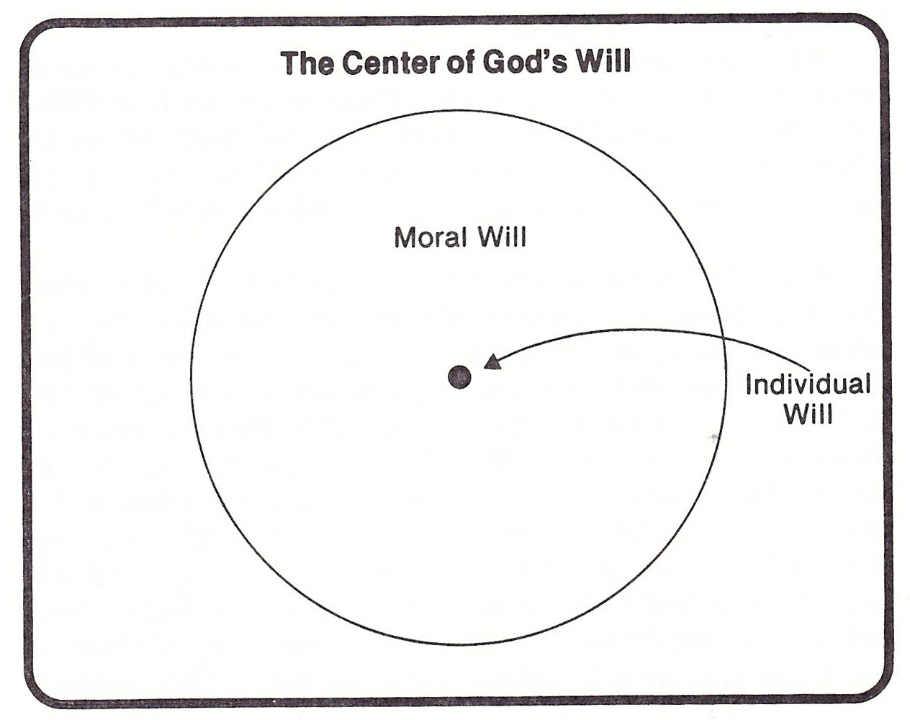

Slide 32
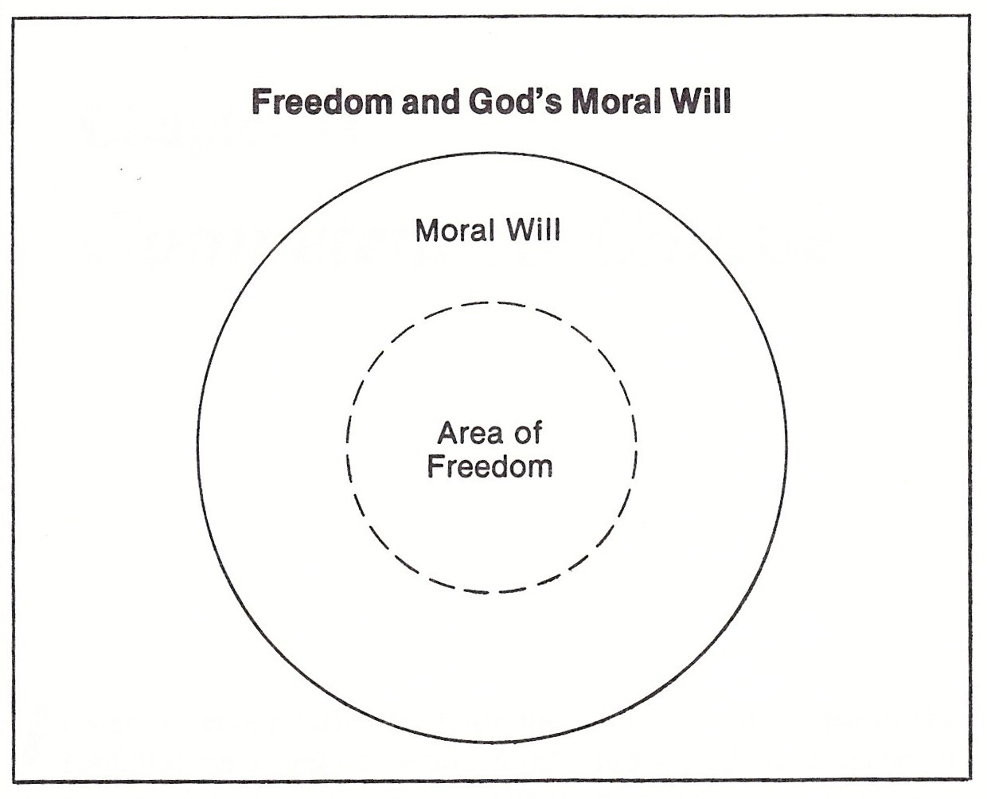

Slide 33
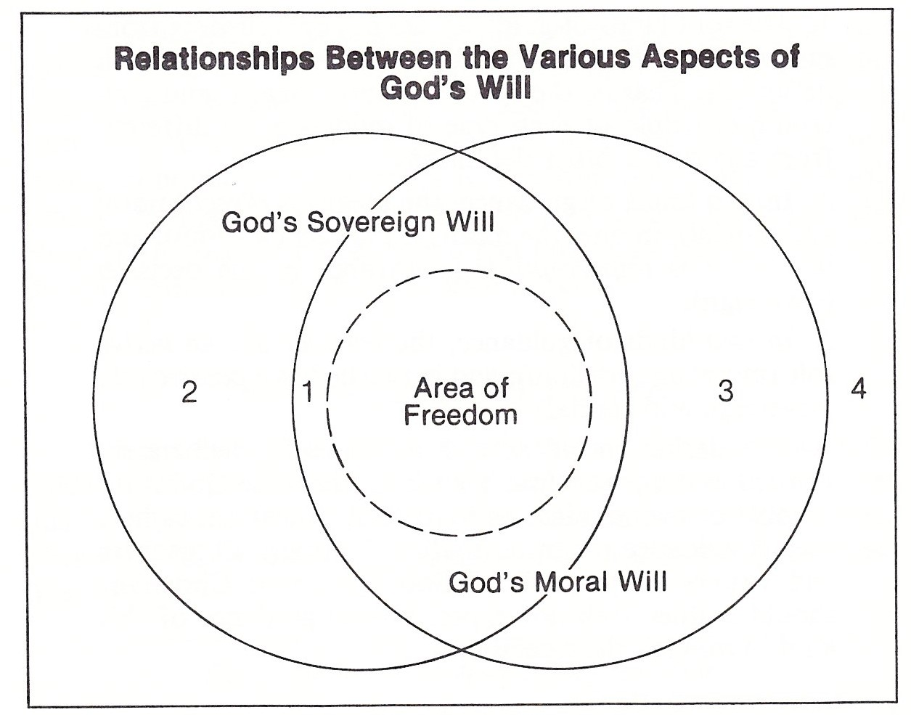

Slide 34
Deuteronomy 29:29:
“The secret things belong to the LORD our God, but the things that are revealed belong to us and to our children forever, that we may do all the words of this law.”

Slide 35
VI. THE WAY OF WISDOM.
God continues to speak—through his Word (period!).
We must expect no more revelation from God, no personal directions or private, secret messages from God.
We are to make our plans which accord with God’s revealed will and to acknowledge that God is free to interrupt them.

Slide 36
James 4:13-17
“Come now, you who say, “Today or tomorrow we will go into such and such a town and spend a year there and trade and make a profit”— ¹⁴yet you do not know what tomorrow will bring. What is your life? For you are a mist that appears for a little time and then vanishes. ¹⁵Instead you ought to say, “If the Lord wills, we will live and do this or that.” ¹⁶As it is, you boast in your arrogance. All such boasting is evil. ¹⁷So whoever knows the right thing to do and fails to do it, for him it is sin.”

Slide 37
VI. THE WAY OF WISDOM.
Within the area of freedom, some choices are wiser than others!

Slide 38
1 Corinthians 10:23-24:
“All things are lawful,” but not all things are helpful. “All things are lawful,” but not all things build up. ²⁴Let no one seek his own good, but the good of his neighbor.”

Slide 39
VI. THE WAY OF WISDOM.
Within the area of freedom, some choices are wiser than others!
Kevin DeYoung (Just Do Something)
Scripture
Counsel
Prayer

Slide 40
VI. THE WAY OF WISDOM.
Scripture: Not specific directions, but a transformed character that knows God’s way of holiness and what pleases God.
Counsel: Consulting believers who know God’s Word and who know you.
Prayer: Not for some phantom, individual will of God, but for wisdom, for a holy mind and a heart to please God.

Slide 41
VI. THE WAY OF WISDOM.
And then…
MAKE A DECISION!
(and your heavenly Father will bless you!)

Slide 42
VII. A TEST CASE: MARRIAGE.
What is God’s revealed will r.e. marriage?
Of the opposite sex.
Not a close relative.
Free to be married.
Of age/mind of consent.
Sharing your faith in Christ.

Slide 43
VII. A TEST CASE: MARRIAGE.
The way of wisdom r.e. marriage.
Scripture.
Counsel.
Prayer.
MAKE A DECISION!

Slide 44
QUESTIONS AND DISCUSSION

Slide 45
FUTURE SUMMER SEMINARS FOR 2016
June 28 “Anger Management: Quick to Listen, Slow to Speak, and Slow to Become Angry”
July 26 “L.G.B.Transgender: What’s All This Fuss about Bathrooms and Locker Rooms?”
August 9 “Marriage Tune-Up (1): Expectations and Empty love Tanks”
August 16 “Marriage Tune-Up (2): Sexual Pleasure in Marriage”
(All seminars are at the church and begin at 7:00 p.m.)

