Slide 1
Additional seminar titles for 2019:
Tuesday, July 9 “Ethical Systems and Ethical Anarchy”
Tuesday, July 23 “Moral Reasoning: Thinking Clearly and Virtuously”

Slide 2
Ethical Systems and Ethical Anarchy
Dr. Brian Janssen

Slide 3
The NEW MORALITY…
is a MORALITY!
Anything that disagrees with it…
is IMMORAL!
1. If you oppose a woman’s right to choose abortion at any time and for any
reason or no reason…
YOU are immoral.
2. If you think that marriage is between one man and one woman for life…
YOU are immoral.
3. If you do not agree with open borders and free everything for everyone…
YOU are immoral.
4. If you do not agree that people can choose their gender at will…
YOU are immoral.
5. If you make any moral judgments at all…
YOU are immoral.

Slide 4
If you are a Christian who subscribes to traditional, biblical morality…
YOU are immoral, and you should ashamed of yourself.
Your view and your voice has no place in this world any longer.
Liberal British theologian, Theo Hobson:
“For a cultural revolution to take place:
1. What was condemned must be celebrated.
2. What was celebrated must be condemned.
3. Those who will not now celebrate must be condemned.”
How did it come to this?
What is the rationale for such a surprising twist of events?
What are the moral and rational underpinnings of what we are seeing take place in our land with a breathtaking and head-spinning rapidity?

Slide 5
REVIEW
Last month in our first summer seminar we asked the question of whether or not God could serve as a basis for morality.
The surprising answer we heard from the author of a standard, college textbook on ethics was “No, God cannot be the basis for morality, for right and wrong.” Why not?
Because of a logical conundrum, we were told.
If something is right or wrong simply because God says it is so, then it is merely arbitrary.
And so what if God says that something evil is right?
On the other hand, if there is such a thing as objective morality, right and wrong, then even God has to submit to it. And so we can just skip God and go find that morality for ourselves.
So which is it? Is the good supreme or is God supreme?

Slide 6
And the surprisingly simple answer is what the Bible everywhere states. God does not simply know what is good, nor does God simply submit to what is good.
Rather, God IS good. Goodness is real, but goodness flows from God’s essential character. It is a false dichotomy to suggest that either goodness must be supreme or God must be supreme, one or the other, when goodness is contained within God himself. God is good. A perfectly good God is supreme and there is no incompatibility or division.
That answer is quite simple. And it made me wonder why the very intelligent author of this textbook couldn’t see it, why he had to resort to a logical fallacy, this false dichotomy, in order to dismiss God as the foundation of morality.
The reason is simple: the author is an atheist. He has already decided that there is no God, so, logically speaking, a non-existent God could not tell us right from wrong (cannot tell us anything!).
And then the author had to make the facts fit his beliefs. So he had to fudge on the truth.

Slide 7
That’s quite obvious. But this atheistic, secular perspective has convinced much of the world around us.
In fact, his view has now spun out of control and has gone in a direction I’m sure the author did not want it to go. It has spiraled into moral anarchy, so that explains where we are today.
Let’s review the intellectual and cultural shifts that have taken place over the last several centuries to bring us up to what we now find today.

Slide 8
Premodernism (325 A.D. – 1700s A.D.)
In the pre-modern, Western view, God was the source of all truth, mediated through the world he made and the Scriptures. Humanity could know objective truth through these means.
Revelation and reason lead to the knowledge of God.
GOD
|
TRUTH
/ \
NATURE SCRIPTURE
\ /
HUMANITY

Slide 9
Modernism (1700s A.D. – 1960s A.D.)
In the modern, Enlightenment view, God is no longer necessary. Objective truth is still available, but is discovered by observation and reason.
This universally recognized truth will lead to unity, peace, and progress for all. Modernism is cheerfully optimistic about the future.
GOD
|
TRUTH
/ \
NATURE SCRIPTURE
\ /
HUMANITY

Slide 10
Postmodernism (1960s-present)
In the mid-1900s, some would date this shift on the death of JFK, widespread pessimism gripped the Western world. Thinkers lost the bright optimism that modernists held about attaining a universal truth that would lead to global utopia.
What’s more, any universal truth claims became suspect. Truth claims were used by the powerful to exploit the weak. Any universal truth claim was considered exploitative, and so was rejected.

Slide 11
Postmodernism (1960s-present)
Not long ago a group of students from Pomona College in California sent a letter of protest to the college president David Oxtoby declaring that objective truth is a myth espoused by white supremacists.
“The idea that there is a single truth—‘the Truth’—is a construct of the Euro-West that is deeply rooted in the Enlightenment…. This construction is a myth and white supremacy, imperialism, colonization, capitalism, and the United States of America are all of its progeny. The idea that the truth is an entity for which we must search, in matters that endanger our abilities to exist in open spaces, is an attempt to silence oppressed people.”
That’s pretty amazing. In response, I would like to ask the authors of that letter whether they believe their assertion is actually, objectively true. Of course, they would have no answer. They would be forced to say: “It is true that nothing is true,” which is pure nonsense.

Slide 12
Postmodernism (1960s-present)
So there was no longer any Truth, only truths, individual truths. Truth became personal. There was no longer any objective reality. There is no “true truth” any longer, only “truths” or “beliefs” or “preferences.” Now if nothing is really true, then nothing can really be false. And if nothing is false, then it is impossible to lie. Anything we say may be true for us, so it cannot be a lie. Reality is what you decide it to be. One can “self-identify” as whatever they choose to be.

Slide 13
Postmodernism (1960s-present)
This has led to extreme relativism and individualism. The only thing I can now rely on in a postmodern context is my self.

Slide 14
Postmodernism (1960s-present)
So now we are left with only individual selfs living in and acknowledging only their own truth and their own reality. And the result, according to one observer is that the self is now
“shallow,
self-absorbed,
elusive,
leery of commitments,
unattached to people or place,
dedicated to keeping all options open,
frequently incapable of loyalty or gratitude.”

Slide 15
Postmodernism (1960s-present)
GOD
|
TRUTH
/ \
NATURE SCRIPTURE
\ /
HUMANITY
the self the self the self

Slide 16
Now if morality is merely personal, if something is not right for all but only right for me, if something can be right for me but not right for you, then everything may be right which means that nothing may be wrong.
Morality is now personal. You have your own moral code, I have mine, and there is no universal right or wrong to arbitrate between us. Right and wrong are only what I choose them to be.
This is what the author of the textbook did not anticipate, and when he deals with it, it’s clear that he doesn’t know how to handle it. He tries to be rational, but it doesn’t work because postmodernism is irrational.

Slide 17
Here’s why this is important. In a premodern worldview, we already have a morality divinely delivered by God’s Word. Of course we still have to apply biblical morality in the difficult or unusual cases, but we can all agree on the basics of what is right and wrong and why that is so.
But with these shifts, first away from God and Scripture, and then away from any kind of objective truth itself, we now have no foundation for truth or morality.
What is right and wrong? Ask ten people you will get twenty answers. What we now have are mere moral theories.
The textbook I use lists no less than eight moral theories, many of which would lead to conflicting and contradictory conclusions in deciding moral issues.
And then the student is informed that none of these is completely satisfying, so they have to choose a moral theory for themselves or perhaps construct their own. In other words, we are left with complete and irreconcilable moral anarchy.
And this is what’s being taught to college students today.

Slide 18
In the remaining time we will breeze through these eight most common moral theories introducing them to you.
At the end you may be able to identify the moral arguments you hear as people appeal to them: utilitarianism, natural law, virtue ethics, or cultural relativism, for example. You may already know something about each.
And then, after the break, I want to show you how, remarkably, biblical morality actually satisfies the goals of almost all of these moral theories.
Too bad we long ago left the “gold standard” of God’s Word.

Slide 19
I. MODERN ETHICAL SYSTEMS
By “modern” ethical systems, we do not mean ethics that are up to date, ethics that use indoor plumbing and have cell phones. Rather modern ethical systems have been developed from a modern worldview.
In this view, there is real, objective truth and morality, right and wrong, but we can learn these from nature and from reason. We don’t need God, and we don’t need the Bible to tell us.
Because these moral truths can be gleaned from nature and not from religion, everyone will agree, and we can all come together and live according to this new, rational, natural system of ethics. Or so they had hoped.

Slide 20
I. MODERN ETHICAL SYSTEMS
But how do you look to nature and discover what nature teaches us about ethics? This is much harder than they first thought.
And there are two main views on how nature and reason teach what is right and wrong. One is called the consequentialist method and the other is called the nonconsequentialist method.
In other words, one focuses on the impact of our moral decisions, what will happen if we choose this or that, and the other seeks to find universal rules which teach us right and wrong, no matter what the impact might be in particular instances.
And, alas, there are divisions in the consequentialist and nonconsequentialist camps as well. The two main consequentialist views ask whether to focus on the individual or to focus on the group.

Slide 21
A. Consequentialists ethics.
1. The first consequentialist ethic is called “ethical egoism.” In other words, you sit down and decide which course of action is best for you, which will lead to the greatest positive impact on yourself. And whatever you decide, that is right. That is what is moral. I am not making this up.
Whatever you think will bring the greatest good into your life is right, that is objectively good and right, and you must do it. It would be immoral to choose anything else. Your moral duty is to do what’s best for yourself, and that’s the moral duty of everyone else as well.
The main flaw in this theory becomes evident the first time two people meet in the middle of a one-lane bridge. “What is best for you” means that somebody is going to back up or go over the edge, not best for them.
However, I would argue that biblical ethics is very close to ethical egoism, rightly understood. Decide and choose what is best for you.

Slide 22
A. Consequentialists ethics.
2. The second consequentialist view is known as utilitarianism. The classic slogan of utilitarianism is “the greatest good for the greatest number.” It is associated with the modern philosophers
Jeremy Bentham (1748-1832)
John Stuart Mill (1806-1873)

Slide 23
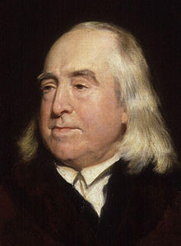
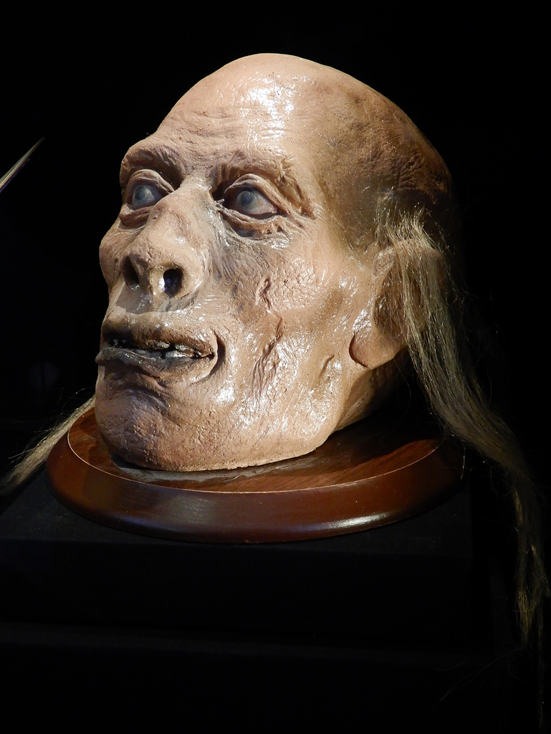

Slide 24
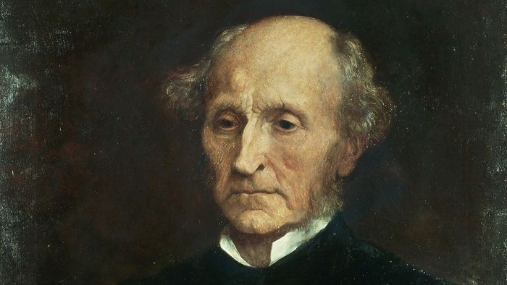

Slide 25
A. Consequentialists ethics.
2. The second consequentialist view is known as utilitarianism. The classic slogan of utilitarianism is “the greatest good for the greatest number.” It is associated with the modern philosophers
Jeremy Bentham (1748-1832)
John Stuart Mill (1806-1873)
It sounds so reasonable, “the greatest good for the greatest number.” That is until you find yourself in the minority, one who is not in the greatest number. Then it doesn’t work so well.
How is this different from ethical egoism?
Ethical egoism—“My happiness is most important.”
Utilitiarianism—“All are equal. Everyone’s happiness is important.” Total happiness for all is taken into consideration.

Slide 26
How to calculate “happiness”? Bentham devised what he called the “hedonic calculus.”
“His approach is straightforward in conception but complicated in details: For each possible action in a particular situation, determine the total amount of happiness or unhappiness produced by it for one individual (that is, the net happiness—happiness minus unhappiness). Gauge the level of happiness with seven basic characteristics such as intensity, duration, and fecundity (how likely the pleasure or pain is to be followed by more pleasure or pain). Repeat this process for all individuals involved and sum their happiness or unhappiness to arrive at an overall net happiness for that particular action. Repeat for each possible action. The action with the best score (the most happiness or least unhappiness) is the morally right one.” (86)

Slide 27
This includes only the total units of happiness, not necessarily the distribution.
Which is better? Out of ten people…
A. One receives 91 units and nine receive 1 unit = a score of 100 or
B. Ten receive 8 units each = a score of only 80
“A” is preferred because it creates a greater total of happiness units.
Like playing the lottery:
100 million people mildly disappointed and one person wildly happy: (is that a net gain or net loss of happiness units?)

Slide 28
What Is “Happiness”?
Bentham and Mill define happiness as “pleasure.”
Bentham considers only quantity.
Mill considers both quantity and quality.
Lower pleasures—eating, drinking, sexual pleasure
Higher pleasures—“pursuing knowledge, appreciating beauty, and creating art.”
Pleasure vs. Happiness vs. Joy
Pleasure: Eating ice cream!
Happiness: At Disneyworld with family!
Joy: A “make a wish” day because child is dying
Is that “happiness”?
Would a majority agree with Mill’s hierarchy of higher and lower pleasures?
(Remember, this ethical system must be objective so that all can see its truthfulness and all would agree with and abide by it. Does it actually work?)

Slide 29
B. Nonconsequentialist Ethical Systems
Nonconsequentialist ethical systems do not ignore the impact of moral decisions, but it is not the first consideration. Rather, nonconsequentialist ethics seeks to find broad principles to follow, principles which are objectively true, which all will agree with and gladly follow.
One nonconsequentialist view was pioneered by German philosopher Immanuel Kant (1724-1804).

Slide 30
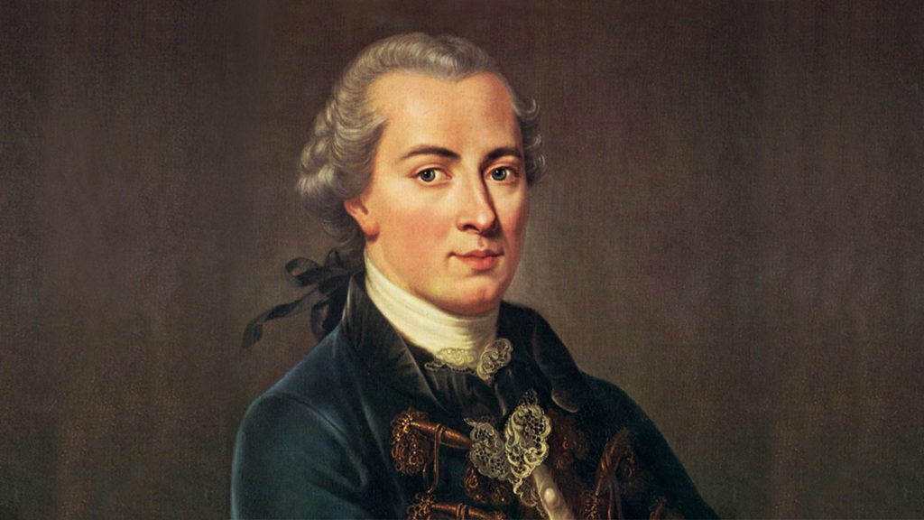

Slide 31
B. Nonconsequentialist Ethical Systems
Nonconsequentialist ethical systems do not ignore the impact of moral decisions, but it is not the first consideration. Rather, nonconsequentialist ethics seeks to find broad principles to follow, principles which are objectively true, which all will agree with and gladly follow.
One nonconsequentialist view was pioneered by German philosopher Immanuel Kant (1724-1804).
His ethical system became known as “the categorical imperative.” A categorical imperative is a rule that is always true and which you must always follow in every situation. He described his view in three different ways. Many think that he was really describing three different ethical systems or principles.

Slide 32
The two most important forms of Kant’s “categorical imperative” are:
First, THE categorical imperative is this: “In every moral choice, do that which you would want to become a universal law that all must follow.” For example, if you are hungry and are tempted to steal bread, would you want that to become a universal law: “It is a moral good to steal bread if you are hungry.”?
You should be willing to allow people to steal bread from you if they are hungry.
Kant: “Act on that maxim which you can at the same time will that it should become a universal law.” This is your duty, and you must do it.
Another of Kant’s versions of THE categorical imperative principle is “the means-end principle.” Always treat people as ends, not as mere means to something else. People are the goal, not merely the tools to be used to accomplish another purpose.

Slide 33
Kant bases this on the fact that people are rational creatures.
“Persons alone have intrinsic value and dignity because they, unlike the rest of creation, are rational agents who are free to choose their own ends, legislate their own moral laws, and assign value to things in the world. People are the givers of value, so they must have ultimate value. They therefore must always be treated as ultimate ends and never merely as means.”

Slide 34
The other main form of nonconsequentialist ethics is the natural law theory pioneered by theologian and philosopher Thomas Aquinas (1225-1274), having its roots in ancient Greek and Roman philosophy.

Slide 36
The other main form of nonconsequentialist ethics is the natural law theory pioneered by theologian and philosopher Thomas Aquinas (1225-1274), having its roots in ancient Greek and Roman philosophy.
We cannot really say that this is a “modern” ethical system because it does not fit the time frame. However, it purports to be an objective basis for morality derived not from God or Scripture, but from nature and reason. This has become the standard ethical system of the Roman Catholic Church.
“Natural law” is that which we can determine from nature itself, including human nature.
Nature itself is rationally ordered and aims at certain purposes.
“How nature is reveals how it should be.”
An acorn steadily grows into a tall and sturdy oak. If that does not happen, if it dies early or is weak or deformed, that is not natural and hence, not good.
For humans the natural and good is that toward which humans naturally strive. If we consider the natural, what is, we can determine the moral, what should be.

Slide 37
What does human nature rightly aim for?
Aquinas:
Preservation of human life
Avoidance of harm
Basic functions that humans and animals share (reproduction, raising offspring, etc.)
Searching for truth
Nurturing social ties
Behavior that is benign and reasonable
How do we learn this?
Nature is ordered and rational.
Humans have the gift of reason.
So humans can discern the inclinations of nature.

Slide 38
Natural law is both objective and absolute: true for all and under all circumstances. Since pregnancy is the natural result of sex, natural law would forbid both contraception and elective abortion, which is the Roman Catholic position.
What about inconsistencies?
A pregnant woman needs chemotherapy to live, but that will kill the unborn child.
Aquinas devised the “doctrine of the double effect:”
Performing a good action may be permissible even if it has bad effects, but performing a bad action for the purpose of achieving good effects is never permissible, and any bad effects must be unintended.
So attempting to do the good, chemotherapy, would be permitted, even if it had the bad side effect of killing the unborn child. However, deliberately doing the bad, aborting the child to save the mother, would not be permitted.

Slide 39
Problems with “Modern” Ethical Systems
1. These supposedly objective moral systems lead to conflicting conclusions. Therefore, they cannot all be right.
2. They all assume that HUMAN good is most important. They are all based on the philosophy of secular HUMANISM.
But many critics object: “Who says that humans are better than any other species?” This view is “speciesism.”
Princeton ethicist Peter Singer argues that an adult cat has more moral worth than a human infant, because an adult cat is more self-aware.
So if you are in the median of a superhighway and notice an adult cat in a cage in the middle of one lane and a human infant in a stroller in the other lane, which direction do you run first?
Save the cat! It has more moral worth.
(Humans have no right to eat non-human animals, either.)

Slide 40
C. Virtue Ethics.
A third category of modern ethics is called “virtue ethics.” It doesn’t fit neatly under the consequentialist or nonconsequentialist banner.
Def. “A theory of morality that makes virtue its central concern.”
Consequentialist Ethics: “Maximize the good.”
Nonconsequentialist Ethics: “Do your duty.”
Virtue Ethics: “Be a good person.”
Morality does not depend on the outcome, nor on the rule, but on a person’s moral virtues or character. So cultivate moral virtues.
Most trace virtue ethics back to the great Greek philosopher Aristotle (384-322 B.C.)

Slide 41
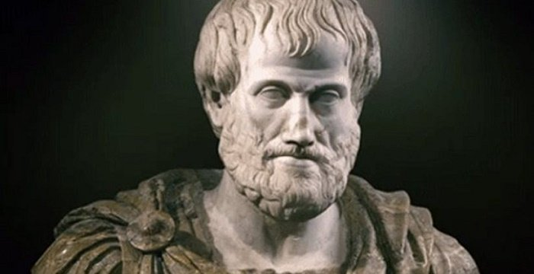

Slide 42
C. Virtue Ethics.
Aristotle explored subjects like causation and determining and distinguishing means and ends. Living beings naturally have a certain end for which they strive.
According to Aristotle, human beings strive for the end he called eudaimonia: happiness or flourishing—the full realization of the good life.
Humans were uniquely gifted with reason, and so to achieve our end of eudaimonia we must live fully in accord with reason.
Virtues are “rational modes of behaving.” So to achieve our end of happiness or flourishing, we must cultivate these virtues.
A virtue is “a stable disposition to act and feel according to some ideal or model of excellence.” It is a character trait that is deeply engrained in us so that we naturally act according to this form of excellence.

Slide 43
C. Virtue Ethics.
Aristotle distinguished between intellectual virtues and moral virtues.
What would be examples of intellectual virtues?
Wisdom, rationality, clear thinking logic.
What would be examples of moral virtues?
Classic “cardinal” virtues justice, temperance, prudence, and fortitude, but also mercy, honesty, loyalty.
Intellectual virtues can be taught, according to Aristotle, but moral virtues must be learned through practice. Habit shapes our character to act and react according to moral virtue.

Slide 44
Aristotle taught that virtue is what we find at what he called “the Golden Mean.”
Perhaps you’ve heard the principle “moderation in all things,” and this is similar. The Golden Mean is the midpoint between two extremes. For example,
cowardice COURAGE recklessness
asceticism MODERATION gluttony
justice MERCY injustice
dictatorship DEMOCRACY anarchy

Slide 45
Today virtue ethicists pick and choose among Aristotle’s teachings.
Today’s virtue ethicists often reject:
1. teleological view of humans as having a pre-programmed “end” such as “flourishing”
2. “Golden Mean” as a measure of virtue.
Today’s virtue ethicists often embrace:
1. emphasis on character vs. rules
2. duty-based morality is “barren” and “one-dimensional.”
a. Cultivation of virtue is the way to human happiness.
b. True ethics must take into account human feelings, motives, intentions, etc. Acting only out of duty seems empty, while acting out of compassion is more robust and genuine.

Slide 46
In marriage, would you want to be treated well only out of duty? Or would you want to be treated well out of affection?
Is there anything incompatible between duty ethics and virtue ethics?
Only if you insert the word “only.” If one performs an act ONLY out of duty, it may lack virtue. If one performs an act ONLY out of virtue, it may lack morality (duty).
Why can’t an act be both a duty (morally right) and done out of virtue, because it is in the best interest of others for whom you care?
Virtue ethics can recognize certain actions as wrong because they lack a certain virtue, such as honesty.

Slide 47
John does not lie to get out of trouble because he has cultivated the virtue of honesty all his life. He would not even think of lying to protect himself.
But the reason he does not lie is not because lying is morally wrong and he must do his duty of telling the truth. Rather, honesty is a virtue he prizes.
He wants to be an honest person because he thinks it is the best way of life, that being honest will produce the eudaimonia (happiness, flourishing) he desires for himself.
So even though honesty in some particular situation may cause inconvenience or pain in the moment, he is aiming for a larger goal: flourishing. And this, he believes, will be best for him in the long run.
What consequentialist moral theory is this similar to?
Ethical egoism says that something is right because it is in my best interest. Virtue ethics says that something is right because it flows from cultivated virtue WHICH WILL BE BEST FOR ME IN THE LONG RUN.

Slide 48
EVALUATION OF VIRTUE ETHICS
Many duty ethicists will concede that doing the right thing from the right motive is superior.
Duty alone may lead to right actions, but actions that are bereft of compassion (unless one sees “compassion” as a part of one’s “duty”).
The problem is in the sense of “alone.” Duty alone or virtue alone.
Virtue alone may not be the best guide to moral acts.
Duty alone may not be the best way of performing moral acts.
“Do the right thing for the right reason and with the right motive.”

Slide 49
Problems with Virtue Ethics
1. Circular reasoning:
A right action is what a virtuous person does, and
A virtuous person does a right action.
But what specifically is a “right” action? (The content is undefined)
And what is “virtue” or “moral excellence”?
It seems to require some outside standard.
And if it does, then do all agree on what is “virtue” or “moral excellence”?

Slide 50
2. Another problem with virtue ethics arises when virtues seem to be in conflict. What virtues are placed in conflict in the following situation?
“You know that your friend committed a crime and you are called to testify against her.”
Honesty (a virtue) vs. Loyalty (a virtue)
What would a virtuous person do?
It would be virtuous to testify against your friend (honesty) and it would not be virtuous to testify against your friend (loyalty). This comes close to violating the law of non-contradiction!
“To testify is virtuous and not-virtuous at the same time and in the same relation.”
If that is the case, then virtue ethics lacks coherence, our first criteria for evaluating a moral theory, and so it fails from the start.

Slide 51
II. POSTMODERN ETHICAL SYSTEMS
A. Subjective Relativism
B. Cultural Relativism
C. Emotivism
A. Subjective Relativism.
“The view that an action is morally right if one approves of it.”
“Subjective relativism says that action X is right for Ann if she approves of it yet wrong for Greg if he disapproves of it. Thus action X can be both right and wrong—right for Ann but wrong for Greg. A person’s approval of an action makes it right for that person. Action X is not objectively right (or wrong). It is right (or wrong) relative to individuals.” (21) So right or wrong becomes a matter of personal taste.

Slide 52
II. POSTMODERN ETHICAL SYSTEMS
A. Subjective Relativism.
On what basis could a subjective relativist decide something is right or wrong? On any basis except one.
One could not give objective reasons or objective evidence.
Why not? Because if one argued that something was right or wrong based on objective (always true) evidence, then someone who disagreed with you would be in error, i.e., wrong.
So the only basis for the subjective relativist to decide what is right or wrong could only be personal preference.

Slide 53
II. POSTMODERN ETHICAL SYSTEMS
Problems with Subjective Relativism.
1. It implies that the person rendering the moral judgment is infallible. One cannot be wrong. By definition, one cannot have a wrong “preference.” How would you argue with someone who says, “My favorite food is steak.”? In subjective relativism, our approval makes an action right or wrong.
2. Moral disagreements are then impossible. One says capital punishment is right, another says it is wrong.
But moral disagreements and discussions occur all the time. And how does one settle an issue?
Either a society permits or does not permit capital punishment. So subjective relativism seems impossible to practice with consistency.

Slide 54
II. POSTMODERN ETHICAL SYSTEMS
B. Cultural Relativism.
“The view that an action is morally right if one’s culture approves of it.”

Slide 55
II. POSTMODERN ETHICAL SYSTEMS
B. Cultural Relativism.
Cultural relativism seems to encourage tolerance, but “there is no necessary connection between tolerance and cultural relativism.” (26)
Why not? Because “tolerance” is a moral value. And a moral value is only right or wrong because a culture endorses it.
What if a culture does not endorse tolerance? Then, for that culture, that is right. And they may then rightly seek to impose their values on another culture, and that would be right for them.
If one argues that tolerance is a universal moral good that must be practiced by all, then cultural relativism cannot be true.

Slide 56
II. POSTMODERN ETHICAL SYSTEMS
Problems with Cultural Relativism
1. As with subjective relativism, cultural relativism assumes moral infallibility. If whatever a culture says is right, then the culture cannot be wrong.
2. Then social reformers, those who desire to change the cultural norms would always be wrong (because the culture is always right).
3. If the culture is always right and you disagree, you automatically lose. What if two within a culture disagree on a moral issue? If right and wrong = whatever the culture endorses as a particular view, a moral disagreement can only be on whether or not the culture agrees with it.

Slide 57
II. POSTMODERN ETHICAL SYSTEMS
Problems with Cultural Relativism
4. And just as a culture cannot be criticized from anyone on the inside, so the culture cannot be criticized from the outside. Why? Because whatever the culture declares is right is right. What if the culture is committing great atrocities against minority members of that culture (e.g. Hitler’s “final solution” of killing Jews because they were born Jews)? If the culture approved, then it would be right.
5. The same applies to the matter of tolerance. Tolerance is the right to disagree. As with subjective relativism, in cultural relativism, you may have a right to disagree with the culture, but it’s irrelevant, because you are by definition in the wrong.
6. Cultural relativism suffers from the practical problem of being nearly impossible to implement. What is the “culture” which decides the moral norm? Is it the government, elected by a majority? Is it the subculture that I am a part of ? Is it my small group of friends? My family? My clan? Is it the whole world order?

Slide 58
II. POSTMODERN ETHICAL SYSTEMS
C. Emotivism.
“The view that moral utterances are neither true nor false but are expressions of emotions or attitudes.” (21)
“The commonsense view of moral judgments is that they ascribe moral properties to such things as actions and people and that they are therefore statements that can be true or false. This view of moral judgments is known as cognitivism. The opposing view, called noncognitivism, denies that moral judgments are statements that can be true or false; they do not ascribe properties to anything. Probably the most famous noncognitivist view is emotivism, which says that moral judgments cannot be true or false because they do not make any claims—they merely express emotions or attitudes. For the emotivist, moral utterances are something akin to exclamations that simply express approving or disapproving feelings: ‘Violence against women—disgusting!’ or ‘Shoplifting—love it!”

Slide 59
II. POSTMODERN ETHICAL SYSTEMS
C. Emotivism.
So instead of using a rational basis to determine what is good or bad, one uses an emotional basis.
But this changes the dynamic. When it comes to emotions, nothing is good or bad but rather pleasant or unpleasant, desirable or repulsive. “People can only agree on attitudes, not in beliefs.” (31)
So influencing the moral views of others is not a rational appeal to the mind, only an appeal to the feelings toward an issue. Any facts will do, so long as they impact the emotions. “Perhaps the most far-reaching implication of emotivism is that nothing is actually good or bad. There simply are no properties of goodness or badness. There is only the expression of favorable or unfavorable emotions or attitudes toward something.” (31)

Slide 60
II. POSTMODERN ETHICAL SYSTEMS
C. Emotivism.
And don’t forget that shame is a powerfully motivating feeling.
This has created what is known as “virtue signaling”:
“refers to the public expression of an opinion on a given topic primarily for the purpose of displaying one’s moral superiority before a large audience to solicit their approval. Online, the practice is often associated with various platitudes shared on social media that proclaim one's political affiliation or stance on a variety of hot-button issues related to social justice; it has been criticized by some as a shallow attempt at improving social status within a particular group.”
So great is the fear of rejection and shame for not taking the “right” view on moral matters, one wears the ribbon or rainbow patch or puts the “coexist” bumper sticker on their car to show that they are on the right side of things even though they may not lift a finger to offer any practical support or help. People are shamed into agreeing with some issue.

Slide 63
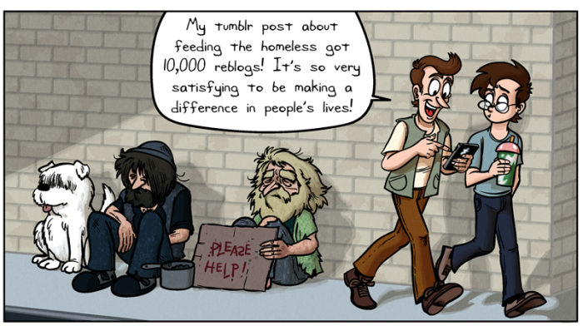

Slide 64
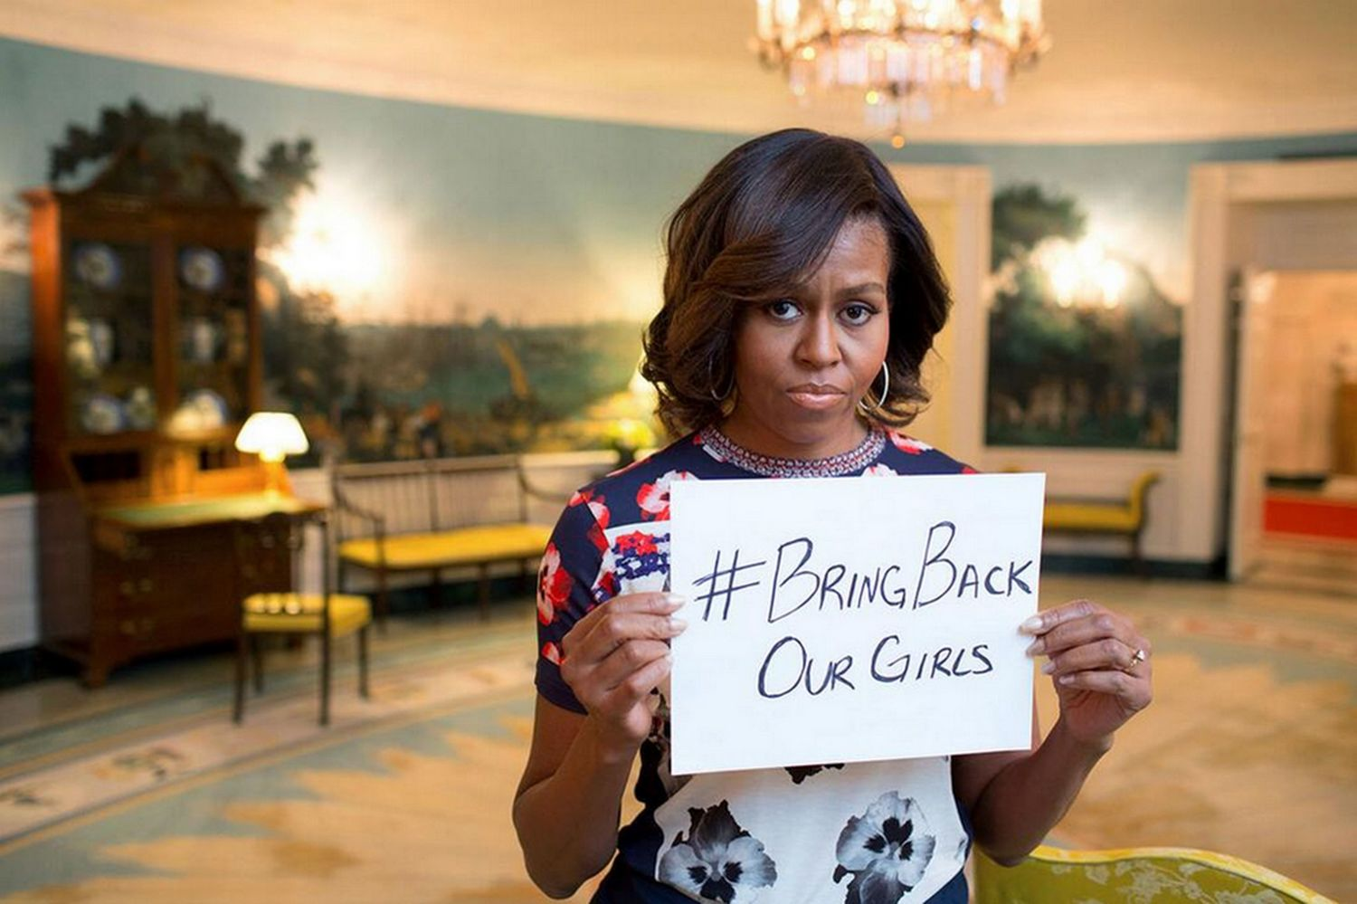

Slide 65
Additional seminar titles for 2019:
Tuesday, July 9 “Ethical Systems and Ethical Anarchy”
Tuesday, July 23 “Moral Reasoning: Thinking Clearly and Virtuously”

Slide 66
Summary
To look to God for knowing right from wrong is irrational.
So you must find another basis for morality.
Modern Ethics
Consequentialist
1. Ethical Egoism
2. Utilitarianism
Nonconsequentialist
3. Kant’s Categorical Imperative
4. Natural Law
5. Virtue Ethics
Postmodern Ethics
6. Subjective Relativism
7. Cultural Relativism
8. Emotivism

Slide 67
Summary
1. Ethical Egoism
2. Utilitarianism
3. Kant’s Categorical Imperative
4. Natural Law
5. Virtue Ethics
6. Subjective Relativism
7. Cultural Relativism
8. Emotivism
Eight moral theories in conflict with each other, leading to incompatible conclusions:
Pick one!

Slide 68
HOW TO SPEAK TO A MORALLY CHAOTIC WORLD.
1. We should remember that there is still a residual conscience informed by the remnants of biblical morality, and by the law of God written on the heart (Rom. 2:15).
But these are wearing thin and being replaced by the new morality. I was surprised how conservative my students were, unaware of the stranger trends in the culture.

Slide 69
HOW TO SPEAK TO A MORALLY CHAOTIC WORLD.
2. Our goal is not to somehow “capture the culture,” but to make disciples of all nations (Matt. 28:19-20). We need to be about the work of baptizing our children and new converts into the faith and teaching them to “obey” everything Jesus commanded, which points to both truth and morality.
Remember, the moral chaos of today is similar to the moral chaos of the Greco-Roman world in the days of the apostles. There was no consistent biblical ethic. In fact, it was the moral chaos of the day that drew many people to the moral stability and moral beauty of the biblical ethic. Many saw an obvious moral superiority in Judaism and later the Christian fellowship.

Slide 70
HOW TO SPEAK TO A MORALLY CHAOTIC WORLD.
3. How do we speak to others in our culture when they instinctively judge every word out of our mouths as immoral?
a. Moral consistency. Biblical ethics alone “work” because they alone are consistent with the world God has made. “All truth is God’s truth.” So we can live consistently in continual faith, repentance, and obedience to Christ.
b. Logical consistency. The biblical faith and ethic alone “make sense.” In my class at NCC I try to show how these various alternative ethical systems are logically inconsistent, both internally and externally. Again, only the biblical worldview can be maintained, for it alone is consistent.
c. Practical consistency. With God’s help, we must live consistently, consistent with the biblical faith. We must not simply talk about the superiority of God’s way, but by our joyfully living before the face of God. One of God’s strategies for reaching the nations is enabling us to live in hope.

Slide 71
HOW TO SPEAK TO A MORALLY CHAOTIC WORLD.
In 1 Peter 3, Peter calls for a high quality of moral obedience to Christ and then describes one of its byproducts:
⁸ Finally, all of you, have unity of mind, sympathy, brotherly love, a tender heart, and a humble mind. ⁹ Do not repay evil for evil or reviling for reviling, but on the contrary, bless, for to this you were called, that you may obtain a blessing. ¹⁰ For
“Whoever desires to love life
and see good days,
let him keep his tongue from evil
and his lips from speaking deceit;
¹¹ let him turn away from evil and do good;
let him seek peace and pursue it.
¹² For the eyes of the Lord are on the righteous,
and his ears are open to their prayer.
But the face of the Lord is against those who do evil.”

Slide 72
HOW TO SPEAK TO A MORALLY CHAOTIC WORLD.
¹³ Now who is there to harm you if you are zealous for what is good? ¹⁴ But even if you should suffer for righteousness’ sake, you will be blessed. Have no fear of them, nor be troubled, ¹⁵ but in your hearts honor Christ the Lord as holy, always being prepared to make a defense to anyone who asks you for a reason for the hope that is in you; yet do it with gentleness and respect, ¹⁶ having a good conscience, so that, when you are slandered, those who revile your good behavior in Christ may be put to shame. ¹⁷ For it is better to suffer for doing good, if that should be God’s will, than for doing evil.

Slide 73
Additional seminar titles for 2019:
Tuesday, July 9 “Ethical Systems and Ethical Anarchy”
Tuesday, July 23 “Moral Reasoning: Thinking Clearly and Virtuously”

