Slide 1
Fear God or Fear Everything:
The Fear of the Lord Destroying All Other Fears

Slide 2
July 10 “Attachment Disorder: Explanation? Excuse? How a ‘Diagnosis’ May Help or Hinder Sanctification”
August 14 “Rules for Radical Christians: Fighting (Cultural) Fire with the Love of Christ”
August 28 “Biblical Economics”—What the Bible Says about Stewardship
All seminars are Tuesday nights at 7:00 p.m.

Slide 3
Introduction: The widespread Impact of Fear
Obsessive-Compulsive Disorder (OCD)
Phobias
Panic attacks
Some forms of insomnia
Post-Traumatic Stress Disorder (PTSD)
The fear of people through peer-pressure to conform
Generalized anxiety disorder
Avoidant personality
Persecutory delusions
Paranoid schizophrenia
Separation anxiety disorder
Overreaction to circumstances: attacks, assaults, litigation, withdrawal, depression, and even suicide
Openness to the arguments of fear-mongers

Slide 4
I. WHAT THIS IS NOT ABOUT.
Fear is a good gift of God
This is not about healthy fear/respect of serious dangers
The Sixth Commandment: “You shall not kill.”
WSC #69L “The Sixth Commandment forbiddeth the taking away of our own life, or the life of our neighbor unjustly, or whatsoever tendeth thereunto.”
This is not about escape from full emotional participation in life.
Not Stoicism: “imperturbability”

Slide 5
Romans 12:15: “Rejoice with those who rejoice, weep with those who weep.”
2 Corinthians 11:28-29: “And, apart from other things, there is the daily pressure on me of my anxiety for all the churches. Who is weak, and I am not weak? Who is made to fall, and I am not indignant?”
I Thessalonians 3:6-10: “But now that Timothy has come to us from you, and has brought us the good news of your faith and love and reported that you always remember us kindly and long to see us, as we long to see you—for this reason, brothers, in all our distress and affliction we have been comforted about you through your faith. For now we live, if you are standing fast in the Lord. For what thanksgiving can we return to God for you, for all the joy that we feel for your sake before our God, as we pray most earnestly night and day that we may see you face to face and supply what is lacking in your faith?”

Slide 6
Ii. WHAT THIS IS ABOUT.
God’s Word commands us to “fear not,” “do not fear,” “do not be afraid,” or “be not afraid” over 100 times.
God is graciously condemning the kind of fear that would cause us to disobey him:
1) not trusting his person or promise so that we do not act upon it,
2) or deliberately disobeying his commands out of the fear of threat or loss
Examples:
Sunday sports tournaments for children
Peer pressure to compromise: children, youth, and adults
Pressure to lower standards for the sake of future happiness, (e.g. marriage)
Not that which makes a man tremble on the battlefield
That which would make a man desert his post on the battlefield
Think you are immune from this kind of fear? One word….
EVANGELISM!!!

Slide 7
IiI. WHY WE FEAR.
unsettledness uncertainty uneasiness
anxiety angst

Slide 8
IiI. WHY WE FEAR.
unsettledness uncertainty uneasiness
anxiety angst
terror, panic, dread, horror, anguish, alarm, dismay, woe, shame, self-loathing, despair
The justly-deserved, inescapable, unending,
unendurable wrath of a holy, almighty,
and all-seeing God!

Slide 9
Romans 1:18-20: “For the wrath of God is revealed from heaven against all ungodliness and unrighteousness of men, who by their unrighteousness suppress the truth. For what can be known about God is plain to them, because God has shown it to them. For his invisible attributes, namely, his eternal power and divine nature, have been clearly perceived, ever since the creation of the world, in the things that have been made. So they are without excuse.”

Slide 10
IiI. WHY WE FEAR.
unsettledness uncertainty uneasiness
anxiety angst
terror, panic, dread, horror, anguish, alarm, dismay, woe, shame, self-loathing, despair
The justly-deserved, inescapable, unending,
unendurable wrath of a holy, almighty,
and all-seeing God!

Slide 11
Iii. Why we fear.
The real problem is that people are not afraid enough.
God’s Word repeatedly reminds us of the reality of hell.
“outer darkness where there is weeping and gnashing of teeth.” (Jesus)
Gehenna: “where the worm does not die and the fire is not quenched” (Jesus)
Revelation 19:20: “the lake of fire that burns with sulfur.”

Slide 12
Hosea 10:7-8: “Samaria’s king shall perish like a twig on the face of the waters. The high places of Aven, the sin of Israel, shall be destroyed. Thorn and thistle shall grow up on their altars, and they shall say to the mountains, Cover us, and to the hills, Fall on us.”
Luke 23:29-30: “For behold, the days are coming when they will say, ‘Blessed are the barren and the wombs that never bore and the breasts that never nursed!’ Then they will begin to say to the mountains, ‘Fall on us,’ and to the hills, ‘Cover us.’”
Revelation 6:15-17: “Then the kings of the earth and the great ones and the generals and the rich and the powerful, and everyone, slave and free, hid themselves in the caves and among the rocks of the mountains, calling to the mountains and rocks, “Fall on us and hide us from the face of him who is seated on the throne, and from the wrath of the Lamb, for the great day of their wrath has come, and who can stand?”

Slide 13
Iii. Why we fear.
The real problem is that people are not afraid enough.
God’s Word repeatedly reminds us of the reality of hell.
“outer darkness where there is weeping and gnashing of teeth.” (Jesus)
Gehenna: “where the worm does not die and the fire is not quenched” (Jesus)
Revelation 19:20: “the lake of fire that burns with sulfur.”
Should we try to alleviate the fears of the unrepentant?
No, God wants the unrepentant to be afraid!
There were some people to whom Jesus did not say, “Fear not.”
The rich, young ruler (Mark 10)
Nicodemus (John 3)
The traumatized of Luke 13
UNBELIEVERS ARE NOT AFRAID ENOUGH—AND IT’S LARGELY OUR FAULT.

Slide 14
Iii. Why we fear.
We need a healthy fear of that which is DANGEROUS.
Who is the most dangerous Person of all?

Slide 15
Matthew 10:28:
“And do not fear those who kill the body but cannot kill the soul. Rather fear him who can destroy both soul and body in hell.”

Slide 16
IV. THE ANSWER TO FEAR.
So what do we do about this fear?
The answer is obvious:
repent and believe the good news of the gospel!

Slide 17
Romans 8:1
“There is therefore now no condemnation for those who are in Christ Jesus.”

Slide 18
IiI. WHY WE FEAR.
unsettledness uncertainty uneasiness
anxiety angst
terror, panic, dread, horror, anguish, alarm, dismay, woe, shame, self-loathing, despair
The justly-deserved, inescapable, unending,
unendurable wrath of a holy, almighty,
and all-seeing God!

Slide 19
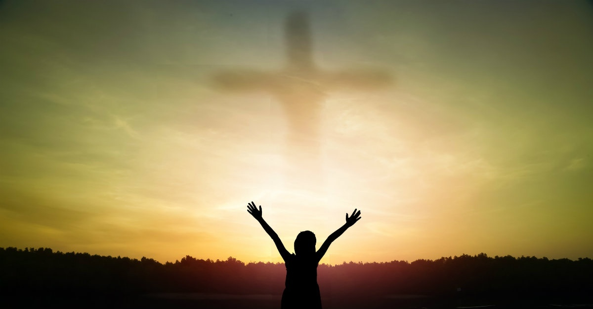
IiI. WHY WE FEAR.
unsettledness uncertainty uneasiness
anxiety angst
STEADFAST LOVE & FAITHFULNESS

Slide 20
IV. THE ANSWER TO FEAR.
Levels of Gospel Impact
6. Love
5. Reverence
4. Zeal
3. Affection
2. Relief
1. Incredulity

Slide 21
v. The fear of the lord.
If the fear of the Lord is the beginning of wisdom, what is wisdom’s end?
If we do not fear the Lord, if we are unrepentant, then we are still under his judgment. So any possible threat to our physical life, becomes an intense matter for fear, because it will deliver us to the horror.

Slide 22
Amos 5:18-20:
“Woe to you who desire the day of the LORD! Why would you have the day of the LORD? It is darkness, and not light, as if a man fled from a lion, and a bear met him, or went into the house and leaned his hand against the wall, and a serpent bit him. Is not the day of the LORD darkness, and not light, and gloom with no brightness in it?”

Slide 23
v. The fear of the lord.
If the fear of the Lord is the beginning of wisdom, what is wisdom’s end?
If we do not fear the Lord, if we are unrepentant, then we are still under his judgment. So any possible threat to our physical life, becomes an intense matter for fear, because it will deliver us to the horror.
Fear God or Fear Everything! Anything could deliver you to God’s justice.

Slide 24
July 10 “Attachment Disorder: Explanation? Excuse? How a ‘Diagnosis’ May Help or Hinder Sanctification”
August 14 “Rules for Radical Christians: Fighting (Cultural) Fire with the Love of Christ”
August 28 “Biblical Economics”—What the Bible Says about Stewardship
All seminars are Tuesday nights at 7:00 p.m.

Slide 25
vi. Why Christians still fear.
?

Slide 26
IV. WHY CHRISTIANS STILL FEAR.
Unsettledness? Uncertainty? Uneasiness?
Anxiety? Angst?
STEADFAST LOVE & FAITHFULNESS

Slide 27
vi. Why Christians still fear.
If the “mother of all storms” has already passed, why are Christians still plagued with fear?
We are not seeking freedom from healthy fear of real dangers.
We are not seeking “imperturbability.”
We want to vanquish fear that would lead us to disobey God.
Why are God’s dear people still plagued by these kinds of fears?
Because we have not yet fully grasped the amazing grace of the gospel!

Slide 28
1 John 4:14-18:
“And we have seen and testify that the Father has sent his Son to be the Savior of the world. Whoever confesses that Jesus is the Son of God, God abides in him, and he in God. So we have come to know and to believe the love that God has for us.
God is love, and whoever abides in love abides in God, and God abides in him. By this is love perfected with us, so that we may have confidence for the day of judgment, (see the primordial threat here, the mother of all storms?) because as he is so also are we in this world. There is no fear in love, but perfect love casts out fear. For fear has to do with punishment, and whoever fears has not been perfected in love.”

Slide 29
vi. Why Christians still fear.
If the “mother of all storms” has already passed, why are Christians still plagued with fear?
We are not seeking freedom from healthy fear of real dangers.
We are not seeking “imperturbability.”
We want to vanquish fear that would lead us to disobey God.
Why are God’s dear people still plagued by these kinds of fears?
Because we have not yet fully grasped the amazing grace of the gospel!
It’s a matter of sanctification

Slide 30
vii. God is worthy of our trust.
We must “come to know and to believe the love that God has for us.”
The Christian faith is a way, not a moment.
The Christian faith is not an insight, though it contains many insights, truths from God’s Word.
The Christian faith is not a feeling, though it certainly involves our feelings, our affections.
The Christian faith is not a decision, though it includes all of our decisions, a steadfast commitment to Christ.
The Christian faith is a way, a path which we walk, step-by-step, all through life.
And three particular truths about God are most helpful when it comes to addressing and overcoming sinful fear:
that God is good, that God is wise, and that God is powerful.

Slide 31
Romans 8:31-30:
GOD’S GOODNESS
“31 What then shall we say to these things? If God is for us, who can be against us? 32 He who did not spare his own Son but gave him up for us all, how will he not also with him graciously give us all things?”

Slide 32
Romans 8:31-30:
GOD’S WISDOM
“33 Who shall bring any charge against God’s elect? It is God who justifies. 34 Who is to condemn? Christ Jesus is the one who died—more than that, who was raised—who is at the right hand of God, who indeed is interceding for us.”

Slide 33
Romans 8:31-30:
GOD’S POWER
“35 Who shall separate us from the love of Christ? Shall tribulation, or distress, or persecution, or famine, or nakedness, or danger, or sword? 36 As it is written, “For your sake we are being killed all the day long; we are regarded as sheep to be slaughtered.” 37 No, in all these things we are more than conquerors through him who loved us. 38 For I am sure that neither death nor life, nor angels nor rulers, nor things present nor things to come, nor powers, 39 nor height nor depth, nor anything else in all creation, will be able to separate us from the love of God in Christ Jesus our Lord.”

Slide 34
2 Peter 1:3-11:
3 His divine power has granted to us all things that pertain to life and godliness, through the knowledge of him who called us to his own glory and excellence, 4 by which he has granted to us his precious and very great promises, so that through them you may become partakers of the divine nature, having escaped from the corruption that is in the world because of sinful desire.
5 For this very reason, make every effort to supplement your faith with virtue, and virtue with knowledge, 6 and knowledge with self-control, and self-control with steadfastness, and steadfastness with godliness, 7 and godliness with brotherly affection, and brotherly affection with love. 8 For if these qualities are yours and are increasing, they keep you from being ineffective or unfruitful in the knowledge of our Lord Jesus Christ. 9 For whoever lacks these qualities is so nearsighted that he is blind, having forgotten that he was cleansed from his former sins.
10 Therefore, brothers, be all the more diligent to make your calling and election sure, for if you practice these qualities you will never fall. 11 For in this way there will be richly provided for you an entrance into the eternal kingdom of our Lord and Savior Jesus Christ.

Slide 35
Sanctification, growing in the qualities of godliness, leads to assurance.
It leads to assurance of our calling and election by God to salvation, assurance of God’s love.
And “perfect love casts out all fear.”

Slide 36
Q&A

Slide 37
July 10 “Attachment Disorder: Explanation? Excuse? How a ‘Diagnosis’ May Help or Hinder Sanctification”
August 14 “Rules for Radical Christians: Fighting (Cultural) Fire with the Love of Christ”
August 28 “Biblical Economics”—What the Bible Says about Stewardship
All seminars are Tuesday nights at 7:00 p.m.

