Slide 1
Hospers PCA Summer Seminars 2020
“The Roots of the (Moral) Revolution”
June 9: “Sigmund Freud’s Complicated Oedipus Complex” (Psychology)
June 23: “Margaret Mead’s Fantasy Island” (Anthropology)
July 21: “Alfred Kinsey’s Wild Ride (or Bogus Adventure?)” (Biology)
August 11: “Karl Barth’s Neo-Unorthodox Arrangement” (Theology)
(All Seminars on Tuesdays at 7:00 p.m.)
Notes:
Now we can be glad that most probably do not cheat or lie or fake their conclusions. In fact, the scientific method has a safeguard built into it from the start. Reliable data can only be gleaned from experiments that can be replicated, repeated with the same results. Anyone should be able to conduct the same experiment under the same conditions and achieve the same outcome. If you perform an experiment a thousand times and get the same results a thousand times, then the data is probably correct, even well established. If you get multiple, conflicting outcomes, then the data is not confirmed and needs more work.

Slide 2
Karl Barth’s Neo-unorthodox arrangement
The Roots of the (Moral) Revolution, Part 4

Slide 3
Matthew 5:27-30
²⁷ “You have heard that it was said, ‘You shall not commit adultery.’ ²⁸ But I say to you that everyone who looks at a woman with lustful intent has already committed adultery with her in his heart. ²⁹ If your right eye causes you to sin, tear it out and throw it away. For it is better that you lose one of your members than that your whole body be thrown into hell. ³⁰ And if your right hand causes you to sin, cut it off and throw it away. For it is better that you lose one of your members than that your whole body go into hell.”
Notes:
Now we can be glad that most probably do not cheat or lie or fake their conclusions. In fact, the scientific method has a safeguard built into it from the start. Reliable data can only be gleaned from experiments that can be replicated, repeated with the same results. Anyone should be able to conduct the same experiment under the same conditions and achieve the same outcome. If you perform an experiment a thousand times and get the same results a thousand times, then the data is probably correct, even well established. If you get multiple, conflicting outcomes, then the data is not confirmed and needs more work.

Slide 4
INTRODUCTION
This is the fourth and final Summer Seminar for 2020, the year of the pandemic.
Our theme for the summer has been “The Roots of the (Moral) Revolution.” Unless you have just awakened from a Rip Van Winkel hundred year sleep you have probably noticed that we have been living through a moral/sexual revolution for the last seventy years or so.
In the last decade things have moved rather rapidly, so that the advent of “gay marriage” (an oxymoron) has now become passé, and we are trying to invent new pronouns to describe the multiple genders people are claiming or self-identifying as.
I just heard yesterday that the city council of “left-leaning” Sommerville, Massachusetts “expanded its notion of family to include people who are polyamorous or maintaining consenting relationships with multiple partners.”
Notes:
Now we can be glad that most probably do not cheat or lie or fake their conclusions. In fact, the scientific method has a safeguard built into it from the start. Reliable data can only be gleaned from experiments that can be replicated, repeated with the same results. Anyone should be able to conduct the same experiment under the same conditions and achieve the same outcome. If you perform an experiment a thousand times and get the same results a thousand times, then the data is probably correct, even well established. If you get multiple, conflicting outcomes, then the data is not confirmed and needs more work.

Slide 5
INTRODUCTION
But the big question is why so many churches are going along with this. We can easily understand the world doing so: non-Christians adrift in moral relativism with no anchor whatsoever.
The sinful heart has one rule: how much self-glorifying and self-gratifying sin can I get away with and still look semi-respectable?
The new morality, based on absolute human autonomy, has now made anything and everything respectable as long as it complies with two guidelines:
#1 It must be “between consenting adults,” although both the words “consenting” and “adults” are being contested as we speak, and
#2 It must be “truly authentic”—true to yourself, that is, as you define or identify yourself.
As long as those two rules are followed, anything and everything goes.
Notes:
Now we can be glad that most probably do not cheat or lie or fake their conclusions. In fact, the scientific method has a safeguard built into it from the start. Reliable data can only be gleaned from experiments that can be replicated, repeated with the same results. Anyone should be able to conduct the same experiment under the same conditions and achieve the same outcome. If you perform an experiment a thousand times and get the same results a thousand times, then the data is probably correct, even well established. If you get multiple, conflicting outcomes, then the data is not confirmed and needs more work.

Slide 6
INTRODUCTION
So why would so many churches be willing to capitulate to such an unbiblical standard?
It must be something more than simply wanting to be liked, to avoid the charge of judgmentalism, bigotry, or prejudice, not to mention racism, sexism, homophobia, biphobia, transphobia, polyamoryphobia and so on.
And it is something more.
It has to do with their view of the Bible itself, for the Bible is absolutely clear when it comes to the practice of human sexuality and the enjoyment of sexual pleasure: one man-one woman exclusively together in the lifelong covenant of marriage.
Period. End of story.
Notes:
Now we can be glad that most probably do not cheat or lie or fake their conclusions. In fact, the scientific method has a safeguard built into it from the start. Reliable data can only be gleaned from experiments that can be replicated, repeated with the same results. Anyone should be able to conduct the same experiment under the same conditions and achieve the same outcome. If you perform an experiment a thousand times and get the same results a thousand times, then the data is probably correct, even well established. If you get multiple, conflicting outcomes, then the data is not confirmed and needs more work.

Slide 7
INTRODUCTION
As we have seen, since the late1800s the world has been steadily chipping away at this ideal.
And it has been doing so largely in the name of “science.”
It began with the advent of logical positivism, the philosophy of Auguste Comte (1798–1857), who insisted that the only thing we can accept as true is that which we can prove by scientific instruments.
(Of course, that statement cannot be proved by scientific instruments, so we should not accept as true.)
But ever since, people have tended to trust science, or that which can be demonstrated through the scientific method.
Notes:
Now we can be glad that most probably do not cheat or lie or fake their conclusions. In fact, the scientific method has a safeguard built into it from the start. Reliable data can only be gleaned from experiments that can be replicated, repeated with the same results. Anyone should be able to conduct the same experiment under the same conditions and achieve the same outcome. If you perform an experiment a thousand times and get the same results a thousand times, then the data is probably correct, even well established. If you get multiple, conflicting outcomes, then the data is not confirmed and needs more work.

Slide 8
INTRODUCTION
Sigmund Freud (1856-1939)
Notes:
Now we can be glad that most probably do not cheat or lie or fake their conclusions. In fact, the scientific method has a safeguard built into it from the start. Reliable data can only be gleaned from experiments that can be replicated, repeated with the same results. Anyone should be able to conduct the same experiment under the same conditions and achieve the same outcome. If you perform an experiment a thousand times and get the same results a thousand times, then the data is probably correct, even well established. If you get multiple, conflicting outcomes, then the data is not confirmed and needs more work.

Slide 9
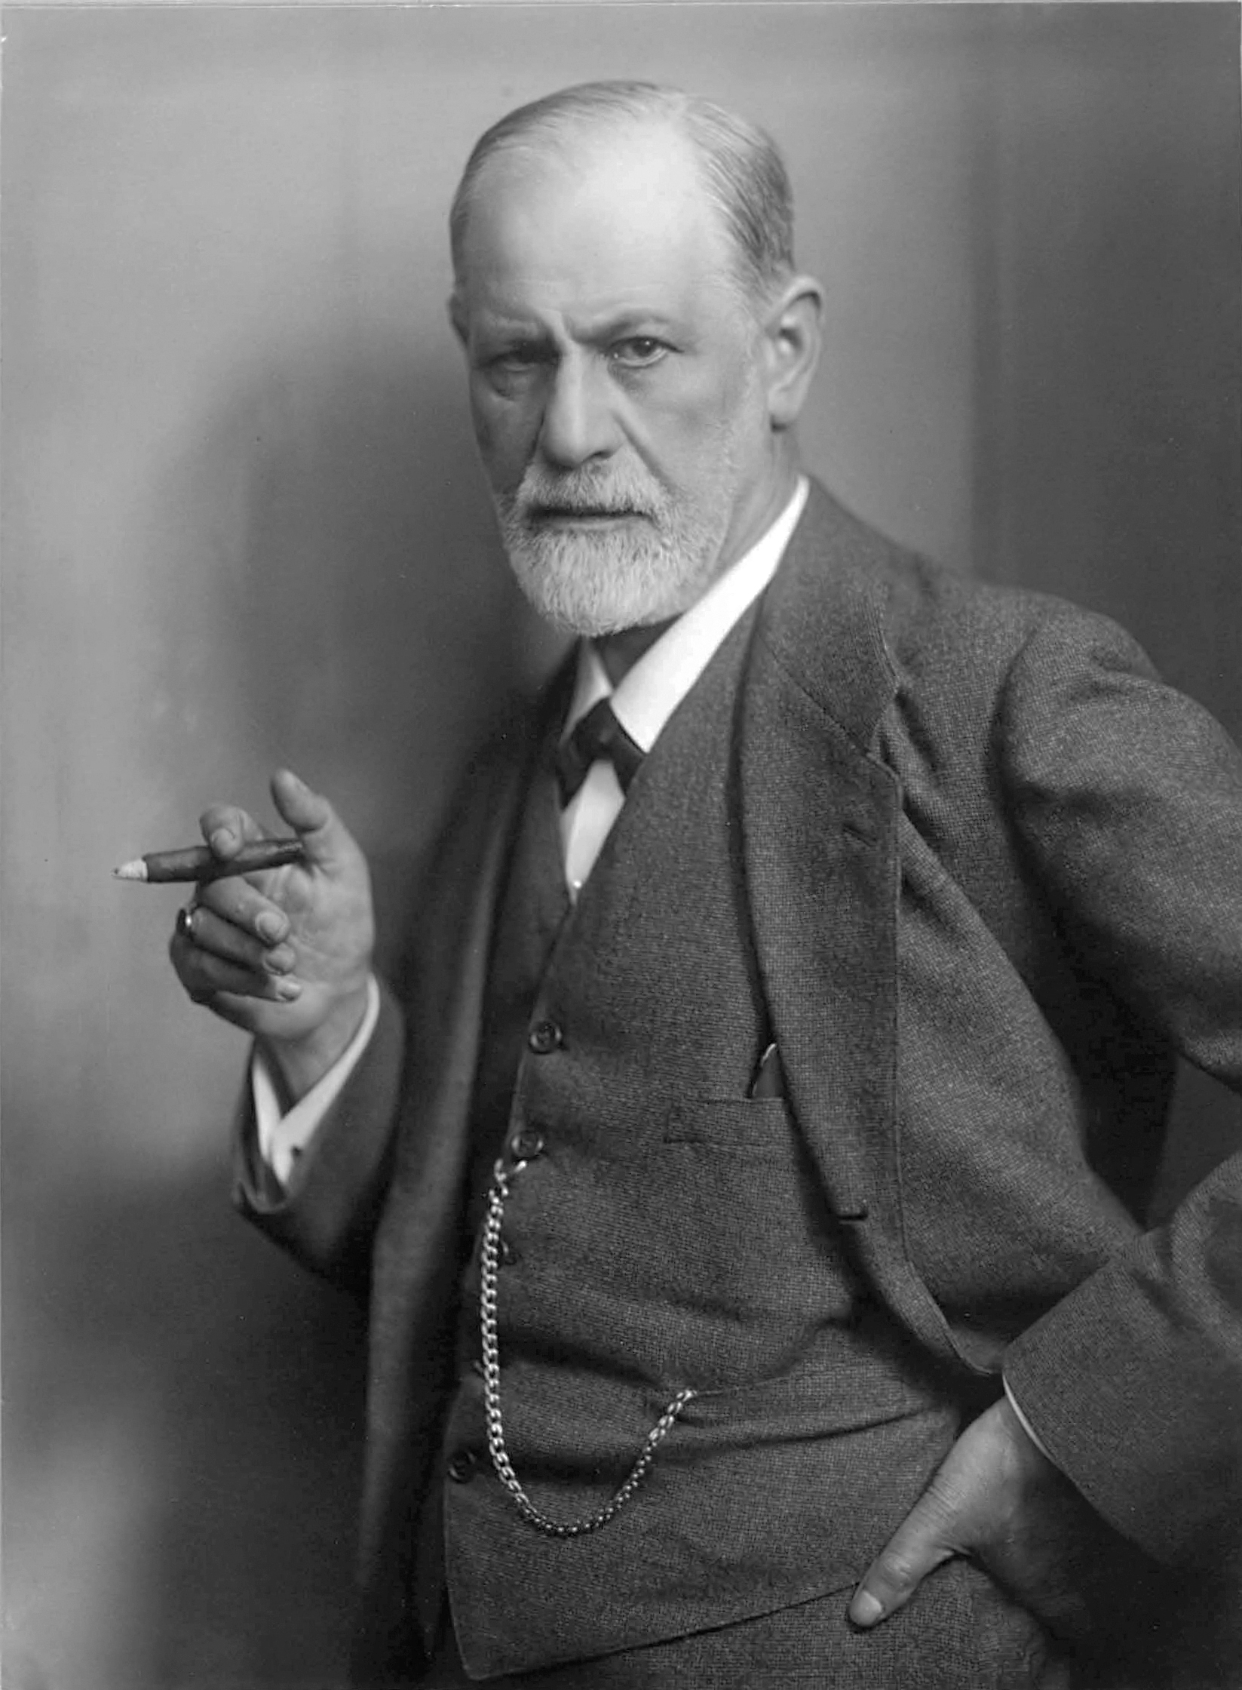
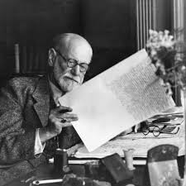

Slide 10
INTRODUCTION
Sigmund Freud (1856-1939)
The first “root” of the (moral) revolution we examined was the so-called “father of modern psychology,” the Austrian physician and psychologist, atheist, Sigmund Freud.
Freud’s central thesis was that we repress unfulfilled desires and negative experiences into a realm called the unconscious, and that this is psychologically harmful.
He combined this with the theory that as children develop they go through “psychosexual stages”: the oral stage, the phallic stage, and so forth. Psychological neurosis is caused by unfulfilled sexual desires repressed into the unconscious.
The most controversial stage was what he called the “Oedipus complex” where the little boy wants to murder his father so he can have sex with his mother. And Freud argued for a more relaxed understanding and practice of sex to prevent psychological problems.
Notes:
Now we can be glad that most probably do not cheat or lie or fake their conclusions. In fact, the scientific method has a safeguard built into it from the start. Reliable data can only be gleaned from experiments that can be replicated, repeated with the same results. Anyone should be able to conduct the same experiment under the same conditions and achieve the same outcome. If you perform an experiment a thousand times and get the same results a thousand times, then the data is probably correct, even well established. If you get multiple, conflicting outcomes, then the data is not confirmed and needs more work.

Slide 11
INTRODUCTION
Most today dismiss Freud’s theories, largely because he offered little or no evidence for them (not very scientific).
And, come to find, Freud himself hated his father and wanted to murder him, and he carried on a decades-long adulterous, incestuous affair with his dull, old wife’s snappy younger sister who came to live with their family as a housekeeper, and was probably a “mother-figure” for Freud, so go figure.
Notes:
Now we can be glad that most probably do not cheat or lie or fake their conclusions. In fact, the scientific method has a safeguard built into it from the start. Reliable data can only be gleaned from experiments that can be replicated, repeated with the same results. Anyone should be able to conduct the same experiment under the same conditions and achieve the same outcome. If you perform an experiment a thousand times and get the same results a thousand times, then the data is probably correct, even well established. If you get multiple, conflicting outcomes, then the data is not confirmed and needs more work.

Slide 12
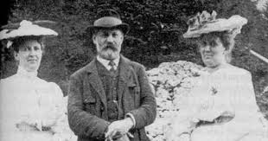

Slide 13
INTRODUCTION
Most today dismiss Freud’s theories, largely because he offered little or no evidence for them (not very scientific).
And, come to find, Freud himself hated his father and wanted to murder him, and he carried on a decades-long adulterous, incestuous affair with his dull, old wife’s snappy younger sister who came to live with their family as a housekeeper, and was probably a “mother-figure” for Freud, so go figure.
So Freud’s theories probably had more to do with Freud’s justifying his own vile behavior.
But the implication stuck, a small idea that has lingered to the present: psychology declares that we should not be so hung up or repressed when it comes to sex. Sexual purity can lead to psychological problems.
Notes:
Now we can be glad that most probably do not cheat or lie or fake their conclusions. In fact, the scientific method has a safeguard built into it from the start. Reliable data can only be gleaned from experiments that can be replicated, repeated with the same results. Anyone should be able to conduct the same experiment under the same conditions and achieve the same outcome. If you perform an experiment a thousand times and get the same results a thousand times, then the data is probably correct, even well established. If you get multiple, conflicting outcomes, then the data is not confirmed and needs more work.

Slide 14
INTRODUCTION
Margaret Mead (1901-1978)
Notes:
Now we can be glad that most probably do not cheat or lie or fake their conclusions. In fact, the scientific method has a safeguard built into it from the start. Reliable data can only be gleaned from experiments that can be replicated, repeated with the same results. Anyone should be able to conduct the same experiment under the same conditions and achieve the same outcome. If you perform an experiment a thousand times and get the same results a thousand times, then the data is probably correct, even well established. If you get multiple, conflicting outcomes, then the data is not confirmed and needs more work.

Slide 15
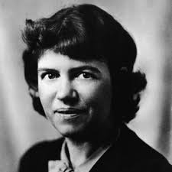
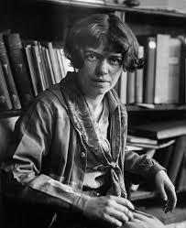
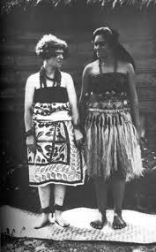
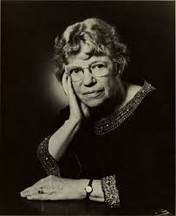
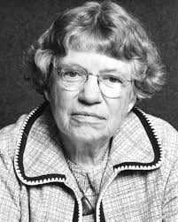

Slide 16
INTRODUCTION
Margaret Mead (1901-1978)
The second “root” of the moral revolution was Margaret Mead.
Mead was also an atheist and an anthropologist who went off to prove that culture, not human nature or biology, caused problems in adolescence.
She went to find an ideal culture of free and easy sex during adolescence.
And, lo and behold! that she found in her eight-months of part-time study in Samoa, a blissful, sandy beach where young people were cavorting all night with various partners of various genders under the romantic moon with the sound of the crashing surf in the background.
And, guess what? There was no jealousy, no competition, and no crime at all in Samoa, and mysteriously, no unwedded pregnancies either, zero! And nobody was even sure whose children belonged to whom: it was all just one big happy, free-love family!
Notes:
Now we can be glad that most probably do not cheat or lie or fake their conclusions. In fact, the scientific method has a safeguard built into it from the start. Reliable data can only be gleaned from experiments that can be replicated, repeated with the same results. Anyone should be able to conduct the same experiment under the same conditions and achieve the same outcome. If you perform an experiment a thousand times and get the same results a thousand times, then the data is probably correct, even well established. If you get multiple, conflicting outcomes, then the data is not confirmed and needs more work.

Slide 17
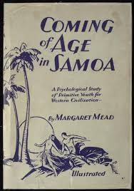
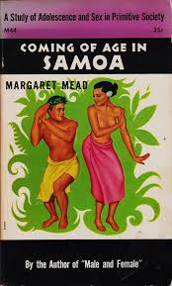

Slide 18
INTRODUCTION
Never mind that another researcher named Dr. Derek Freeman actually went and lived on the Island of Samoa for several years and was even accepted as a member of their community.
Freeman re-did all of Mead’s “research” and discovered that every one of her major conclusions was not only false, but was almost the exact opposite of the truth.
Virginity, for example, among young, unmarried women was the carefully guarded ideal, not free-love with whomever.
Jealousy was quite common and prompted many crimes.
And the incidence of rape in Samoa was one of the highest in the world.
Notes:
Now we can be glad that most probably do not cheat or lie or fake their conclusions. In fact, the scientific method has a safeguard built into it from the start. Reliable data can only be gleaned from experiments that can be replicated, repeated with the same results. Anyone should be able to conduct the same experiment under the same conditions and achieve the same outcome. If you perform an experiment a thousand times and get the same results a thousand times, then the data is probably correct, even well established. If you get multiple, conflicting outcomes, then the data is not confirmed and needs more work.

Slide 19
INTRODUCTION
And never mind that Mead herself arrived at Samoa after committing adultery with one of her professors and commencing a lesbian affair with an older mentor that lasted for decades.
She was clearly NOT trying to shade the data to excuse her inexcusable behavior, even though all her conclusions were proved to be false.
And never mind that Derek Freeman actually met and interviewed one of the two Samoan women who admitted to hoaxing Margaret Mead about all her (false) sexual exploits.
The takeaway is that the science of anthropology has joined with the science of psychology to declare that sexual restraint and rules against promiscuity or homosexuality lead to jealousy, competition, and crime.
So this is the scientific “strike two against traditional sexual morality.”
Notes:
Now we can be glad that most probably do not cheat or lie or fake their conclusions. In fact, the scientific method has a safeguard built into it from the start. Reliable data can only be gleaned from experiments that can be replicated, repeated with the same results. Anyone should be able to conduct the same experiment under the same conditions and achieve the same outcome. If you perform an experiment a thousand times and get the same results a thousand times, then the data is probably correct, even well established. If you get multiple, conflicting outcomes, then the data is not confirmed and needs more work.

Slide 20
INTRODUCTION
Alfred Kinsey (1894-1956)
Notes:
Now we can be glad that most probably do not cheat or lie or fake their conclusions. In fact, the scientific method has a safeguard built into it from the start. Reliable data can only be gleaned from experiments that can be replicated, repeated with the same results. Anyone should be able to conduct the same experiment under the same conditions and achieve the same outcome. If you perform an experiment a thousand times and get the same results a thousand times, then the data is probably correct, even well established. If you get multiple, conflicting outcomes, then the data is not confirmed and needs more work.

Slide 21
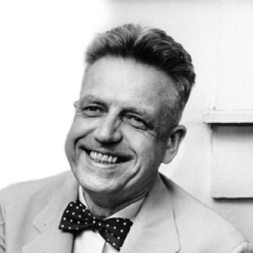
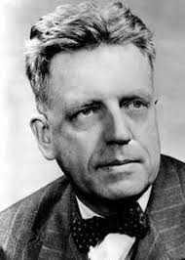
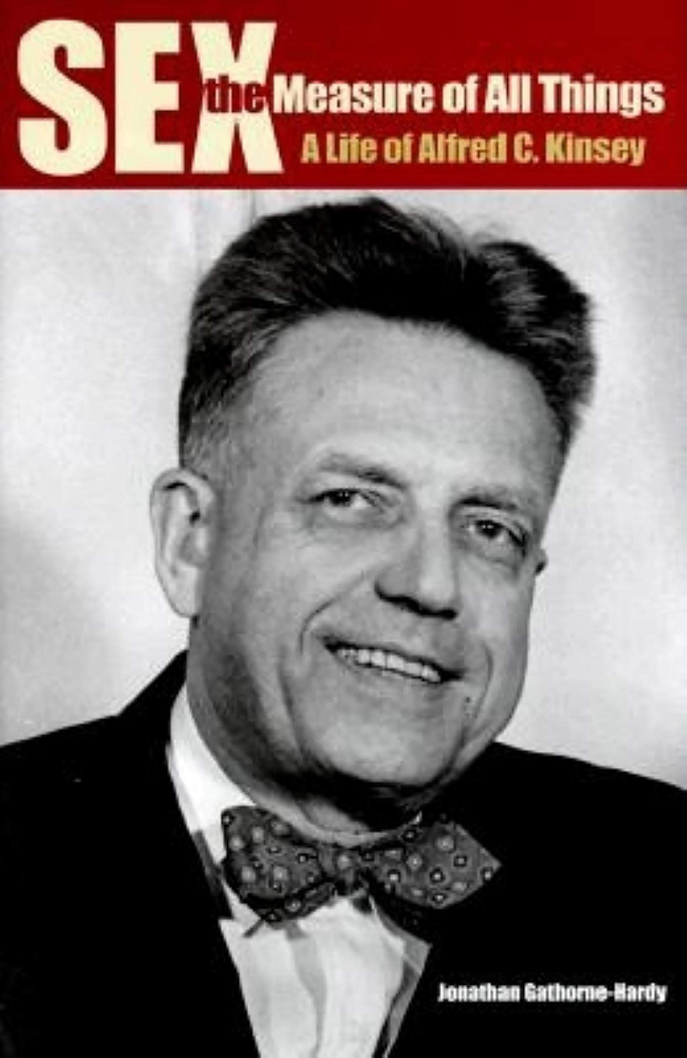

Slide 22
INTRODUCTION
Alfred Kinsey (1894-1956)
The third root of the moral revolution is the one we considered last time, Alfred Kinsey (also an atheist—I’m sensing a pattern here).
Kinsey was a trained biologist who specialized in bugs, wasps, and that somehow qualified him to speak authoritatively about human sexuality.
Kinsey, clearly a sexual predator and either a personal pedophile or one who aided and abetted child sexual abusers, added his weighty credentials to the sexual revolution.
By taking the sexual histories of mostly prison inmates, prostitutes, and those he secured through ads in underground homosexual periodicals, Kinsey came up with unbelievable (literally, “not believable”) statistics on the sexual practices of American men (1948) and later American women (1953).
Notes:
Now we can be glad that most probably do not cheat or lie or fake their conclusions. In fact, the scientific method has a safeguard built into it from the start. Reliable data can only be gleaned from experiments that can be replicated, repeated with the same results. Anyone should be able to conduct the same experiment under the same conditions and achieve the same outcome. If you perform an experiment a thousand times and get the same results a thousand times, then the data is probably correct, even well established. If you get multiple, conflicting outcomes, then the data is not confirmed and needs more work.

Slide 23
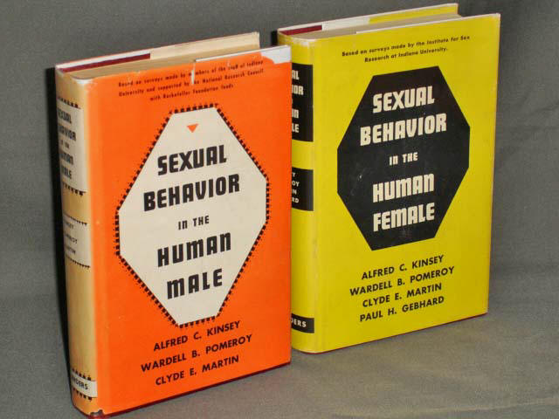
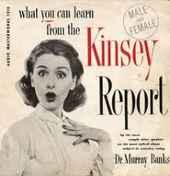

Slide 24
INTRODUCTION
Kinsey declared that almost all men and nearly a majority of women engage in premarital sex.
Three-quarters of all husbands and about half of all wives commit adultery (or at least would be willing to).
In other words, everybody’s doing it.
It’s unhealthy not to do it as much as you possibly can.
Never mind that almost everybody criticized his method as unscientific. The idea has lingered and grown.
Science, in this case, biology votes against traditional sexual morality as well.
Notes:
Now we can be glad that most probably do not cheat or lie or fake their conclusions. In fact, the scientific method has a safeguard built into it from the start. Reliable data can only be gleaned from experiments that can be replicated, repeated with the same results. Anyone should be able to conduct the same experiment under the same conditions and achieve the same outcome. If you perform an experiment a thousand times and get the same results a thousand times, then the data is probably correct, even well established. If you get multiple, conflicting outcomes, then the data is not confirmed and needs more work.

Slide 25
INTRODUCTION
So small wonder that the moral revolution has made such headway!
In an increasingly secular society, a society of unregenerate sinners whose ultimate goal is to get away with as much self-glorifying and self-gratifying sin as they possibly can while maintaining a semi-respectable reputation, these three “scientists,” Freud, Mead, and Kinsey have dismantled the brakes and stomped on the gas pedal.
Science in the form of psychology, anthropology, and biology has proved that the only bad sexual desire or practice is the one you deny yourself.
Science, or at least pseudo-science declares it to be so!
Notes:
Now we can be glad that most probably do not cheat or lie or fake their conclusions. In fact, the scientific method has a safeguard built into it from the start. Reliable data can only be gleaned from experiments that can be replicated, repeated with the same results. Anyone should be able to conduct the same experiment under the same conditions and achieve the same outcome. If you perform an experiment a thousand times and get the same results a thousand times, then the data is probably correct, even well established. If you get multiple, conflicting outcomes, then the data is not confirmed and needs more work.

Slide 26
THE LAST LINE OF DEFENSE: THEOLOGY!
But that’s where Christians in our day have been betrayed.
Many put their faith in the most prominent theologian of the twentieth century, the Swiss pastor and professor Karl Barth.
For several decades Karl Barth has been the darling of conservative Protestants who did not want to seem too conservative or liberal Protestants in conservative churches who did not want to seem too liberal.
But, in truth, Karl Barth has turned out to be the fourth root of the moral revolution, last of the “four horsemen of the (moral) apocalypse.”
Notes:
Now we can be glad that most probably do not cheat or lie or fake their conclusions. In fact, the scientific method has a safeguard built into it from the start. Reliable data can only be gleaned from experiments that can be replicated, repeated with the same results. Anyone should be able to conduct the same experiment under the same conditions and achieve the same outcome. If you perform an experiment a thousand times and get the same results a thousand times, then the data is probably correct, even well established. If you get multiple, conflicting outcomes, then the data is not confirmed and needs more work.

Slide 27
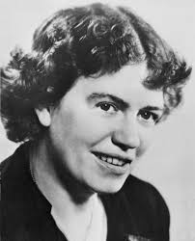
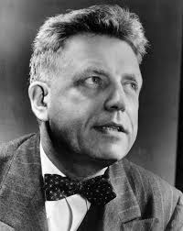
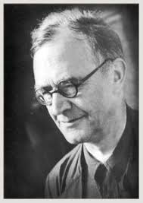
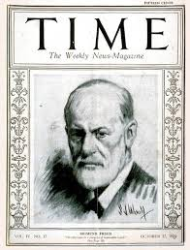
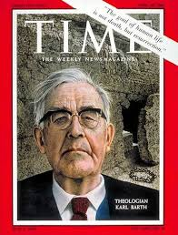

Slide 28
THE GREATEST THEOLOGIAN OF THE TWENTIETH CENTURY
Karl Barth (1886-1968) was at the forefront of a school of theology sometimes called “neo-orthodoxy,” “dialectical theology,” “crisis theology,” and often simply “Barthianism.”
Notes:
Now we can be glad that most probably do not cheat or lie or fake their conclusions. In fact, the scientific method has a safeguard built into it from the start. Reliable data can only be gleaned from experiments that can be replicated, repeated with the same results. Anyone should be able to conduct the same experiment under the same conditions and achieve the same outcome. If you perform an experiment a thousand times and get the same results a thousand times, then the data is probably correct, even well established. If you get multiple, conflicting outcomes, then the data is not confirmed and needs more work.

Slide 30
THE GREATEST THEOLOGIAN OF THE TWENTIETH CENTURY
Karl Barth (1886-1968) was at the forefront of a school of theology sometimes called “neo-orthodoxy,” “dialectical theology,” “crisis theology,” and often simply “Barthianism.”
You probably know pastors, local theology professors, and church leaders who are ardent fans of Karl Barth or have been deeply influenced by the theology of Karl Barth. You may be one of them.
Karl Barth was a voluminous writer. His crowning achievement was his multi-multi-volume Church Dogmatics.
Notes:
Now we can be glad that most probably do not cheat or lie or fake their conclusions. In fact, the scientific method has a safeguard built into it from the start. Reliable data can only be gleaned from experiments that can be replicated, repeated with the same results. Anyone should be able to conduct the same experiment under the same conditions and achieve the same outcome. If you perform an experiment a thousand times and get the same results a thousand times, then the data is probably correct, even well established. If you get multiple, conflicting outcomes, then the data is not confirmed and needs more work.

Slide 31
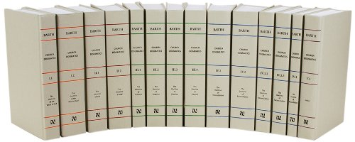

Slide 32
THE GREATEST THEOLOGIAN OF THE TWENTIETH CENTURY
Barth wrote so much and kept updating his writings so frequently that it is hard to state exactly what he taught.
Couple this with his so-called “dialectical method” and you find even more confusion.
Barth loved the tensions in theology. Christ is both God and Man. God is both three and one. God is sovereign, and people have free will.
John Frame writes of the difficulty of nailing Barth down:
Notes:
Now we can be glad that most probably do not cheat or lie or fake their conclusions. In fact, the scientific method has a safeguard built into it from the start. Reliable data can only be gleaned from experiments that can be replicated, repeated with the same results. Anyone should be able to conduct the same experiment under the same conditions and achieve the same outcome. If you perform an experiment a thousand times and get the same results a thousand times, then the data is probably correct, even well established. If you get multiple, conflicting outcomes, then the data is not confirmed and needs more work.

Slide 33
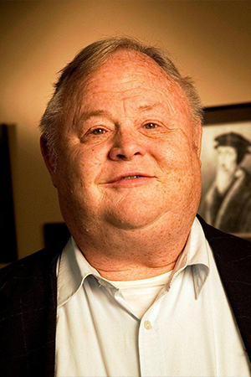
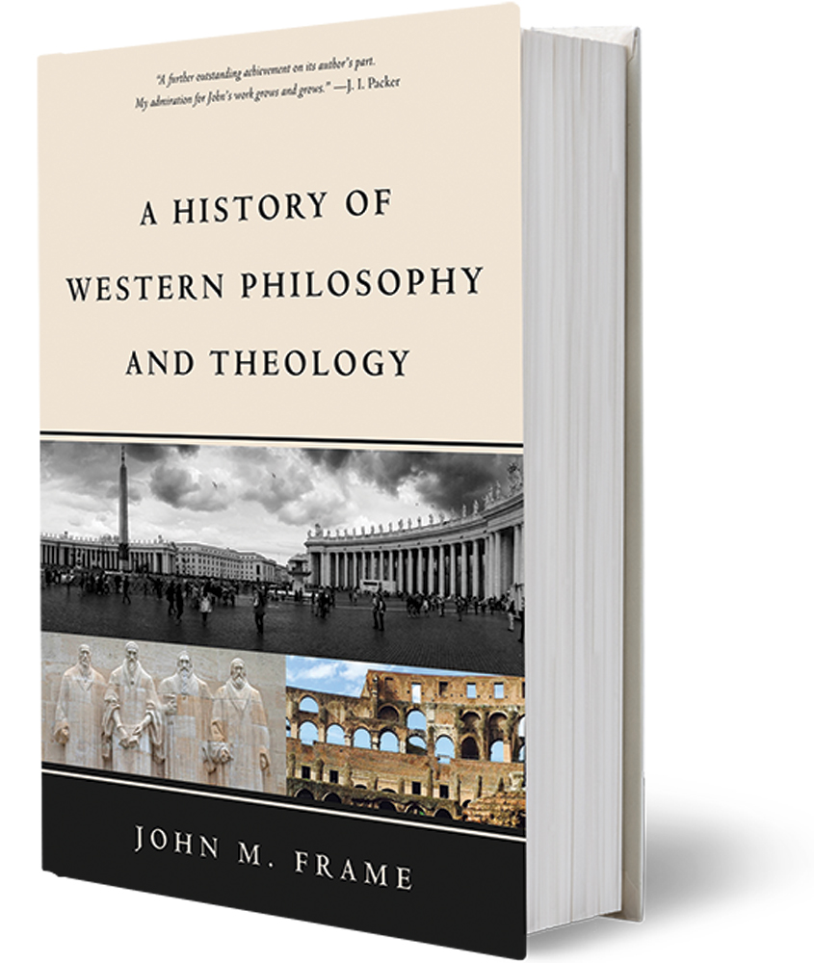

Slide 34
THE GREATEST THEOLOGIAN OF THE TWENTIETH CENTURY
“The wide differences among scholars on the evaluation of Barth arise partly through the difficulty of interpreting him. Because of the huge volume and complexity of his writings, there has been much controversy over what Barth ‘really means.’ This is true of his individual sentences as well as his books….It is possible to argue a wide variety of interpretations from the Church Dogmatics. Almost any thesis about Barth can be supported from somewhere in his writings, opposed from somewhere else.” (History of Western, 366)
Notes:
Now we can be glad that most probably do not cheat or lie or fake their conclusions. In fact, the scientific method has a safeguard built into it from the start. Reliable data can only be gleaned from experiments that can be replicated, repeated with the same results. Anyone should be able to conduct the same experiment under the same conditions and achieve the same outcome. If you perform an experiment a thousand times and get the same results a thousand times, then the data is probably correct, even well established. If you get multiple, conflicting outcomes, then the data is not confirmed and needs more work.

Slide 35
THE GREATEST THEOLOGIAN OF THE TWENTIETH CENTURY
For our purposes I want to focus on one of his teachings, namely that God cannot speak in words.
“Words” cannot be the Word of God.
Truth statements, propositions (such as we find all over the Bible) are only human attempts to explain God or to put into words what God has said.
Words are the mere products of humans, not God, and “to err is human.”
So all words, including the words we find in the Bible, are merely human (and therefore erring words).
But Barth was really reacting to the failed theological liberalism he had been taught, so I must give you some background.
Notes:
Now we can be glad that most probably do not cheat or lie or fake their conclusions. In fact, the scientific method has a safeguard built into it from the start. Reliable data can only be gleaned from experiments that can be replicated, repeated with the same results. Anyone should be able to conduct the same experiment under the same conditions and achieve the same outcome. If you perform an experiment a thousand times and get the same results a thousand times, then the data is probably correct, even well established. If you get multiple, conflicting outcomes, then the data is not confirmed and needs more work.

Slide 36
THEOLOGICAL LIBERALISM
Friedrich Schleiermacher (1786-1834) is known as the father of modern theology, modern “liberal” theology, that is.
Notes:
Now we can be glad that most probably do not cheat or lie or fake their conclusions. In fact, the scientific method has a safeguard built into it from the start. Reliable data can only be gleaned from experiments that can be replicated, repeated with the same results. Anyone should be able to conduct the same experiment under the same conditions and achieve the same outcome. If you perform an experiment a thousand times and get the same results a thousand times, then the data is probably correct, even well established. If you get multiple, conflicting outcomes, then the data is not confirmed and needs more work.

Slide 37
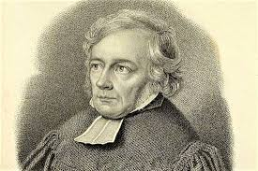

Slide 38
THEOLOGICAL LIBERALISM
Friedrich Schleiermacher (1786-1834) is known as the father of modern theology, modern “liberal” theology, that is.
The intellectuals of his day had written off God as unknowable or even nonexistent. They could not accept the God of the Bible with his interventions into the world and his miracles, which they considered impossible.
Schleiermacher sought to reach out to them in his 1799 book Speeches on Religion to Its Cultured Despisers. In it, he reduced God and all religion to feelings.
So, instead of a God “out there” commanding this or that and creating worlds and miracles, God was now “in here.” His central concept was that God or true religion was “the feeling of absolute dependence.”
Notes:
Now we can be glad that most probably do not cheat or lie or fake their conclusions. In fact, the scientific method has a safeguard built into it from the start. Reliable data can only be gleaned from experiments that can be replicated, repeated with the same results. Anyone should be able to conduct the same experiment under the same conditions and achieve the same outcome. If you perform an experiment a thousand times and get the same results a thousand times, then the data is probably correct, even well established. If you get multiple, conflicting outcomes, then the data is not confirmed and needs more work.

Slide 39
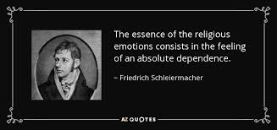

Slide 40
THEOLOGICAL LIBERALISM
Here are some key tenets of Schleiermacher’s theology.
1. One’s personal feelings are the only authority, not Scripture, creeds, or the ideas of others.
2. Revelation is nonpropositional. Revelation or God’s communication may come in the broad events of history or in subjective thoughts, but not in any form that would trump our personal feelings.
3. God is so far above us that we cannot describe him in words or concepts. But God is found in our inner feelings. Christ is the prime example of one with exalted religious feelings.
4. Salvation is not what Christ has done for us in history but comes when people are raised to their highest personal level of religious consciousness.
5. Traditional theological terms are redefined in psychological categories. “Sin” is preoccupation with earthly concerns while “salvation” is to think of more transcendent truths.
Notes:
Now we can be glad that most probably do not cheat or lie or fake their conclusions. In fact, the scientific method has a safeguard built into it from the start. Reliable data can only be gleaned from experiments that can be replicated, repeated with the same results. Anyone should be able to conduct the same experiment under the same conditions and achieve the same outcome. If you perform an experiment a thousand times and get the same results a thousand times, then the data is probably correct, even well established. If you get multiple, conflicting outcomes, then the data is not confirmed and needs more work.

Slide 41
THEOLOGICAL LIBERALISM
“For Schleiermacher there was no transcendent, self-disclosing God in the traditional sense; man’s own feelings constituted this ground of reality, with Jesus as the man in whom these feelings of God-consciousness attained their highest perfection.” (“Liberalism, German,” New Dictionary of Theology)
Religion is basically one’s personal feelings and personal, spiritual development, not formal creeds, beliefs, or commandments. And all religion is basically the same thing, reduced to a few, bland assertions.
Notes:
Now we can be glad that most probably do not cheat or lie or fake their conclusions. In fact, the scientific method has a safeguard built into it from the start. Reliable data can only be gleaned from experiments that can be replicated, repeated with the same results. Anyone should be able to conduct the same experiment under the same conditions and achieve the same outcome. If you perform an experiment a thousand times and get the same results a thousand times, then the data is probably correct, even well established. If you get multiple, conflicting outcomes, then the data is not confirmed and needs more work.

Slide 43
THEOLOGICAL LIBERALISM
Admittedly, that’s quite different from the biblical faith as revealed in Scripture. Let me offer a simple illustration of the two positions.
Notes:
Now we can be glad that most probably do not cheat or lie or fake their conclusions. In fact, the scientific method has a safeguard built into it from the start. Reliable data can only be gleaned from experiments that can be replicated, repeated with the same results. Anyone should be able to conduct the same experiment under the same conditions and achieve the same outcome. If you perform an experiment a thousand times and get the same results a thousand times, then the data is probably correct, even well established. If you get multiple, conflicting outcomes, then the data is not confirmed and needs more work.

Slide 44
THEOLOGICAL LIBERALISM
Suppose you visit a garage sale and notice a jigsaw puzzle for sale in a plain box, no picture. Thinking this might be a good challenge for a long winter’s night, you ask the proprietor if all the pieces are in the box. He assures you they are. And so on that basis you buy the puzzle.
But he lied. As you work the puzzle you find many pieces missing. You are able to make out the broad picture, a delightful scene, but there are many gaps. You may guess as to what may be in those missing parts, but with limited assurance.
The orthodox view of Scripture is similar. God has revealed himself and his will in Scripture, not everything, of course, but enough that we might know him and grasp the wonder of his glorious plan.
We may also make some educated guesses regarding matters he has kept to himself, but only with limited understanding.
Notes:
Now we can be glad that most probably do not cheat or lie or fake their conclusions. In fact, the scientific method has a safeguard built into it from the start. Reliable data can only be gleaned from experiments that can be replicated, repeated with the same results. Anyone should be able to conduct the same experiment under the same conditions and achieve the same outcome. If you perform an experiment a thousand times and get the same results a thousand times, then the data is probably correct, even well established. If you get multiple, conflicting outcomes, then the data is not confirmed and needs more work.

Slide 45
THEOLOGICAL LIBERALISM
In the view of theological liberalism, the garage sale proprietor also lied but in a more serious way.
Not only were some pieces missing, but some spurious and false pieces were mixed in.
And so the first task is to sort the pieces, retaining the true and discarding the false.
In theological liberalism, Scripture is a mixture of God’s Word (the few bland assertions) and erring human ideas. And one must sort the true from the false.
For Schleiermacher the traditional religionists “identified religion with creeds, and men who could no longer accept the creeds thought that they were through with religion. But this was a tragic mistake, for they still were in contact with God through their feelings of dependence upon the universe.” (Hordern, A Layman’s Guide to Protestant Theology, 44)
Notes:
Now we can be glad that most probably do not cheat or lie or fake their conclusions. In fact, the scientific method has a safeguard built into it from the start. Reliable data can only be gleaned from experiments that can be replicated, repeated with the same results. Anyone should be able to conduct the same experiment under the same conditions and achieve the same outcome. If you perform an experiment a thousand times and get the same results a thousand times, then the data is probably correct, even well established. If you get multiple, conflicting outcomes, then the data is not confirmed and needs more work.

Slide 46
THEOLOGICAL LIBERALISM
Theological liberalism sought the “essence” of Christianity (or of all religions). Often this was distilled down to the bland assertions of “the universal fatherhood of God and the universal brotherhood of man.”
Notes:
Now we can be glad that most probably do not cheat or lie or fake their conclusions. In fact, the scientific method has a safeguard built into it from the start. Reliable data can only be gleaned from experiments that can be replicated, repeated with the same results. Anyone should be able to conduct the same experiment under the same conditions and achieve the same outcome. If you perform an experiment a thousand times and get the same results a thousand times, then the data is probably correct, even well established. If you get multiple, conflicting outcomes, then the data is not confirmed and needs more work.

Slide 47
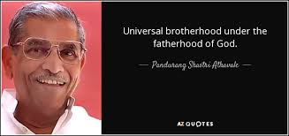

Slide 48
THEOLOGICAL LIBERALISM
Theological liberalism reached its pinnacle around the end of the nineteenth century but began to decline quickly due to two factors.
The first was the continued attacks of the rationalists who argued for consistency: if the basic facts presented in the Bible were not true, why try to keep the sentiment?
Notes:
Now we can be glad that most probably do not cheat or lie or fake their conclusions. In fact, the scientific method has a safeguard built into it from the start. Reliable data can only be gleaned from experiments that can be replicated, repeated with the same results. Anyone should be able to conduct the same experiment under the same conditions and achieve the same outcome. If you perform an experiment a thousand times and get the same results a thousand times, then the data is probably correct, even well established. If you get multiple, conflicting outcomes, then the data is not confirmed and needs more work.

Slide 49
THEOLOGICAL LIBERALISM
The second factor was the raw brutality of World War I.
Notes:
Now we can be glad that most probably do not cheat or lie or fake their conclusions. In fact, the scientific method has a safeguard built into it from the start. Reliable data can only be gleaned from experiments that can be replicated, repeated with the same results. Anyone should be able to conduct the same experiment under the same conditions and achieve the same outcome. If you perform an experiment a thousand times and get the same results a thousand times, then the data is probably correct, even well established. If you get multiple, conflicting outcomes, then the data is not confirmed and needs more work.

Slide 51
THEOLOGICAL LIBERALISM
The second factor was the raw brutality of World War I.
Liberalism was quite optimistic that this new viewpoint, shorn of antiquated and divisive religious dogmas, would usher in a utopian world order of harmony and peace.
The Great War demonstrated that the world was growing worse, not better.
This shattering disillusionment all but destroyed liberalism and ushered in the second great challenge within the church, the challenge of neo-orthodoxy.
Karl Barth was taught by the liberal scholars of his day including Adolf von Harnack and Wilhelm Herrmann. But he reacted against their re-casting of religion as mere psychology.
Notes:
Now we can be glad that most probably do not cheat or lie or fake their conclusions. In fact, the scientific method has a safeguard built into it from the start. Reliable data can only be gleaned from experiments that can be replicated, repeated with the same results. Anyone should be able to conduct the same experiment under the same conditions and achieve the same outcome. If you perform an experiment a thousand times and get the same results a thousand times, then the data is probably correct, even well established. If you get multiple, conflicting outcomes, then the data is not confirmed and needs more work.

Slide 52
NEO-ORTHODOXY
Just as theological liberalism sought to rescue Christianity from rationalism by agreeing with rationalism but fleeing to romanticism (feelings), neo-orthodoxy sought to rescue Christianity from liberalism by agreeing with rationalism but fleeing to existential philosophy.
“A majority of the neo-orthodox began as liberals and this colored their thinking in two ways. On the one hand, certain aspects of liberalism lived on in them; they were as critical of fundamentalism as the liberals had been; they accepted biblical criticism in its most radical forms. On the other hand, the neo-orthodox reacted against certain liberal concepts such as the use of reason or natural theology.”(Hordern, Laymans, 112)
The two figures most closely associated with neo-orthodoxy are the Swiss theologians Emil Brunner (1889-1996) and Karl Barth (1886-1968).
Notes:
Now we can be glad that most probably do not cheat or lie or fake their conclusions. In fact, the scientific method has a safeguard built into it from the start. Reliable data can only be gleaned from experiments that can be replicated, repeated with the same results. Anyone should be able to conduct the same experiment under the same conditions and achieve the same outcome. If you perform an experiment a thousand times and get the same results a thousand times, then the data is probably correct, even well established. If you get multiple, conflicting outcomes, then the data is not confirmed and needs more work.

Slide 53
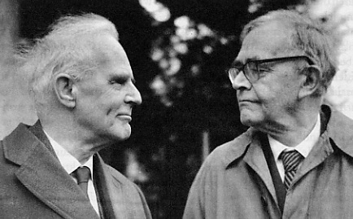

Slide 54
NEO-ORTHODOXY
Though neo-orthodoxy is complex and encompasses sometimes opposing viewpoints, it sought to re-institute key themes of Reformed theology (the sovereignty of God, sin, salvation by grace alone, faith alone) hence “orthodoxy,” but it was not the old orthodoxy, chiefly in its view of the Scriptures as errant human documents.
Drawing from the existential philosophy of the Danish Søren Kierkegaard (1813-1855),
Notes:
Now we can be glad that most probably do not cheat or lie or fake their conclusions. In fact, the scientific method has a safeguard built into it from the start. Reliable data can only be gleaned from experiments that can be replicated, repeated with the same results. Anyone should be able to conduct the same experiment under the same conditions and achieve the same outcome. If you perform an experiment a thousand times and get the same results a thousand times, then the data is probably correct, even well established. If you get multiple, conflicting outcomes, then the data is not confirmed and needs more work.

Slide 56
NEO-ORTHODOXY
Though neo-orthodoxy is complex and encompasses sometimes opposing viewpoints, it sought to re-institute key themes of Reformed theology (the sovereignty of God, sin, salvation by grace alone, faith alone) hence “orthodoxy,” but it was not the old orthodoxy, chiefly in its view of the Scriptures as errant human documents.
Drawing from the existential philosophy of the Danish Søren Kierkegaard (1813-1855), Christianity was proposed not so much as a commitment to certain truths or propositions but a living encounter with the living God who has chosen to make himself known through a human, fallible and errant document (the Bible).
Christian orthodoxy has consistently held that Christianity is a living encounter with the living God who has chosen to make himself known through his living, written Word, a divine-human work that, as the very Word of God, is authoritative as well as infallible and inerrant.
Notes:
Now we can be glad that most probably do not cheat or lie or fake their conclusions. In fact, the scientific method has a safeguard built into it from the start. Reliable data can only be gleaned from experiments that can be replicated, repeated with the same results. Anyone should be able to conduct the same experiment under the same conditions and achieve the same outcome. If you perform an experiment a thousand times and get the same results a thousand times, then the data is probably correct, even well established. If you get multiple, conflicting outcomes, then the data is not confirmed and needs more work.

Slide 57
NEO-ORTHODOXY
Here are some examples from Barth’s Church Dogmatics that demonstrate his belief that the Bible is a merely human, erring document.
Book I,2; p. 509 “We have to face up to them and to be clear that in the Bible it may be a matter of simply believing the Word of God, even though it meets us, not in the form of what we call history, but in the form of what we think must be called saga or legend.”
Book I, 2; p. 509 “But the vulnerability of the Bible, i.e., its capacity for error, also extends to its religious or theological content.”
Book I, 2; p. 509 “There are obvious and overlapping contradictions—e.g., between the Law and the prophets, between John and the Synoptists, between Paul and James.”
Book I, 2; p. 510 “For within certain limits and therefore relatively they [the biblical writers] are all vulnerable and therefore capable of error even in respect of religion and theology.”
Notes:
Now we can be glad that most probably do not cheat or lie or fake their conclusions. In fact, the scientific method has a safeguard built into it from the start. Reliable data can only be gleaned from experiments that can be replicated, repeated with the same results. Anyone should be able to conduct the same experiment under the same conditions and achieve the same outcome. If you perform an experiment a thousand times and get the same results a thousand times, then the data is probably correct, even well established. If you get multiple, conflicting outcomes, then the data is not confirmed and needs more work.

Slide 58
NEO-ORTHODOXY
Book I, 2; p. 529 “The prophets and apostles as such, even in their office, even in their function as witnesses, even in the act of writing down their witnesses, were real, historical men as we are, and therefore sinful in their action, and capable and actually guilty of error in their spoken and written word.”
Book I, 2; p. 529 “To the bold postulate, that if their [biblical writers’] word is to be the Word of God they must be inerrant in every word, we oppose the even bolder assertion that, according to the scriptural witness about man, which applies to them too, they can be at fault in any word, and have been at fault in every word, and yet according to the same scriptural witness, being justified and sanctified by grace alone, they have still spoken the Word of God in their fallible and erring human word.”
Notes:
Now we can be glad that most probably do not cheat or lie or fake their conclusions. In fact, the scientific method has a safeguard built into it from the start. Reliable data can only be gleaned from experiments that can be replicated, repeated with the same results. Anyone should be able to conduct the same experiment under the same conditions and achieve the same outcome. If you perform an experiment a thousand times and get the same results a thousand times, then the data is probably correct, even well established. If you get multiple, conflicting outcomes, then the data is not confirmed and needs more work.

Slide 59
NEO-ORTHODOXY
Book I, 2; p. 531-532 “If God was not ashamed of the fallibility of all the human words of the Bible, of their historical and scientific inaccuracies, their theological contradictions, the uncertainty of their tradition, and, above all, their Judaism, but adopted and made use of these expressions in all their fallibility as witnesses, we do not need to be ashamed when He wills to renew it to us in all its fallibility as witness, and it is mere self-will and disobedience to try to find some infallible elements in the Bible. But finally we are absolved from having to know and name as such the event or events, in which Scripture proves and confirms to us as the Word of God.”
Notes:
Now we can be glad that most probably do not cheat or lie or fake their conclusions. In fact, the scientific method has a safeguard built into it from the start. Reliable data can only be gleaned from experiments that can be replicated, repeated with the same results. Anyone should be able to conduct the same experiment under the same conditions and achieve the same outcome. If you perform an experiment a thousand times and get the same results a thousand times, then the data is probably correct, even well established. If you get multiple, conflicting outcomes, then the data is not confirmed and needs more work.

Slide 60
NEO-ORTHODOXY
So the Bible is not the Word of God, only Jesus is. The words of the Bible only matter insofar as they mediate Jesus, the living Word, to us.
This view is quite common in our day.
One will find remnants of this view on college campuses and in numerous churches.
A few years ago our former Presbytery of the (liberal) PC(USA) examined a candidate for ordination. One of the pastors asked this question: “Is the Bible the Word of God or is Jesus the Word of God?” Of course the answer is “both.”
But you know what prompted the question (the pastor asking the question was committed to Barthianism).
Notes:
Now we can be glad that most probably do not cheat or lie or fake their conclusions. In fact, the scientific method has a safeguard built into it from the start. Reliable data can only be gleaned from experiments that can be replicated, repeated with the same results. Anyone should be able to conduct the same experiment under the same conditions and achieve the same outcome. If you perform an experiment a thousand times and get the same results a thousand times, then the data is probably correct, even well established. If you get multiple, conflicting outcomes, then the data is not confirmed and needs more work.

Slide 61
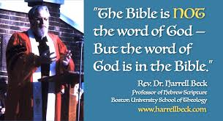

Slide 62
NEO-ORTHODOXY
Similarly, many will agree that the Bible is “infallible,” but not that it is “inerrant.”
In their view “infallible” means that Scripture does not fail, but “inerrant” means that there are no errors in Scripture.
Neo-orthodoxy teaches that the Bible is a fallible human book, but that the Word of God speaks infallibly to us through the Bible.
Many have observed that on this point Barth may have misunderstood or conflated the Reformed doctrine of illumination whereby the Holy Spirit makes the believer alive to the living text of the Word of God written, without which we remain dead to it.
Notes:
Now we can be glad that most probably do not cheat or lie or fake their conclusions. In fact, the scientific method has a safeguard built into it from the start. Reliable data can only be gleaned from experiments that can be replicated, repeated with the same results. Anyone should be able to conduct the same experiment under the same conditions and achieve the same outcome. If you perform an experiment a thousand times and get the same results a thousand times, then the data is probably correct, even well established. If you get multiple, conflicting outcomes, then the data is not confirmed and needs more work.

Slide 63
NEO-ORTHODOXY
I have been in churches where, just before reading Scripture, the pastor says: “Listen for the Word of God as I read our Scripture lesson from John 12, etc.”
Whether that pastor knows it or not, that is a neo-orthodox statement: not “listen TO the Word of God” but “listen FOR the Word of God.”
The implication is that “the Bible is NOT the Word of God, but when you listen to the Bible you may have an encounter with the Word of God.”
Often a typical “Bible study,” intentionally or not, may be neo-orthodox in its method.
The leader reads a verse and then asks, “What does this verse mean to you?”
Wrong question. The Bible already has a singular, objective meaning. There is only one interpretation, while there may be many applications.
Notes:
Now we can be glad that most probably do not cheat or lie or fake their conclusions. In fact, the scientific method has a safeguard built into it from the start. Reliable data can only be gleaned from experiments that can be replicated, repeated with the same results. Anyone should be able to conduct the same experiment under the same conditions and achieve the same outcome. If you perform an experiment a thousand times and get the same results a thousand times, then the data is probably correct, even well established. If you get multiple, conflicting outcomes, then the data is not confirmed and needs more work.

Slide 64
NEO-ORTHODOXY
Theologian William Hordern explains:
“Because God is the living God, Barth warns against identifying the Word of God with any human form or institution. Not even the Bible can be identified with the Word of God. The error of fundamentalism, as he sees it, is that it takes the Bible as a “self-sufficient Paper-Pope.” To Barth the words of the Bible and of the human Jesus are “tokens.” One may read the Bible without hearing the Word of God. But the Word does come to us through these tokens. Some day, as we read a passage of Scripture, it may suddenly come alive and speak to us in the situation in which we find ourselves. The writers of Scripture wrote to tell of the revelation they received from God and, as we read, the same God who spoke to them may speak to us. Thus, says Barth, the Bible is a record of a past revelation and a promise of a future revelation.” (Hordern, Layman’s, 133)
Notes:
Now we can be glad that most probably do not cheat or lie or fake their conclusions. In fact, the scientific method has a safeguard built into it from the start. Reliable data can only be gleaned from experiments that can be replicated, repeated with the same results. Anyone should be able to conduct the same experiment under the same conditions and achieve the same outcome. If you perform an experiment a thousand times and get the same results a thousand times, then the data is probably correct, even well established. If you get multiple, conflicting outcomes, then the data is not confirmed and needs more work.

Slide 65
“If a Bible sits in the forest and there is no one there to read it, is it still the Word of God?”

Slide 66
NEO-ORTHODOXY
Barth would decisively answer “No.”
The Bible may become the Word of God to someone as God wills, but it is not the Word of God.
Not even the words Jesus spoke while he was on earth were the Word of God!
God cannot speak to us in words, only through words.
Notes:
Now we can be glad that most probably do not cheat or lie or fake their conclusions. In fact, the scientific method has a safeguard built into it from the start. Reliable data can only be gleaned from experiments that can be replicated, repeated with the same results. Anyone should be able to conduct the same experiment under the same conditions and achieve the same outcome. If you perform an experiment a thousand times and get the same results a thousand times, then the data is probably correct, even well established. If you get multiple, conflicting outcomes, then the data is not confirmed and needs more work.

Slide 67
NEO-ORTHODOXY
So if the Bible is fallible, what about the ethical standards and moral commandments in Scripture? Does Barth consider these likewise fallible and erring, and therefore non-binding?
Of course he does, as Hordern demonstrates:
“Barth repudiates ethics which are bound by rules and regulations. Throughout the Bible God commands men in specific terms directed to their unique time and place. In Christ we find the pattern for our obedience and we must be disciples of Christ in each particular situation with its uniqueness and needs. In one sense this seems to leave the Christian without guidance because he cannot run his life by laws that are never to be broken. But, on the other hand, Christ is a concrete individual and loyalty to his spirit does not leave the Christian without concrete guidance for his behavior.” (Hordern, Layman’s, 145)
Notes:
Now we can be glad that most probably do not cheat or lie or fake their conclusions. In fact, the scientific method has a safeguard built into it from the start. Reliable data can only be gleaned from experiments that can be replicated, repeated with the same results. Anyone should be able to conduct the same experiment under the same conditions and achieve the same outcome. If you perform an experiment a thousand times and get the same results a thousand times, then the data is probably correct, even well established. If you get multiple, conflicting outcomes, then the data is not confirmed and needs more work.

Slide 69
EVALUATION OF NEO-ORTHODOXY
Common critiques of neo-orthodoxy demonstrate its inherent weakness.
First, its declaration that God’s revelation is knowable only by personal faith renders it impervious to verification or falsification.
Another weakness is its sheer subjectivity. From this perspective it has no answer to those who claim to have encountered God in other religions or who claim other conclusions from their “encounter” with the Word of God through Scripture.
In spite of these serious defects, neo-orthodoxy, especially its view on the complete fallibility of Scripture, is still very much the coin of the realm today.
Notes:
Now we can be glad that most probably do not cheat or lie or fake their conclusions. In fact, the scientific method has a safeguard built into it from the start. Reliable data can only be gleaned from experiments that can be replicated, repeated with the same results. Anyone should be able to conduct the same experiment under the same conditions and achieve the same outcome. If you perform an experiment a thousand times and get the same results a thousand times, then the data is probably correct, even well established. If you get multiple, conflicting outcomes, then the data is not confirmed and needs more work.

Slide 70
EVALUATION OF NEO-ORTHODOXY
Theologian David F. Wells objects to what he calls “the damaging dichotomy” in neo-orthodoxy:
Notes:
Now we can be glad that most probably do not cheat or lie or fake their conclusions. In fact, the scientific method has a safeguard built into it from the start. Reliable data can only be gleaned from experiments that can be replicated, repeated with the same results. Anyone should be able to conduct the same experiment under the same conditions and achieve the same outcome. If you perform an experiment a thousand times and get the same results a thousand times, then the data is probably correct, even well established. If you get multiple, conflicting outcomes, then the data is not confirmed and needs more work.

Slide 71
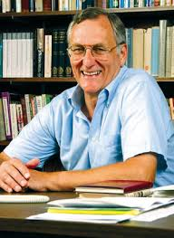
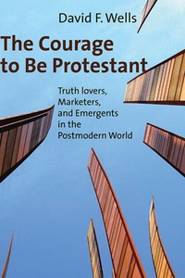

Slide 72
EVALUATION OF NEO-ORTHODOXY
“The Christian message, then, is very clear. It is not, as the neo-orthodox imagined, that the experience of the resurrected Christ, the living Word, happens apart from the written Word. This is a fallacious distinction. It produces a damaging dichotomy between truth in the pages of Scripture and truth in the person of Christ, between the historical Jesus and the Christ of faith. The gospel, in fact, is the gospel of both the historical Jesus and the Christ of faith at the same time. This proclamation was initially oral. Now it is found in the pages of Scripture. And this disclosure of God and his redemptive purposes in the Son is absolute. It will endure for all of time.” (Wells, The Courage to be Protestant, 83)
Notes:
Now we can be glad that most probably do not cheat or lie or fake their conclusions. In fact, the scientific method has a safeguard built into it from the start. Reliable data can only be gleaned from experiments that can be replicated, repeated with the same results. Anyone should be able to conduct the same experiment under the same conditions and achieve the same outcome. If you perform an experiment a thousand times and get the same results a thousand times, then the data is probably correct, even well established. If you get multiple, conflicting outcomes, then the data is not confirmed and needs more work.

Slide 73
EVALUATION OF NEO-ORTHODOXY
Wells goes on to explain that the New Testament shows apostolic Christianity being shaped into “a set of clear teachings, now the doctrines of Scripture.”
“Sometimes these are simply called ‘teachings’ (Acts 2:42; 2 Tim. 3:10) or ‘the standard of teaching (Rom. 6:17) or ‘doctrine’ (1 Tim. 1:10)….In the Pastorals we find more varied language. Besides ‘teaching,’ we also have ‘the faith’ (Titus 1:13; 1 Tim. 3:9), ‘the truth’ (1 Tim. 2:4; 4:3), the ‘pattern of sound words’ (2 Tim. 1:13), or ‘the deposit’ (1 Tim. 6:20; 2 Tim. 1:14).”
Notes:
Now we can be glad that most probably do not cheat or lie or fake their conclusions. In fact, the scientific method has a safeguard built into it from the start. Reliable data can only be gleaned from experiments that can be replicated, repeated with the same results. Anyone should be able to conduct the same experiment under the same conditions and achieve the same outcome. If you perform an experiment a thousand times and get the same results a thousand times, then the data is probably correct, even well established. If you get multiple, conflicting outcomes, then the data is not confirmed and needs more work.

Slide 74
EVALUATION OF NEO-ORTHODOXY
Wells then notes:
“Christianity, in these and texts like them, is described as the faith, the truth, the pattern of sound words, the traditions, the sound doctrine, and what was delivered in the beginning. This is what the apostles taught, it is what they believed, it is what they “delivered” to the church, it is what is “entrusted” to the church. Christians are those who “believe” this teaching, who “know” it, who “have” it, who “stand” in it, and who are “established” in it. The New Testament letters were written to remind believers about their responsibilities in relation to this teaching, this faith that has been delivered to the church in its final and completed form. The apostles, we read, write to “remind” them of it, urge them to “pay close attention” to it, to “stand firm” in it, to “follow” it, to “hold” onto it, to “guard” it as one might a precious jewel, and to “contend” earnestly for this truth.” (Wells, Courage, 84)
Notes:
Now we can be glad that most probably do not cheat or lie or fake their conclusions. In fact, the scientific method has a safeguard built into it from the start. Reliable data can only be gleaned from experiments that can be replicated, repeated with the same results. Anyone should be able to conduct the same experiment under the same conditions and achieve the same outcome. If you perform an experiment a thousand times and get the same results a thousand times, then the data is probably correct, even well established. If you get multiple, conflicting outcomes, then the data is not confirmed and needs more work.

Slide 75
EVALUATION OF NEO-ORTHODOXY
To return to our jigsaw puzzle analogy, for neo-orthodoxy all of the pieces in the box are false pieces.
Yet by working among them, looking at them and examining them, one gets a sense of what the big picture is, even more, one enjoys an encounter with the painter of the original picture himself, even though the pieces themselves do not inform or instruct us in what to believe or what to do.
Notes:
Now we can be glad that most probably do not cheat or lie or fake their conclusions. In fact, the scientific method has a safeguard built into it from the start. Reliable data can only be gleaned from experiments that can be replicated, repeated with the same results. Anyone should be able to conduct the same experiment under the same conditions and achieve the same outcome. If you perform an experiment a thousand times and get the same results a thousand times, then the data is probably correct, even well established. If you get multiple, conflicting outcomes, then the data is not confirmed and needs more work.

Slide 76
“SQUISHY” NEO-ORTHODOXY
As we said, conservative Christians who do not want to appear too conservative, or liberal Christians in conservative churches who want to flirt with liberalism greatly love Barth.
In part, this is because his theology is “squishy” especially in its doctrine of Scripture.
The Bible is important in that it brings us the Word of God. But we are not tied down or held back by its actual words, commands, or beliefs.
Notes:
Now we can be glad that most probably do not cheat or lie or fake their conclusions. In fact, the scientific method has a safeguard built into it from the start. Reliable data can only be gleaned from experiments that can be replicated, repeated with the same results. Anyone should be able to conduct the same experiment under the same conditions and achieve the same outcome. If you perform an experiment a thousand times and get the same results a thousand times, then the data is probably correct, even well established. If you get multiple, conflicting outcomes, then the data is not confirmed and needs more work.

Slide 77
“SQUISHY” NEO-ORTHODOXY
And in truth, Barth often serves as a gateway drug to more destructive forms of unbelief.
The Bible’s many clear commands about sexual purity between husband and wife alone can suddenly be read as flexible guidelines.
One might assert that God is saying something other to me than what the plain words of the Bible mean, and God is speaking through the words in the Bible, words which are certainly not the Word of God.
What the Word of God tells me is to be loving and accepting, welcoming to all.
And I can determine what that may mean for me.
And a “squishy” sexual morality is clearly where Bartianism often leads. For evidence of this, one need look no further than Karl Barth himself.
Notes:
Now we can be glad that most probably do not cheat or lie or fake their conclusions. In fact, the scientific method has a safeguard built into it from the start. Reliable data can only be gleaned from experiments that can be replicated, repeated with the same results. Anyone should be able to conduct the same experiment under the same conditions and achieve the same outcome. If you perform an experiment a thousand times and get the same results a thousand times, then the data is probably correct, even well established. If you get multiple, conflicting outcomes, then the data is not confirmed and needs more work.

Slide 78
BARTH’S NEO-UNORTHODOX ARRANGEMENT
For much of Barth’s life there were rumors that this honored pastor and professor was a little too close to his attractive young secretary, Charlotte von Kirschbaum.
(Continued in Part 2)
Notes:
Now we can be glad that most probably do not cheat or lie or fake their conclusions. In fact, the scientific method has a safeguard built into it from the start. Reliable data can only be gleaned from experiments that can be replicated, repeated with the same results. Anyone should be able to conduct the same experiment under the same conditions and achieve the same outcome. If you perform an experiment a thousand times and get the same results a thousand times, then the data is probably correct, even well established. If you get multiple, conflicting outcomes, then the data is not confirmed and needs more work.

