Slide 1
BARTH’S NEO-UNORTHODOX ARRANGEMENT
For much of Barth’s life there were rumors that this honored pastor and professor was a little too close to his attractive young secretary, Charlotte von Kirschbaum.
Notes:
Now we can be glad that most probably do not cheat or lie or fake their conclusions. In fact, the scientific method has a safeguard built into it from the start. Reliable data can only be gleaned from experiments that can be replicated, repeated with the same results. Anyone should be able to conduct the same experiment under the same conditions and achieve the same outcome. If you perform an experiment a thousand times and get the same results a thousand times, then the data is probably correct, even well established. If you get multiple, conflicting outcomes, then the data is not confirmed and needs more work.

Slide 2
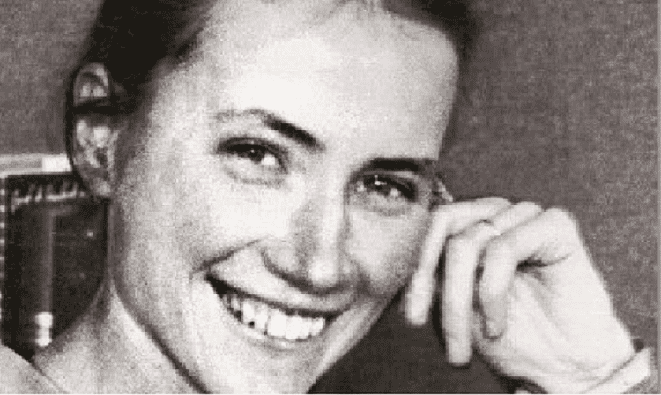
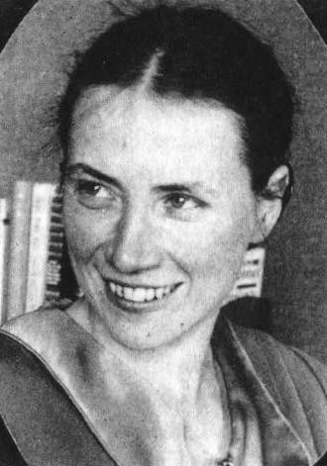

Slide 3
BARTH’S NEO-UNORTHODOX ARRANGEMENT
But in 2008 the letters between Charlotte von Kirschbaum and Karl Barth from 1925-1935 were published. And what they reveal is truly shocking.
Long after Barth had been married to his wife, Nelly, the mother of his children, he met and fell in love with the young von Kirschbaum, a nurse by trade.
Eventually, he asked her to be his secretary, and spent the summer with her in a small house on Lake Zurich.
Notes:
Now we can be glad that most probably do not cheat or lie or fake their conclusions. In fact, the scientific method has a safeguard built into it from the start. Reliable data can only be gleaned from experiments that can be replicated, repeated with the same results. Anyone should be able to conduct the same experiment under the same conditions and achieve the same outcome. If you perform an experiment a thousand times and get the same results a thousand times, then the data is probably correct, even well established. If you get multiple, conflicting outcomes, then the data is not confirmed and needs more work.

Slide 4
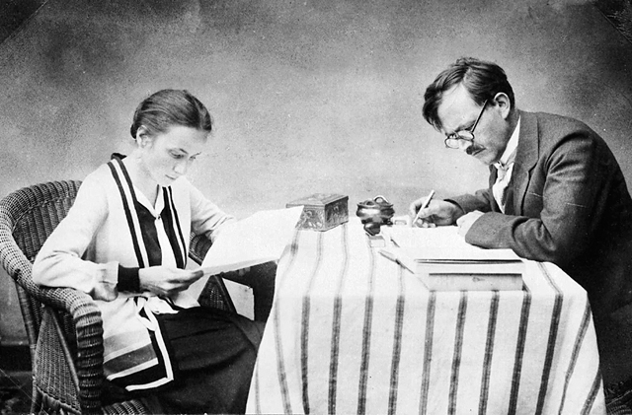

Slide 5
BARTH’S NEO-UNORTHODOX ARRANGEMENT
At the end of the summer, von Kirschbaum moved into the Barth household in a “Notgemeindschaft zu dritt” “a union of trouble and necessity as a threesome.”
Barth remained committed to his marriage, but also to his true love to von Kirschbaum.
Several have tried to soften the ugliness of this arrangement in which Karl’s wife Nelly Barth suffered greatly, as you can imagine, but it is just as bad as it sounds.
Notes:
Now we can be glad that most probably do not cheat or lie or fake their conclusions. In fact, the scientific method has a safeguard built into it from the start. Reliable data can only be gleaned from experiments that can be replicated, repeated with the same results. Anyone should be able to conduct the same experiment under the same conditions and achieve the same outcome. If you perform an experiment a thousand times and get the same results a thousand times, then the data is probably correct, even well established. If you get multiple, conflicting outcomes, then the data is not confirmed and needs more work.

Slide 6
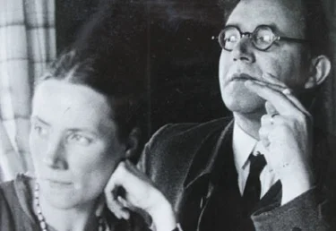
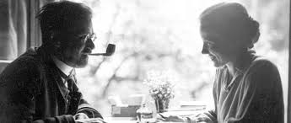
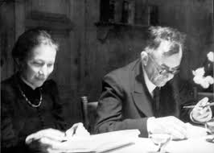
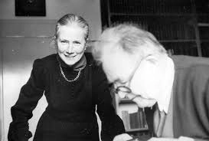
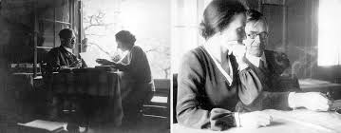

Slide 8
BARTH’S NEO-UNORTHODOX ARRANGEMENT
All of this was exposed to the public in an article written by Christiane Tietz, University of Zurich, Faculty of Theology, published in Theology Today in 2017.
It is painful to read.
Barth’s trying to justify his decades-long extramarital affair sounds at times exactly like the excuses proffered by every philandering husband who wants to take a walk on the wild side.
The suffering he subjected his wife and the mother of his children to is unconscionable.
I will quote a review of the article by my friend, Bill Evans, Professor of Bible and Religion at Erskine College. His review is titled “Why I Still Don’t Much Care for Karl Barth.”
Notes:
Now we can be glad that most probably do not cheat or lie or fake their conclusions. In fact, the scientific method has a safeguard built into it from the start. Reliable data can only be gleaned from experiments that can be replicated, repeated with the same results. Anyone should be able to conduct the same experiment under the same conditions and achieve the same outcome. If you perform an experiment a thousand times and get the same results a thousand times, then the data is probably correct, even well established. If you get multiple, conflicting outcomes, then the data is not confirmed and needs more work.

Slide 9
BARTH’S NEO-UNORTHODOX ARRANGEMENT
“[Tietz’s] article itself, with copious quotations from the letters of the principals, is excruciating to read. Barth first met von Kirschbaum, who was fifteen years younger than he, in 1925 at the home of a friend and by early in 1926 they knew they were in love. In September of 1929 Barth moved von Kirschbaum into his home, and from that point on the theologian lived with two women. The picture of Barth that emerges from these letters is that of a man who recognized the awkwardness of his situation but who was steadfastly unwilling to give up his relationship with a mistress who, unlike Barth’s wife, was both a physical and intellectual partner.
Notes:
Now we can be glad that most probably do not cheat or lie or fake their conclusions. In fact, the scientific method has a safeguard built into it from the start. Reliable data can only be gleaned from experiments that can be replicated, repeated with the same results. Anyone should be able to conduct the same experiment under the same conditions and achieve the same outcome. If you perform an experiment a thousand times and get the same results a thousand times, then the data is probably correct, even well established. If you get multiple, conflicting outcomes, then the data is not confirmed and needs more work.

Slide 10
BARTH’S NEO-UNORTHODOX ARRANGEMENT
“The article also details the cognitive bargaining in which both Barth and von Kirschbaum engaged in order to justify this Notgemeinsschaft zu dritt (“union of necessity and trouble as a threesome”). Barth himself rejected the admonitions of friends and family, and his own mother asked him, “What is the most brilliant theology good for, if it is to be shipwrecked in one’s own house?” (Tietz, 107; cf. pp. 103-104). As Tietz (p. 102) summarizes Barth in one of his letters, “The necessity lay in this: He wants to keep the outer order of marriage but also to be true to his love to Charlotte. He confesses his guilt: that in a situation where he was still immature, he had asked Nelly to become his wife, that he was not what a man should be for his wife, and that he finally was unable to remain faithful to her.”
Notes:
Now we can be glad that most probably do not cheat or lie or fake their conclusions. In fact, the scientific method has a safeguard built into it from the start. Reliable data can only be gleaned from experiments that can be replicated, repeated with the same results. Anyone should be able to conduct the same experiment under the same conditions and achieve the same outcome. If you perform an experiment a thousand times and get the same results a thousand times, then the data is probably correct, even well established. If you get multiple, conflicting outcomes, then the data is not confirmed and needs more work.

Slide 11
BARTH’S NEO-UNORTHODOX ARRANGEMENT
“Yet, while recognizing a personal failure toward his wife Barth seems to have denied any moral failure, declaring that he had “never preached morally,” and, writing to von Kirschbaum, “it cannot just be the devil’s work, it must have some meaning and a right to live, that we, no, I will only talk about me: that I love you and do not see any chance to stop this” (pp. 107, 109). Even von Kirschbaum was convinced that her relationship to Barth was a “marriage” and that it was a “responsible relationship” before God (p. 110).
“All this is, frankly, disturbing in ways that challenge the capacity of language to describe. Terms such as “adultery” and “affair” don’t seem to do full justice to what Barth was up to. Perhaps “functional bigamy” is a better descriptor, but the level of chutzpa and hubris evident in Barth’s behavior and his disregard for the feelings of his wife Nelly are truly astonishing.”
Notes:
Now we can be glad that most probably do not cheat or lie or fake their conclusions. In fact, the scientific method has a safeguard built into it from the start. Reliable data can only be gleaned from experiments that can be replicated, repeated with the same results. Anyone should be able to conduct the same experiment under the same conditions and achieve the same outcome. If you perform an experiment a thousand times and get the same results a thousand times, then the data is probably correct, even well established. If you get multiple, conflicting outcomes, then the data is not confirmed and needs more work.

Slide 12
BARTH’S NEO-UNORTHODOX ARRANGEMENT
Bill Evans observes that one should not judge Barth’s theology on his actions but on its own merits.
I agree, to a point.
To disqualify someone’s ideas simply on their personal behavior, without engaging or refuting their ideas, is a recognized logical fallacy called “an ad hominem (to the man) attack.” This happens continually today in our present “cancel culture.” If one cannot refute another person’s position, they simply shout “racist!” and their opponent is “cancelled”: dismissed and ignored.
Notes:
Now we can be glad that most probably do not cheat or lie or fake their conclusions. In fact, the scientific method has a safeguard built into it from the start. Reliable data can only be gleaned from experiments that can be replicated, repeated with the same results. Anyone should be able to conduct the same experiment under the same conditions and achieve the same outcome. If you perform an experiment a thousand times and get the same results a thousand times, then the data is probably correct, even well established. If you get multiple, conflicting outcomes, then the data is not confirmed and needs more work.

Slide 13
BARTH’S NEO-UNORTHODOX ARRANGEMENT
But what if one’s own views or teaching leads to the bad behavior?
Remember, Barth’s theological method is called “dialectical,” loving the tension between opposites. And Barth used that “tension” to justify his adultery.
Tietz writes: “Barth interprets his own situation theologically as standing in tension between ‘order’ and that which ‘has come upon us unintentionally out of the mysterious-guilty depth of the human,’ between ‘the holiness of the command,’ and ‘that you and I (I don’t know on which level) are together,” between the right and the ‘natural event.’”
(108)
Notes:
Now we can be glad that most probably do not cheat or lie or fake their conclusions. In fact, the scientific method has a safeguard built into it from the start. Reliable data can only be gleaned from experiments that can be replicated, repeated with the same results. Anyone should be able to conduct the same experiment under the same conditions and achieve the same outcome. If you perform an experiment a thousand times and get the same results a thousand times, then the data is probably correct, even well established. If you get multiple, conflicting outcomes, then the data is not confirmed and needs more work.

Slide 14
BARTH’S NEO-UNORTHODOX ARRANGEMENT
Tietz continues: “Barth also stands in the tension between ‘the shadow of guilt and suffering and renunciation’ and a ‘right to each other which is difficult to outline’ and which leads to joy. Barth is convinced: ‘it cannot just be the devils work, it must have some meaning and a right to live, that we, no, I will only talk about me: that I love you and do not see any chance to stop this.’ Barth has the feeling that somehow God did this and speaks of ‘the two who are ordained to me.’”
Imagine poor Nelly Barth objecting to her husband’s adultery, and being accused of opposing God in doing so! Such self-serving cruelty would be shocking even to pagans!
Notes:
Now we can be glad that most probably do not cheat or lie or fake their conclusions. In fact, the scientific method has a safeguard built into it from the start. Reliable data can only be gleaned from experiments that can be replicated, repeated with the same results. Anyone should be able to conduct the same experiment under the same conditions and achieve the same outcome. If you perform an experiment a thousand times and get the same results a thousand times, then the data is probably correct, even well established. If you get multiple, conflicting outcomes, then the data is not confirmed and needs more work.

Slide 15
BARTH’S NEO-UNORTHODOX ARRANGEMENT
Here it is in Barth’s own words:
“The way I am, I never could and still cannot deny either the reality of my marriage or the reality of my love. It is true that I am married, that I am a father and a grandfather. It is also true that I love. And it is true, that these two facts don’t match. This is why we after some hesitation at the beginning decided not to solve the problem with a separation on one or the other side.”
Notes:
Now we can be glad that most probably do not cheat or lie or fake their conclusions. In fact, the scientific method has a safeguard built into it from the start. Reliable data can only be gleaned from experiments that can be replicated, repeated with the same results. Anyone should be able to conduct the same experiment under the same conditions and achieve the same outcome. If you perform an experiment a thousand times and get the same results a thousand times, then the data is probably correct, even well established. If you get multiple, conflicting outcomes, then the data is not confirmed and needs more work.

Slide 16
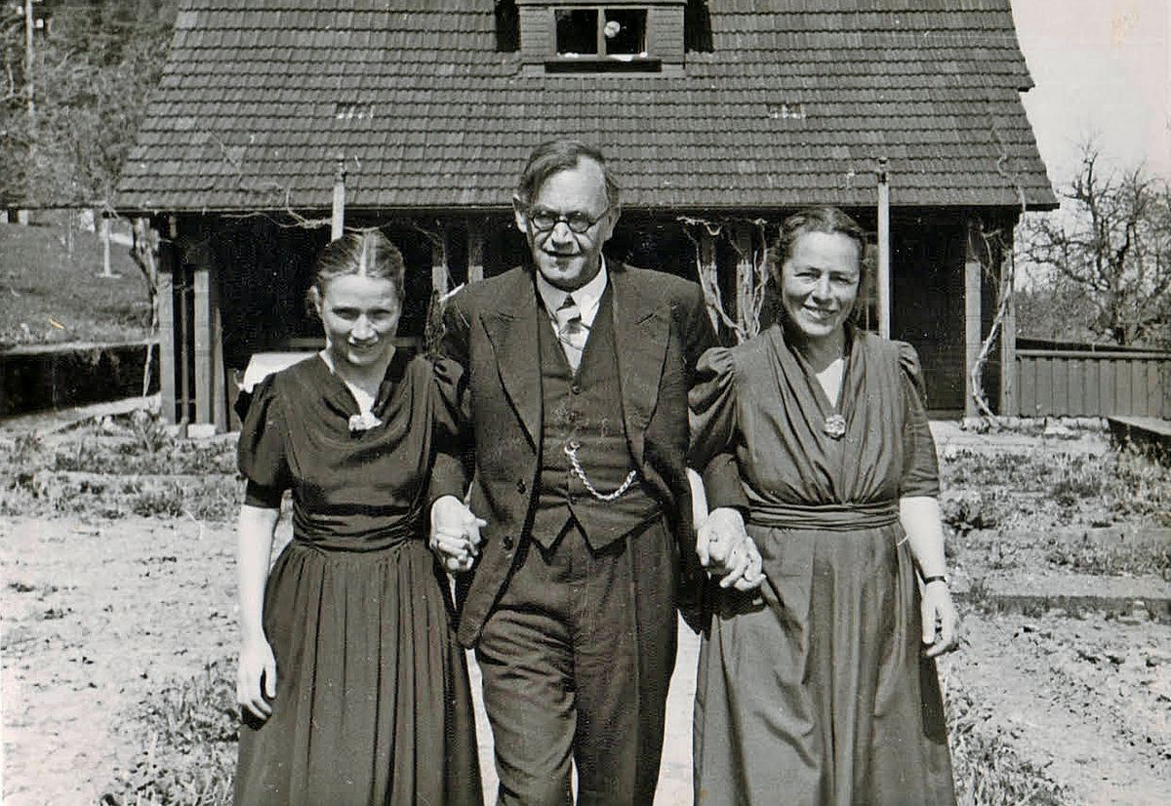

Slide 17
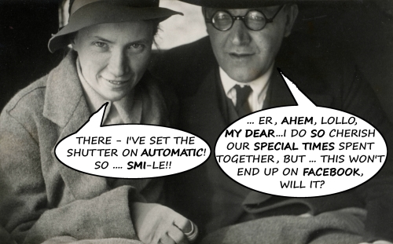

Slide 18
BARTH’S NEO-UNORTHODOX ARRANGEMENT
Imagine approaching your spouse and trying to explain that your younger girlfriend or boyfriend needs to move into your house with the two of you because you feel a duty to your spouse, but really love your lover as well. How do you think that would work out?
Notes:
Now we can be glad that most probably do not cheat or lie or fake their conclusions. In fact, the scientific method has a safeguard built into it from the start. Reliable data can only be gleaned from experiments that can be replicated, repeated with the same results. Anyone should be able to conduct the same experiment under the same conditions and achieve the same outcome. If you perform an experiment a thousand times and get the same results a thousand times, then the data is probably correct, even well established. If you get multiple, conflicting outcomes, then the data is not confirmed and needs more work.

Slide 19
BARTH’S NEO-UNORTHODOX ARRANGEMENT
And remember, this is not the atheist Freud or the atheist Mead or the atheist, sexual predator Kinsey, but “the greatest theologian of the twentieth century!”
We probably should look closely and critically at a theology that could produce and try to justify this disgraceful threesome.
Barth’s own mother complained: “What is the most brilliant theology good for, if it is to be shipwrecked in one’s own home?”
Notes:
Now we can be glad that most probably do not cheat or lie or fake their conclusions. In fact, the scientific method has a safeguard built into it from the start. Reliable data can only be gleaned from experiments that can be replicated, repeated with the same results. Anyone should be able to conduct the same experiment under the same conditions and achieve the same outcome. If you perform an experiment a thousand times and get the same results a thousand times, then the data is probably correct, even well established. If you get multiple, conflicting outcomes, then the data is not confirmed and needs more work.

Slide 20
BARTH’S NEO-UNORTHODOX ARRANGEMENT
Bill Evan’s explains why he “still does not much care for Karl Barth.” “The good stuff in Barth can generally be found elsewhere in the tradition. But when Barth ventures out on his own….the results are often unhappy.”
Theologian John Frame is also “generally negative” toward Barth. But he says, “I confess that I can spend hours reading pages and pages of Barth and finding nothing wrong, and much that edifies me.”
But why bother with Barth when others have said the same, and have done so more reliably and more faithfully?
Notes:
Now we can be glad that most probably do not cheat or lie or fake their conclusions. In fact, the scientific method has a safeguard built into it from the start. Reliable data can only be gleaned from experiments that can be replicated, repeated with the same results. Anyone should be able to conduct the same experiment under the same conditions and achieve the same outcome. If you perform an experiment a thousand times and get the same results a thousand times, then the data is probably correct, even well established. If you get multiple, conflicting outcomes, then the data is not confirmed and needs more work.

Slide 21
BARTH’S SAD LEGACY
But, as I suggested earlier, Barth is a gateway drug that often leads to more radical forms of unbelief. And let me give you an example.
For twenty years I served this church when we were in the liberal Presbyterian Church (USA). Things became so crazy that we left in 2006.
I did my initial seminary training at Trinity Evangelical Divinity School in the time of “the battle for the Bible.” Fuller Seminary had become Barthian, and Trinity responded quite loudly.
A Presbyterian (USA) seminary professor at Fuller named Jack Rogers had coauthored a book that contended that every theologian back to the Apostle Paul had actually been a Barthian and had taught that the Bible was not the inerrant Word of God but only mediated the Word of God at times. They quoted from all the greats including Luther and Calvin.
Notes:
Now we can be glad that most probably do not cheat or lie or fake their conclusions. In fact, the scientific method has a safeguard built into it from the start. Reliable data can only be gleaned from experiments that can be replicated, repeated with the same results. Anyone should be able to conduct the same experiment under the same conditions and achieve the same outcome. If you perform an experiment a thousand times and get the same results a thousand times, then the data is probably correct, even well established. If you get multiple, conflicting outcomes, then the data is not confirmed and needs more work.

Slide 22
BARTH’S SAD LEGACY
Two of my professors from Trinity, D.A. Carson and John Woodbridge went back and checked all of their quotations.
Notes:
Now we can be glad that most probably do not cheat or lie or fake their conclusions. In fact, the scientific method has a safeguard built into it from the start. Reliable data can only be gleaned from experiments that can be replicated, repeated with the same results. Anyone should be able to conduct the same experiment under the same conditions and achieve the same outcome. If you perform an experiment a thousand times and get the same results a thousand times, then the data is probably correct, even well established. If you get multiple, conflicting outcomes, then the data is not confirmed and needs more work.

Slide 23
BARTH’S SAD LEGACY
Carson and Woodbridge found that in virtually every instance Rogers and his partner had misquoted, or only partially quoted those theologians, and they demonstrated all of these errors in their book Biblical Authority.
It was a masterful response that was quite embarrassing to Jack Rogers and showed him to be a biased, third-rate, pseudo-scholar.
So all through my three years of seminary, the neo-orthodox Jack Rogers, the Barthian was the enemy.
Notes:
Now we can be glad that most probably do not cheat or lie or fake their conclusions. In fact, the scientific method has a safeguard built into it from the start. Reliable data can only be gleaned from experiments that can be replicated, repeated with the same results. Anyone should be able to conduct the same experiment under the same conditions and achieve the same outcome. If you perform an experiment a thousand times and get the same results a thousand times, then the data is probably correct, even well established. If you get multiple, conflicting outcomes, then the data is not confirmed and needs more work.

Slide 24
BARTH’S SAD LEGACY
Imagine my surprise when I was ordained into the PC(USA). Guess who was the hero of the conservatives in the PC(USA)?
Jack Rogers, the “conservative” Barthian. He was among the leaders of the more biblical side of the PC(USA).
And the chief issue at the time was the ordination of unrepentant, self-affirmed homosexuals.
But about ten years into it, Jack Rogers, the conservative, neo-orthodox champion flipped. He changed his mind in favor of homosexual ordination.
All the conservatives were quite disillusioned.
But for Jack Rogers, Barth had proved to be a gateway drug to a more radical form of unbelief, and eventually for the whole denomination. With Jack Rogers help, the PC(USA) went full-on, pro-gay ordination in 2006. That was the year we left.
Notes:
Now we can be glad that most probably do not cheat or lie or fake their conclusions. In fact, the scientific method has a safeguard built into it from the start. Reliable data can only be gleaned from experiments that can be replicated, repeated with the same results. Anyone should be able to conduct the same experiment under the same conditions and achieve the same outcome. If you perform an experiment a thousand times and get the same results a thousand times, then the data is probably correct, even well established. If you get multiple, conflicting outcomes, then the data is not confirmed and needs more work.

Slide 26
LET’S SUPPOSE…
Karl Barth was a pastor and theology professor for all of his adult life.
So…
suppose your pastor had his girlfriend move in with him and his wife in a “threesome.” How do you think your church would respond?
I know what would happen in our denomination, the PCA.
Other elders or pastors or church members would confront the adulterer.
If he tried to excuse or to justify his adultery (as Barth did), disciplinary charges would be filed.
He would be tried before the presbytery, and his ordination would be revoked.
If he continued in his refusal to repent (as Barth did, apparently his whole life), he would be excommunicated, for the sake of his soul.
Notes:
Now we can be glad that most probably do not cheat or lie or fake their conclusions. In fact, the scientific method has a safeguard built into it from the start. Reliable data can only be gleaned from experiments that can be replicated, repeated with the same results. Anyone should be able to conduct the same experiment under the same conditions and achieve the same outcome. If you perform an experiment a thousand times and get the same results a thousand times, then the data is probably correct, even well established. If you get multiple, conflicting outcomes, then the data is not confirmed and needs more work.

Slide 27
PASTOR KARL BARTH?
Think of it, Karl Barth could not serve as a pastor, elder, or deacon in any rightly ordered church!
In fact, the unrepentant, long-term adulterer could not even be a member of any rightly ordered church.
Real Christians sin, sometimes quite shockingly.
But real Christians repent and turn from their sin just as earnestly.
Notes:
Now we can be glad that most probably do not cheat or lie or fake their conclusions. In fact, the scientific method has a safeguard built into it from the start. Reliable data can only be gleaned from experiments that can be replicated, repeated with the same results. Anyone should be able to conduct the same experiment under the same conditions and achieve the same outcome. If you perform an experiment a thousand times and get the same results a thousand times, then the data is probably correct, even well established. If you get multiple, conflicting outcomes, then the data is not confirmed and needs more work.

Slide 28
A CHRISTIAN WHO WILL NOT REPENT OF SIN?
More seriously, do you know what we call a Christian who refuses to repent of their sin?
We rightly call them an unbeliever.
Do you know what we call theological teaching that excuses adultery?
We call it false teaching, heresy.
Do we know what we call those who teach heresy?
We call them false teachers.
We call them heretics.
Notes:
Now we can be glad that most probably do not cheat or lie or fake their conclusions. In fact, the scientific method has a safeguard built into it from the start. Reliable data can only be gleaned from experiments that can be replicated, repeated with the same results. Anyone should be able to conduct the same experiment under the same conditions and achieve the same outcome. If you perform an experiment a thousand times and get the same results a thousand times, then the data is probably correct, even well established. If you get multiple, conflicting outcomes, then the data is not confirmed and needs more work.

Slide 29
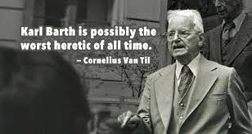

Slide 30
THEOLOGIAN KARL BARTH?
“The greatest theologian of the twentieth century?”
I would consider his mother to be a greater theologian, for at least she knew right from wrong. Barth’s mother asked…
“What is the most brilliant theology good for, if it is to be shipwrecked in one’s own house?”
Notes:
Now we can be glad that most probably do not cheat or lie or fake their conclusions. In fact, the scientific method has a safeguard built into it from the start. Reliable data can only be gleaned from experiments that can be replicated, repeated with the same results. Anyone should be able to conduct the same experiment under the same conditions and achieve the same outcome. If you perform an experiment a thousand times and get the same results a thousand times, then the data is probably correct, even well established. If you get multiple, conflicting outcomes, then the data is not confirmed and needs more work.

Slide 31
REPENTANCE INCLUDES RENUNCIATION
Barth said that “renunciation” of his adulterous “love” for his girlfriend was not an option.
Jesus said, “If your right eye causes you to sin, tear it out and throw it away. For it is better that you lose one of your members than that your whole body be thrown into hell.” (Matthew 5:29)
But then, quite conveniently for Barth, those words cannot be the “Word of God,” because not even the Son of God can speak the Word of God using words, words that might bind us in some way.
And what we receive from Barth is squishy wiggle room, and no sure foundation for life here or in the hereafter.
Notes:
Now we can be glad that most probably do not cheat or lie or fake their conclusions. In fact, the scientific method has a safeguard built into it from the start. Reliable data can only be gleaned from experiments that can be replicated, repeated with the same results. Anyone should be able to conduct the same experiment under the same conditions and achieve the same outcome. If you perform an experiment a thousand times and get the same results a thousand times, then the data is probably correct, even well established. If you get multiple, conflicting outcomes, then the data is not confirmed and needs more work.

Slide 32
DESIRE AND TRUTH
E. Michael Jones’ comment could well apply to Barth: “The most insidious corruption brought about by sexual sin…is the corruption of the mind. One moves all too easily from sexual sins, which are probably the most common to mankind, to intellectual sins, which are the most pernicious.” (Degenerate Moderns, 12)
So we must decide:
“There are ultimately only two alternatives in the intellectual life: either one conforms desire to the truth or one conforms truth to desire.” (Jones, 11)
Notes:
Now we can be glad that most probably do not cheat or lie or fake their conclusions. In fact, the scientific method has a safeguard built into it from the start. Reliable data can only be gleaned from experiments that can be replicated, repeated with the same results. Anyone should be able to conduct the same experiment under the same conditions and achieve the same outcome. If you perform an experiment a thousand times and get the same results a thousand times, then the data is probably correct, even well established. If you get multiple, conflicting outcomes, then the data is not confirmed and needs more work.

Slide 34
Hospers PCA Summer Seminars 2020
“The Roots of the (Moral) Revolution”
June 9: “Sigmund Freud’s Complicated Oedipus Complex” (Psychology)
June 23: “Margaret Mead’s Fantasy Island” (Anthropology)
July 21: “Alfred Kinsey’s Wild Ride (or Bogus Adventure?)” (Biology)
August 11: “Karl Barth’s Neo-Unorthodox Arrangement” (Theology)
(All Seminars on Tuesdays at 7:00 p.m.)

