Slide 1
Hospers PCA Summer Seminars 2020
“The Roots of the (Moral) Revolution”
June 9: “Sigmund Freud’s Complicated Oedipus Complex” (Psychology)
June 23: “Margaret Mead’s Fantasy Island” (Anthropology)
July 21: “Alfred Kinsey’s Wild Ride (or Bogus Adventure?)” (Biology)
August 11: “Karl Barth’s Neo-Unorthodox Arrangement” (Theology)
(All Seminars on Tuesdays at 7:00 p.m.)
Notes:
Now we can be glad that most probably do not cheat or lie or fake their conclusions. In fact, the scientific method has a safeguard built into it from the start. Reliable data can only be gleaned from experiments that can be replicated, repeated with the same results. Anyone should be able to conduct the same experiment under the same conditions and achieve the same outcome. If you perform an experiment a thousand times and get the same results a thousand times, then the data is probably correct, even well established. If you get multiple, conflicting outcomes, then the data is not confirmed and needs more work.

Slide 2
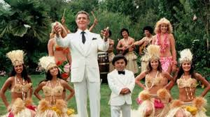
MARGARET MEAD’S FANTASY ISLAND

Slide 3
Margaret mead’s fantasy island
The Roots of the (Moral) Revolution, Part 2

Slide 4
INTRODUCTION
This year’s theme for all four summer seminars is :
“The Roots of the (Moral) Revolution.”
We are examining the supposed intellectual giants who loaned seemingly scientific credence to the sexual revolution:
Sigmund Freud in psychology,
Margaret Mead in anthropology,
the unindicted sexual predator Alfred Kinsey in biology or sexology,
and finally the outlier, Karl Barth in theology.
Notes:
Now we can be glad that most probably do not cheat or lie or fake their conclusions. In fact, the scientific method has a safeguard built into it from the start. Reliable data can only be gleaned from experiments that can be replicated, repeated with the same results. Anyone should be able to conduct the same experiment under the same conditions and achieve the same outcome. If you perform an experiment a thousand times and get the same results a thousand times, then the data is probably correct, even well established. If you get multiple, conflicting outcomes, then the data is not confirmed and needs more work.

Slide 5
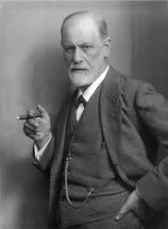
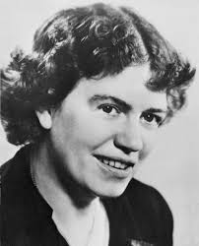
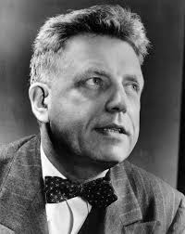
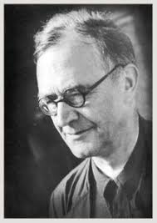
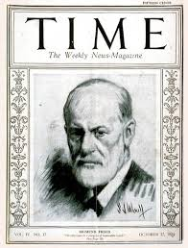
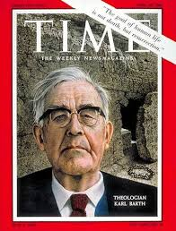

Slide 6
INTRODUCTION
Through their shoddy, so-called “research” and unsubstantiated theories, each one gave the green light to the sexual revolution and stomped on the gas pedal, unleashing a runaway locomotive which by now has become an obvious train wreck of sexual licentiousness.
Notes:
Now we can be glad that most probably do not cheat or lie or fake their conclusions. In fact, the scientific method has a safeguard built into it from the start. Reliable data can only be gleaned from experiments that can be replicated, repeated with the same results. Anyone should be able to conduct the same experiment under the same conditions and achieve the same outcome. If you perform an experiment a thousand times and get the same results a thousand times, then the data is probably correct, even well established. If you get multiple, conflicting outcomes, then the data is not confirmed and needs more work.

Slide 7
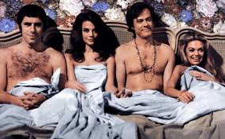

Slide 8
INTRODUCTION
Through their shoddy, so-called “research” and unsubstantiated theories, each one gave the green light to the sexual revolution and stomped on the gas pedal, unleashing a runaway locomotive which by now has become an obvious train wreck of sexual licentiousness.
We witness the carnage in the destroyed innocence, the ruined lives and families, and the cultural gates flung wide open to pornography, human trafficking, and sexual exploitation of children,
and, worst of all, the holocaust of abortion on demand: sixty-one million plus unborn children up the chimney, with another seventeen hundred plus today and every day of the year.
Notes:
Now we can be glad that most probably do not cheat or lie or fake their conclusions. In fact, the scientific method has a safeguard built into it from the start. Reliable data can only be gleaned from experiments that can be replicated, repeated with the same results. Anyone should be able to conduct the same experiment under the same conditions and achieve the same outcome. If you perform an experiment a thousand times and get the same results a thousand times, then the data is probably correct, even well established. If you get multiple, conflicting outcomes, then the data is not confirmed and needs more work.

Slide 10
INTRODUCTION
In fact, this theme of the exploding sexual revolution is literally “ripped from the headlines.”
Last week the US Supreme Court ruled that the 1964 Civil Rights Act against sex discrimination now applies to the entire growing rainbow of capital letters in the LGBTQ+++ universe.
So, if you have someone with the road gear of a man who unknowingly got hired as a woman to teach high school girls PE, and that person hands out towels in the girls’ locker room, you’d better not try to fire them. And the girls better not try to ditch PE, either. And that probably goes for Christian and parochial schools as well.
Notes:
Now we can be glad that most probably do not cheat or lie or fake their conclusions. In fact, the scientific method has a safeguard built into it from the start. Reliable data can only be gleaned from experiments that can be replicated, repeated with the same results. Anyone should be able to conduct the same experiment under the same conditions and achieve the same outcome. If you perform an experiment a thousand times and get the same results a thousand times, then the data is probably correct, even well established. If you get multiple, conflicting outcomes, then the data is not confirmed and needs more work.

Slide 12
INTRODUCTION
In fact, this theme of the exploding sexual revolution is literally “ripped from the headlines.”
Last week the US Supreme Court ruled that the 1964 Civil Rights Act against sex discrimination now applies to the entire growing rainbow of capital letters in the LGBTQ+++ universe.
So, if you have someone with the road gear of a man who unknowingly got hired as a woman to teach high school girls PE, and that person hands out towels in the girls’ locker room, you’d better not try to fire them. And the girls better not try to ditch PE, either. And that probably goes for Christian and parochial schools as well.
I’m not a prophet nor the son of a prophet and I work for a non-profit organization, but there is no way I can envision that error being corrected in my lifetime.
Notes:
Now we can be glad that most probably do not cheat or lie or fake their conclusions. In fact, the scientific method has a safeguard built into it from the start. Reliable data can only be gleaned from experiments that can be replicated, repeated with the same results. Anyone should be able to conduct the same experiment under the same conditions and achieve the same outcome. If you perform an experiment a thousand times and get the same results a thousand times, then the data is probably correct, even well established. If you get multiple, conflicting outcomes, then the data is not confirmed and needs more work.

Slide 13
INTRODUCTION
But for each of these “scholars” there was also another motive, plainly evident.
Each one was an eager participant, even a pioneer in the sexual revolution themselves, engaging in shameful sexual sin and so motivated by a powerful impulse to pull down the prevailing sexual moral code and to replace it with something matching their preferred practice.
Notes:
Now we can be glad that most probably do not cheat or lie or fake their conclusions. In fact, the scientific method has a safeguard built into it from the start. Reliable data can only be gleaned from experiments that can be replicated, repeated with the same results. Anyone should be able to conduct the same experiment under the same conditions and achieve the same outcome. If you perform an experiment a thousand times and get the same results a thousand times, then the data is probably correct, even well established. If you get multiple, conflicting outcomes, then the data is not confirmed and needs more work.

Slide 14
INTRODUCTION
So how did it come to this?
One factor is the subject of this year’s summer seminars. We were assured by the “experts” that free love is healthy and that rules and restrictions are bad and create not only neuroses, mental illness (Sigmund Freud) but virtually every cultural problem humanity has ever faced (Margaret Mead).
As we saw last time, Freud’s odd theories attributing almost all mental illness to frustrated, unresolved sexual desires were eventually dismissed. But in their time, they found their niche.
Instead of considering Freud a sex-obsessed, dirty old man, many welcomed his message, excited about the possibility of a new morality of sexual liberation.
Notes:
Now we can be glad that most probably do not cheat or lie or fake their conclusions. In fact, the scientific method has a safeguard built into it from the start. Reliable data can only be gleaned from experiments that can be replicated, repeated with the same results. Anyone should be able to conduct the same experiment under the same conditions and achieve the same outcome. If you perform an experiment a thousand times and get the same results a thousand times, then the data is probably correct, even well established. If you get multiple, conflicting outcomes, then the data is not confirmed and needs more work.

Slide 15
INTRODUCTION
And even though the theories have been debunked, the subtle implication has remained and even grown over time: “it is not psychologically healthy to allow your sexual desires to go unfulfilled.”
But, alas, Freud’s strangest and most bizarre theory, that every child wants to commit incest, to kill their same sex parent and have sex with their opposite sex parent, which Freud made famous as his “Oedipus complex,” was most likely a reflection of Freud’s own guilty conscience.
Freud carried on a decades-long, incestuous, adulterous affair with his boring wife’s snappy younger sister and live-in housekeeper/slash/mother figure.
Notes:
Now we can be glad that most probably do not cheat or lie or fake their conclusions. In fact, the scientific method has a safeguard built into it from the start. Reliable data can only be gleaned from experiments that can be replicated, repeated with the same results. Anyone should be able to conduct the same experiment under the same conditions and achieve the same outcome. If you perform an experiment a thousand times and get the same results a thousand times, then the data is probably correct, even well established. If you get multiple, conflicting outcomes, then the data is not confirmed and needs more work.

Slide 16
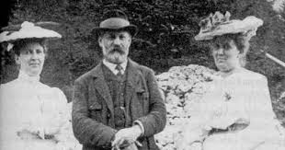

Slide 17
INTRODUCTION
Minna Bernays lived in his household for forty-two years. As a psychologist trying to fix patients, this was less of a “blind leading the blind” scenario and more of the “sicko trying to heal the sick” situation.
I’m not sure I want to follow this guy into any kind of moral/sexual revolution. Judging from his own practice, I’m a little troubled as to where he might lead us.
But many have followed him into the revolution, and we are witnessing some pretty terrible things, some of them unimaginable just a few decades ago.
Notes:
Now we can be glad that most probably do not cheat or lie or fake their conclusions. In fact, the scientific method has a safeguard built into it from the start. Reliable data can only be gleaned from experiments that can be replicated, repeated with the same results. Anyone should be able to conduct the same experiment under the same conditions and achieve the same outcome. If you perform an experiment a thousand times and get the same results a thousand times, then the data is probably correct, even well established. If you get multiple, conflicting outcomes, then the data is not confirmed and needs more work.

Slide 18
INTRODUCTION
Again, this is not a mere ad hominem attack on the man’s character instead of his ideas.
The point is that his ideas came from his morally diseased character, so his life and practice should not simply be taken into account, but they actually reveal the foundation for his, what one Freud scholar and supporter calls, “obscene” theories.
Notes:
Now we can be glad that most probably do not cheat or lie or fake their conclusions. In fact, the scientific method has a safeguard built into it from the start. Reliable data can only be gleaned from experiments that can be replicated, repeated with the same results. Anyone should be able to conduct the same experiment under the same conditions and achieve the same outcome. If you perform an experiment a thousand times and get the same results a thousand times, then the data is probably correct, even well established. If you get multiple, conflicting outcomes, then the data is not confirmed and needs more work.

Slide 19
INTRODUCTION
And then there was Margaret Mead.
Notes:
Now we can be glad that most probably do not cheat or lie or fake their conclusions. In fact, the scientific method has a safeguard built into it from the start. Reliable data can only be gleaned from experiments that can be replicated, repeated with the same results. Anyone should be able to conduct the same experiment under the same conditions and achieve the same outcome. If you perform an experiment a thousand times and get the same results a thousand times, then the data is probably correct, even well established. If you get multiple, conflicting outcomes, then the data is not confirmed and needs more work.

Slide 20
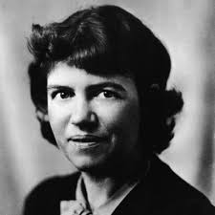
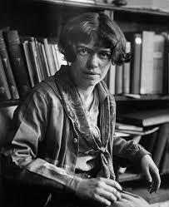
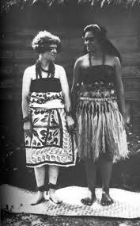
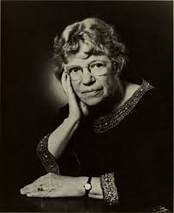
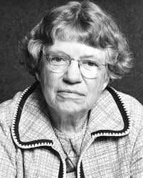

Slide 21
INTRODUCTION
And then there was Margaret Mead.
If you have heard of any anthropologist ever, you have heard of Margaret Mead, the most celebrated, the most famous, and, it turns out, the most fraudulent of them all.
As of 1993 her 1928 book Coming of Age in Samoa had sold millions upon millions of copies in sixteen languages including Urdu and Serbo-Croatian.
Notes:
Now we can be glad that most probably do not cheat or lie or fake their conclusions. In fact, the scientific method has a safeguard built into it from the start. Reliable data can only be gleaned from experiments that can be replicated, repeated with the same results. Anyone should be able to conduct the same experiment under the same conditions and achieve the same outcome. If you perform an experiment a thousand times and get the same results a thousand times, then the data is probably correct, even well established. If you get multiple, conflicting outcomes, then the data is not confirmed and needs more work.

Slide 22
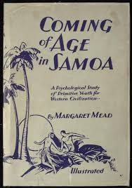
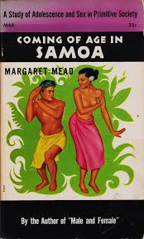

Slide 23
INTRODUCTION
And then there was Margaret Mead.
If you have heard of any anthropologist ever, you have heard of Margaret Mead, the most celebrated, the most famous, and, it turns out, the most fraudulent of them all.
As of 1993 her 1928 book Coming of Age in Samoa had sold millions upon millions of copies in sixteen languages including Urdu and Serbo-Croatian.
It had the effect of, as E. Michael Jones writes, shaping the field of anthropology into “a discipline that studied cultures far away in order to have an impact on how we did things close to home.” (20) As the past president of the American Anthropological Association Sherwood L. Washburn put it, Coming of Age in Samoa “influenced the way people were brought up in this country.”
Notes:
Now we can be glad that most probably do not cheat or lie or fake their conclusions. In fact, the scientific method has a safeguard built into it from the start. Reliable data can only be gleaned from experiments that can be replicated, repeated with the same results. Anyone should be able to conduct the same experiment under the same conditions and achieve the same outcome. If you perform an experiment a thousand times and get the same results a thousand times, then the data is probably correct, even well established. If you get multiple, conflicting outcomes, then the data is not confirmed and needs more work.

Slide 24
INTRODUCTION
And yet the legend and the myth that was so influential for the millions who read her book and the millions more who were taught her conclusions was seriously threatened in 1983 by an Australian anthropologist, Derek Freeman, who actually spent years in Samoa, unlike Mead’s brief nine months.

Slide 25
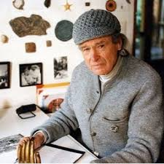
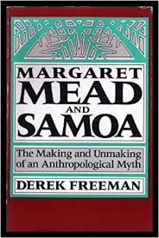
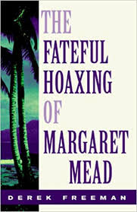

Slide 26
INTRODUCTION
And yet the legend and the myth that was so influential for the millions who read her book and the millions more who were taught her conclusions was seriously threatened in 1983 by an Australian anthropologist, Derek Freeman, who actually spent years in Samoa, unlike Mead’s brief nine months.
Freeman became an expert in Samoan language and culture.
He examined her research and her conclusions and discovered that on virtually every major subject she addressed, she had seriously missed the mark, often proclaiming the precise opposite of the truth.

Slide 27
INTRODUCTION
What we should bear in mind is that one who finally blew the whistle on her was not an evangelical Christian.
Derek Freeman was certainly a Darwinian evolutionist and probably an atheist. In other words, he was carrying no water for biblical morality. His agenda was something far different.
Notes:
Now we can be glad that most probably do not cheat or lie or fake their conclusions. In fact, the scientific method has a safeguard built into it from the start. Reliable data can only be gleaned from experiments that can be replicated, repeated with the same results. Anyone should be able to conduct the same experiment under the same conditions and achieve the same outcome. If you perform an experiment a thousand times and get the same results a thousand times, then the data is probably correct, even well established. If you get multiple, conflicting outcomes, then the data is not confirmed and needs more work.

Slide 28
I. THE DEBATE.
In the late 1800s and early 1900s there was a furious debate raging in the academic world between the strict, atheistic evolutionists and the philosophical idealists.
The evolutionists insisted that human behavior was completely controlled by biology, that humans were mere machines, and that all behavior was predetermined by the chemical processes in their brains and bodies.
The philosophical idealists disagreed. They believed that outside factors beyond biology were the keys to behavior: societal, cultural forces.
This was the classic “nature or nurture” debate. Which determined behavior: chemicals or culture?

Slide 29
I. THE DEBATE.
One of the chief proponents on the anti-evolution, philosophical idealism, nurture or cultural forces debate was the famed anthropologist Franz Boas, a German scholar who was teaching at Columbia University in New York.
He also happened to become Margaret Mead’s mentor and sponsoring professor for her doctoral program in anthropology.

Slide 30
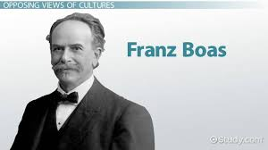

Slide 31
I. THE DEBATE.
But if Boas could find a society where for some cultural reason adolescence was free from the seemingly universal turmoil, a “negative instance,” then he would have great evidence on his side: culture determined behavior, not evolutionary biology.
Margaret Mead had longed to travel to some exotic place; her mentor devised the experiment, and with a research grant in her pocket, she was off to the romantic, South Seas paradise land of Samoa.
So, just to recap: the debate was not for or against biblical Christianity or Christian morality. Both sides of the nature or nurture debate would have been neutral or even hostile toward Christianity.
Mead was off to try to prove her professor’s point: to find a land where the problems of adolescence did not exist, and to find the reason exclusively among the cultural practices of that people.

Slide 32
II. MARGARET MEAD
Margaret Mead (1901-1978) was born in Philadelphia.
Though her mother denied the existence of a personal God, on her own initiative, ten-year-old Margaret was baptized into the Episcopal Church.
Her goal from a young age was “human betterment,” and one of her early aspirations was “to be known for having made a difference in the world.”
When she turned sixteen, she became secretly engaged to a student at the General Theological Seminary in New York, Luther Cressman, who would eventually become the first of three husbands.

Slide 33
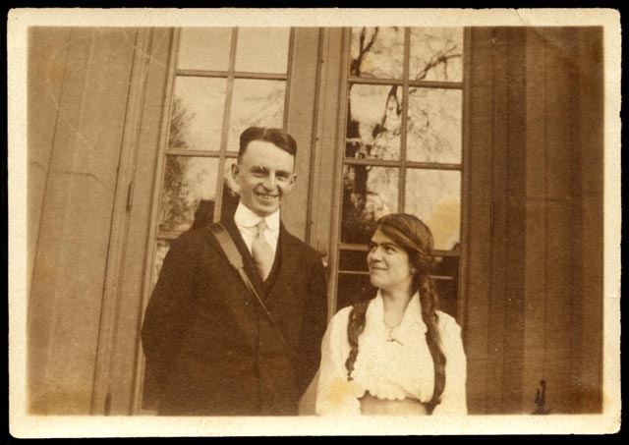

Slide 34
II. MARGARET MEAD
At the age of seventeen she went to De Pauw University in Greencastle, Indiana. Intending to become a writer, she took courses in English composition and literature.
While there she received awards for her dramatic writing.
But she really longed to be in New York studying with the trendsetters and to be with her fiancé.
In 1920, she convinced her father, and enrolled in the Barnard College of Columbia University in New York City.

Slide 35
II. MARGARET MEAD
Mead switched her major to psychology and apparently accepted the theories of Freud (she later quotes him uncritically, including his most controversial theory of the Oedipus complex), but in her senior year was attracted to anthropology, the study of human cultures.
She also took a course in zoology where her professor had studied in the romantic land of Tahiti.
While she was also in her undergraduate training at Barnard, she became a student of Franz Boas and of his teaching assistant Ruth Benedict.
She was powerfully impressed by Boas and called him “the greatest mind she had ever encountered.” She was naturally eager to please him, and upon her graduation Boas accepted her as a doctoral student in anthropology.

Slide 36
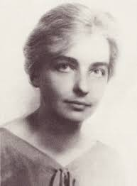
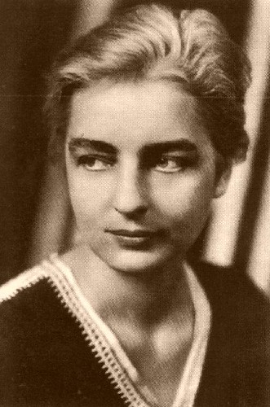

Slide 37
II. MARGARET MEAD
It was in her final year as his student that Boas tasked her with the assignment of finding a “negative instance,” a culture where the seemingly universal problems of adolescence did not exist.
She negotiated a testing ground for this in the romantic, South Seas area of Samoa. With a research grant in her pocket, she was off to prove her mentor’s point.

Slide 38
II. MARGARET MEAD
On her way to Samoa she spent several weeks studying in the Bishop Museum in Hawaii.

Slide 39
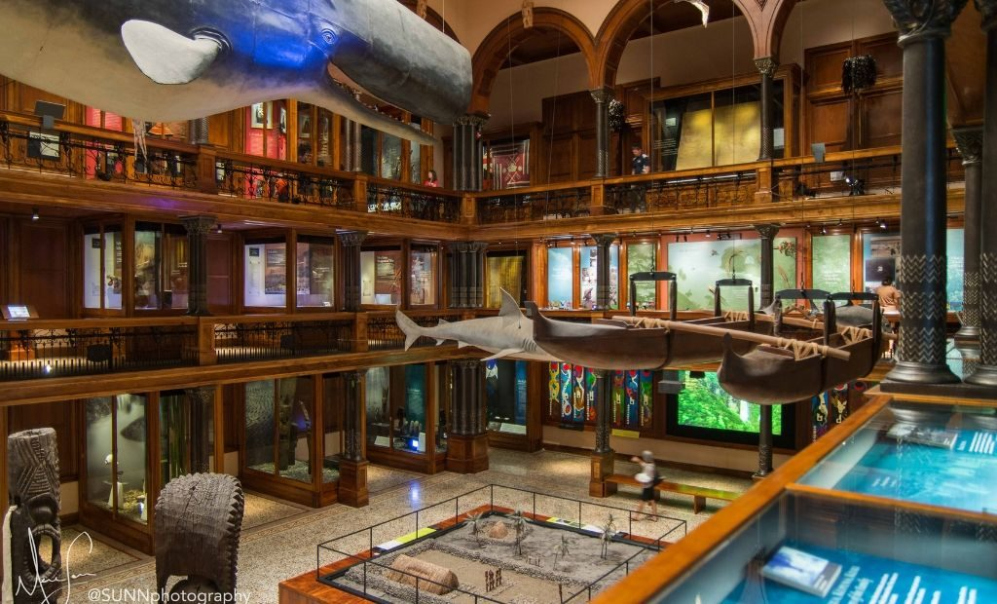

Slide 40
II. MARGARET MEAD
On her way to Samoa she spent several weeks studying in the Bishop Museum in Hawaii.
The staff there was eager for research on Samoa as well. So, along with the assignment from Boas, she agreed to do additional study for the Museum, and all in the space of only nine months, which would include learning the language, something she had never attempted before.
Part of her time was interrupted by a major hurricane and the lengthy clean up that followed.
On the island of her major research she did not live in a village, but with an American military family, and only made forays into the villages, mostly during daylight hours.

Slide 41
II. MARGARET MEAD
In the end, this person who was skilled in “creative writing,” who from a young age was dedicated to “human betterment” and wanted “to be known for having made a difference in the world” wrote up her findings for the professor she sought to please (he was enthusiastically pleased) which soon was published as Coming of Age in Samoa.

Slide 43
II. MARGARET MEAD
In the end, this person who was skilled in “creative writing,” who from a young age was dedicated to “human betterment” and wanted “to be known for having made a difference in the world” wrote up her findings for the professor she sought to please (he was enthusiastically pleased) which soon was published as Coming of Age in Samoa.
Apart from a few pages in the back titled “Materials Upon which the Analysis is Based,” the book contains not a single footnote and no bibliography, curious from a doctoral dissertation research project.
E. Michael Jones describes it as “novelistic”: “It is an account composed of equal parts poetic description and anthropological moralizing.” (23) He notes: “Mead left Samoa nine months after she arrived, claiming she had enough material to allow her to generalize not only about life of Samoan adolescents but about Samoan culture in general and beyond that about ‘our humanity’ as well.” (21)

Slide 44
II. MARGARET MEAD
Oh, and one other fact we should note: every finding of her research was reported by one witness alone: herself.
There was no independent corroboration of any of her claims. She even changed the names of her interviewees, so no follow-up research could be possible.
Let me just ask at this point, “Is that ‘scientific’?”
Are we required to believe her solitary testimony with zero corroborating evidence, to necessarily accept her sweeping theories and conclusions and radically change all of society, family structure, and sexual morality on her word alone?
Actually, that’s precisely what happened.

Slide 45
II. MARGARET MEAD
The book became a “runaway bestseller” as soon as it was published in 1928 in both the US and in Europe. The message was that “our troubles were caused by restrictive cultural conditions” and this “resonated with the progressive trendsetters of the late [nineteen] twenties.” (22)
But Mead touched a nerve and found a ready audience, longing for the easy, breezy, warm and sensuous, sexual liaisons on a moonlit beach.
In some ways this longing tapped into the myth of “noble savage,” perpetrated by the romantic philosopher Rousseau.
“Civilization has ruined us. The unspoiled primitive in his hut can teach us all the right way.”

Slide 46
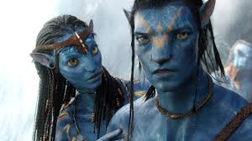

Slide 47
II. MARGARET MEAD
“Writing in The Nation, Frieda Kirchwey claimed that ‘somewhere in each of us, hidden among our more obscure desires and our impulses of escape, is a palmfringed, South Sea island…, a languorous atmosphere promising freedom and irresponsibility….Thither we run...to find love which is free, easy and satisfying

Slide 48
II. MARGARET MEAD
“Samuel D. Schmalhausen effused over ‘the innocent strangely impersonal naively mechanistic-behavoristic sexing of the light-hearted youths and maidens of faroff Samoa’ and felt that there were but two roads of heart fulfillment: ‘Samoa or Calvary: happy-go-lucky felicity or tragic intensity.’
In his book, Our Changing Culture, published one year after Coming of Age, Schmalhausen concluded, ‘Back to the South Sea Isles!’ back to ‘naturalness and simplicity and sexual joy’.
It was a cry echoed by…Havelock Ellis, the sexologist, paramour [or lover], and associate of Margaret Sanger” (23) the founder of Planned Parenthood.

Slide 49
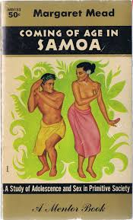

Slide 50
II. MARGARET MEAD
So at the turn of the century, Sigmund Freud declared that unfulfilled sexual desires were to the root of most mental problems.
And a quarter of a century later, Margaret Mead declared that sexual restrictions were the cause of most cultural, societal problems as well.
And all of this was accepted uncritically, because it was “scientific.”
Notes:
Now we can be glad that most probably do not cheat or lie or fake their conclusions. In fact, the scientific method has a safeguard built into it from the start. Reliable data can only be gleaned from experiments that can be replicated, repeated with the same results. Anyone should be able to conduct the same experiment under the same conditions and achieve the same outcome. If you perform an experiment a thousand times and get the same results a thousand times, then the data is probably correct, even well established. If you get multiple, conflicting outcomes, then the data is not confirmed and needs more work.

Slide 51
III. FACTORS LEADING TO THE HOAXING
The warm, pink, cozy, satisfying fantasy islands of Samoa dominated the anthropological world…until someone bothered to visit Samoa and poke around a little bit.
Margaret Mead had spent nine months there, including a couple of months learning the language and another month of down time in the aftermath of the hurricane when everyone was too busy cleaning up to talk to her, by her own reports.
So she devoted half a year to her “research” and became an expert even though she never actually lived with the people there, but always in the comfort of an American naval compound.

Slide 52
III. FACTORS LEADING TO THE HOAXING
Derek Freeman, Professor of Anthropology at the Australian National University, lived in Samoa over three years, learned the language fluently, was accepted as a member of a Samoan family, and was given a chiefly title.
In his first book, which hit like a bombshell, Freeman refuted virtually all of Mead’s claims.
Unlike Mead’s book which contains no footnotes or supporting documentation beyond her statistical reports of her own private interviews, Freeman’s first book contains sixty pages of detailed footnotes. (His second book has over three hundred detailed footnotes.)
Any reader can easily check his facts. No reader could check Mead’s facts.

Slide 53
III. FACTORS LEADING TO THE HOAXING
For example, Mead declared that Samoans were “one of the most amiable, least contentious, and most peaceful people in the world.”
Freeman documents the many conflicts, uprisings, and inter-tribe wars, not to mention statistics on violent crime.
Mead depicts them as giving but “the slightest attention to religion” with “no temples” and “no religious festivals.”
Freeman documents the reports of early missionaries to their very complex religious views and practices, not to mention the thriving Christian church that had been planted by missionaries there in the late 1800s.

Slide 54
III. FACTORS LEADING TO THE HOAXING
Mead noted the lack of strict punishment in Samoa and called it a land that “is kind to all and does not make sufficient demands upon any.”
Freeman cites many examples of the most severe punishments meted out to offenders, including the death penalty, and points out that absolute obedience to the chiefs’ commands was the invariable rule.

Slide 55
III. FACTORS LEADING TO THE HOAXING
Mead claimed that the wonderful “ease in sex relations” enjoyed by the Samoans was “made possible by the whole system of child rearing.” She declared that Samoan children never learn “the meaning of a strong attachment to one person.” There is no sense of children belonging to one father or mother, that they form no special attachment to any certain adults, and this somehow prevents “violent feelings.”
Freeman’s research demonstrated that this was clearly not true. He devised an experiment where a several women surrounded a young child and walked away one at a time. The child did not react at all until his own mother left the circle.

Slide 57
III. FACTORS LEADING TO THE HOAXING
Freeman notes that Mead’s description of childrearing in Samoa actually mirrors the theory and recommended practice of behaviorist psychologist J.B. Watson whose views were popular at the time Mead was in college majoring in…
psychology.

Slide 58
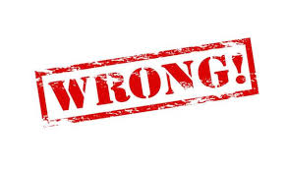
III. FACTORS LEADING TO THE HOAXING
So, was Mead describing Samoa as it was, or culture as she imagined it should be, as she learned in college, in America?
Freeman’s critique is devastating.
The importance of rank in society? Mead was wrong.
Cooperation and competition? Wrong again.
Religion? Wrong.
Punishment? Wrong.
Sex? Wrong!

Slide 59
III. FACTORS LEADING TO THE HOAXING
But it was on sexual customs and practices that she was most wrong.
Mead claimed that “in Samoa, in the romantic South Seas, there was a people with one of the smoothest sex adjustments in the world, among whom, before marriage, love-making—which was their ‘pastime par excellance”—was free, and girls deferred marriage ‘through as many years of casual love-making as possible.’”

Slide 60
III. FACTORS LEADING TO THE HOAXING
Freeman notes “so widely was this view disseminated that many came to believe that Samoan culture included… ‘institutionalized premarital sexuality.’”
In truth, nothing could be more inaccurate. Samoan’s prized virginity even in their pre-Christian days and much more after they had embraced the faith.
Wedding ceremonies regularly included an almost public virginity test, and the girls who failed the test were rejected.
The most highly prized status of a girl in a chiefly family was the “taupou” or ceremonial virgin whose virginity was zealously guarded.

Slide 61
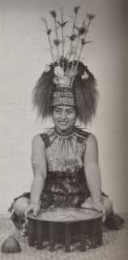
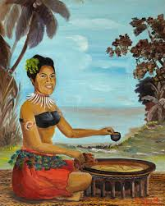

Slide 62
III. FACTORS LEADING TO THE HOAXING
But here is Mead in her own words:
“The Samoan girl who shrugs her shoulders over the excellent technique of some young Lothario is nearer to the recognition of sex as an impersonal force without any intrinsic validity than the sheltered American girl who falls in love with the first man who kisses her. From their familiarity with the reverberations which accompany sex excitement comes the recognition of the essence of impersonal sex attraction….” (Jones, 25)
Today this is called “recreational sex.” (“Friends with benefits?”)

Slide 63
III. FACTORS LEADING TO THE HOAXING
“By discounting the category of perversion, as applied to a practice, and reserving it for the occasional psychic pervert [Samoans] legislate a whole field of neurotic possibility out of existence [echoes of Freud]. Onanism, homosexuality, statistically unusual forms of heterosexual activity, are neither banned nor institutionalized. The wider range which these practices give prevents the development of obsessions of guilt which are so frequent a cause of maladjustment among us….This acceptance of a wider range as ‘normal’ provides a cultural atmosphere in which frigidity and psychic impotence do not occur and in which a satisfactory sex adjustment in marriage can always be established.” (Jones, 25)

Slide 64
III. FACTORS LEADING TO THE HOAXING
E. Michael Jones comments: “To the polymorphously perverse, to the sexually liberated, to those who felt unduly bound by the Judeo-Christian prohibition against adultery, to those who felt that raising their children was an intolerable restriction on their freedom, all of what Mead was saying must have seemed too good to be true. Fifty-five years later [with the advent of Freeman’s book], it turns out that it was.”
Mead also claimed that in Samoa “adultery was not regarded as very serious.”
Freeman notes that in pre-Christian Samoa, adultery was in fact a crime punishable by death. Later, by cutting off a nose or ear.
And even after Christianity had done away with these severe practices, adultery was still considered a serious offense. At the same time that Mead was in Samoa doing her research adultery was illegal, a crime that carried a heavy fine.

Slide 65
III. FACTORS LEADING TO THE HOAXING
Mead was caught in two obvious lies.
When she wrote up her findings for Professor Boas, she reported that in Samoa “sexual life begins with puberty in most cases.”
Yet in the statistical data she provided, she listed twenty-five girls, all of whom reached puberty, and yet fourteen of the twenty-five (56%) are listed as having “no heterosexual activity.”
Where did she get this idea that for most girls, sexual activity begins at puberty, the one contradicted by her own findings?

Slide 66
III. FACTORS LEADING TO THE HOAXING
The other lie was the nearly complete lack of any babies being conceived and born before marriage.
If most Samoan girls become sexually active at puberty with multiple partners over several years and try to defer marriage as long as possible, and yet had no means of birth control, why were their no babies born out of wedlock?
Mead lamely suggested that “in Samoa premarital promiscuity” seemed to ensure “against pregnancy.”
That would make it the most unique place on earth for it is certainly not the case anywhere else in the world.
So is that true? Is that possible? Is it ‘scientific’?
No, it’s absurd.

Slide 67
III. FACTORS LEADING TO THE HOAXING
Freeman’s book was devastating to Mead’s thesis.
He had tried to contact her about the discrepancies while she was still living, but she rebuffed him.
She also rebuffed many educated Samoans who tried to contact her, who flatly denied the validity of her work.
Freeman’s book was published five years after her death. Only the most ardent Mead supporters tried to refute Freeman’s research.
E. Michael Jones summarizes the resistance: “The real attraction of cultural relativism was that it condoned sexual license, something of interest to Americans during the entire span of Mead’s career. According to Time magazine, which weighed in with its report on February 14, 1983, ‘Mead became the natural ally of those who promoted free education, relaxed sexual norms, and green light parenting intended to give American youngsters the trouble-free adolescence enjoyed in Samoa.’

Slide 68
III. FACTORS LEADING TO THE HOAXING
“Coming of Age in Samoa ‘attracted a wide audience for its implied critique of Western civilization.
The book said in effect: The West featured fidelity, competition, overheated sexual arrangements, a tight nuclear family, guilt, stress, and adolescent turmoil; yet here are the alleged primitives leading graceful lives of cooperation, adolescent bliss, casual family ties, and easy sex, all without any signs of guilt or neurosis.’”

Slide 69
III. FACTORS LEADING TO THE HOAXING
Jones goes on to note: “At issue, then, was not so much one anthropologist’s reputation on the academic stock market, but to a project dear to a large segment of the American population, namely sexual liberation. The issue was sex, sex disconnected from the norms of Western civilization, for the most part known as Christianity. One of the century’s seminal disconnectors, it now seemed, was seriously in error—a state of affairs that threatened the whole enterprise.
It was, shall we say, a story of the eighties, something from intellectual history to complement the epidemics of venereal disease now awash in the blood of the sexually liberated. Now it could be shown not only that the sexual license led to disease and death but that its papers had been forged as well. Coming of Age in Samoa, the idyll of casual sex beneath the palm trees, was proving to be about as scientific as the screenplay of Blue Lagoon.” (33)

Slide 70
III. FACTORS LEADING TO THE HOAXING
Sixteen years after his first book, Freeman was compelled to come out with a second, not to retract anything, but to double down.
He had discovered the source of Mead’s deception.
At the end of his first book, Freeman could not bring himself to accuse the now deceased and also discredited Mead of out and out fraud.
So he reasoned that she must have been deceived by some of the adolescent girls from Samoa.
They must have been making up tales, hoaxing her. And the title his second book reflected that belief: The Fateful Hoaxing of Margaret Mead: a Historical Analysis of Her Samoan Research.

Slide 71
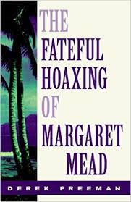

Slide 72
III. FACTORS LEADING TO THE HOAXING
Freeman listed and explained in depth five ways Mead’s hoaxing was fated, “virtually inevitable.”
The first was that she brought with her to Samoa the firm belief of her mentors, Franz Boas and Ruth Benedict, that human behavior was not due to biology but to cultural forces.
She was clearly looking to prove that point.

Slide 73
III. FACTORS LEADING TO THE HOAXING
The second was that her time-consuming moonlighting work in Samoa for the Bishop Museum in Hawaii consumed most of her limited days in Samoa so that near the end she was forced to grasp at some other source of information for her main work, and that was supplied by two Samoan women who from another island, one of whom eventually admitted on the record to hoaxing Margaret Mead with thrilling, purely fictional tales of sexual exploits, which became the centerpiece of Mead’s work, something akin to “locker room bragging” of male counterparts.

Slide 74
III. FACTORS LEADING TO THE HOAXING
The third dynamic was that Mead had also brought with her a false notion imparted by a professor Handy that she would find premarital promiscuity as the rule in Samoa, a land he had never visited or studied, but an idea he had extrapolated from another island, Tahiti.
Fourth, as a follower and adoring student of Franz Boas, she above all wanted to please him with a result that he would find gratifying and acceptable: this “negative instance” where the universal problems of adolescence did not exist, and that because of the lack of cultural rules governing youthful sexual activity.
Finally, the fact that it was commonplace among Samoans to resort to joking and teasing when pressed for information on sexual behavior, a custom of which Mead was unaware and took for sober testimony.

Slide 75
III. FACTORS LEADING TO THE HOAXING
As I mentioned, Freeman met one of the two women whom Mead had interviewed in March of 1926 on the island of Ofu, a woman who later signed a sworn affidavit that she and another woman had jokingly supplied Mead with many fictional elements that became the heart of her book and the heart of her contribution to the devastating sexual revolution that left countless victims broken and bleeding, not to mention the millions upon millions of discarded unborn children sacrificed on the altar of sexual license.
And please remember, all of this was on the unverified word of one person, quickly embraced by a willing world.

Slide 76
Hospers PCA Summer Seminars 2020
“The Roots of the (Moral) Revolution”
June 9: “Sigmund Freud’s Complicated Oedipus Complex” (Psychology)
June 23: “Margaret Mead’s Fantasy Island” (Anthropology)
July 21: “Alfred Kinsey’s Wild Ride (or Bogus Adventure?)” (Biology)
August 11: “Karl Barth’s Neo-Unorthodox Arrangement” (Theology)
(All Seminars on Tuesdays at 7:00 p.m.)
Notes:
Now we can be glad that most probably do not cheat or lie or fake their conclusions. In fact, the scientific method has a safeguard built into it from the start. Reliable data can only be gleaned from experiments that can be replicated, repeated with the same results. Anyone should be able to conduct the same experiment under the same conditions and achieve the same outcome. If you perform an experiment a thousand times and get the same results a thousand times, then the data is probably correct, even well established. If you get multiple, conflicting outcomes, then the data is not confirmed and needs more work.

Slide 77
IV. MARGARET MEAD’S SEXUAL AGENDA
So Margaret Mead was secretly engaged at the age of sixteen to seminary student Luther Cressman. She pleaded with her father to let her transfer from De Pauw University in Indiana to Barnard College in New York City.

Slide 78
IV. MARGARET MEAD’S SEXUAL AGENDA
Jane Howard wrote a positive biography of Margaret Mead. She describes life at Barnard College.

Slide 80
IV. MARGARET MEAD’S SEXUAL AGENDA
Jane Howard wrote a positive biography of Margaret Mead. She describes life at Barnard College.
“’Preoccupation with sex was common among Barnard undergraduates’ in the twenties. Howard cites one alumna who claimed, ‘If you went to Barnard in those days, you were assumed to be a nymphomaniac.’ Mead had come from a liberal background (‘we were the kind of people who read Emerson’, said Emily Fogg Mead); had an uncle who was expelled from the Unitarian Church for heresy; was conscious of her father as someone with less than salutary sexual morals, but had married young to a young Episcopalian seminarian,” who attended a very liberal seminary, who himself quit seminary and became an anthropologist. (Jones 34)

Slide 81
IV. MARGARET MEAD’S SEXUAL AGENDA
At Barnard College she became a student of Franz Boas and his teaching assistant, Ruth Benedict in the field of anthropology.
Mead herself notes that by “electing anthropology as a career,” she was also “electing a closer relationship with Ruth Benedict who was fourteen years her senior. Ruth Benedict’s biographer, Margaret Caffrey, notes that Mead and Benedict eventually entered into “an intimate sapphic relationship.”
(I had to look it up: it means a female homosexual relationship.)

Slide 82
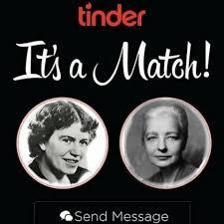

Slide 83
IV. MARGARET MEAD’S SEXUAL AGENDA
After a six year engagement, she married Luther Cressman in 1923.
Before she left for Samoa in 1925 she had a short adulterous affair with a professor Edwin Sapir.
When she left for Samoa in 1925 she handed her husband a parting letter.
He was so shocked by the last line that had to sit down on the running board of the car he had been leaning on.
It read, “I’ll not leave you unless I find someone I love more.”

Slide 84
IV. MARGARET MEAD’S SEXUAL AGENDA
So…before she left for Samoa, she had a homosexual relationship with her mentor, she committed adultery with a professor, and she put her husband of two years on notice.
Aboard ship on her way home from Samoa she met and fell in love with another man, a New Zealander on his way to Cambridge, England to study psychology.
He eventually became her second husband.

Slide 85
IV. MARGARET MEAD’S SEXUAL AGENDA
So…before writing her world-changing book counseling sexual license, in which she declared that “casual homosexual relations between [Samoan] girls never assumed any long-term importance,” (103),
the book that insisted that on the perfect paradise of Samoa “adultery was not regarded as very serious,”
Mead herself had willingly participated in both a homosexual affair that was to last for many years, and at least two adulterous affairs.
One would be excused if they openly wondered whether Mead was writing about adolescent girls in Samoa or about Margaret Mead.

Slide 86
V. GROUNDED IN A BIBLICAL WORLDVIEW
And here’s where a brief review of our biblical, Christian worldview may help to put the pieces together.
The Bible clearly declares that God is the Maker of all things, that he made humans in his image, that he wrote his holy law on every human heart, and that there is none righteous, no not one. So every human being has the same problem: moral guilt before a holy God.
What to do with this guilt?
The Bible’s answer is the incarnate Son of God who fulfilled all righteousness and then suffered the penalty for his people: death and hell on the cross. And he rose again that we might be forgiven and justified, declared right with God. And that includes repentance from sin and self and the Holy Spirit power to defeat sin and to live a life pleasing to God according to his holy law.

Slide 87
V. GROUNDED IN A BIBLICAL WORLDVIEW
But what if someone wants to continue in sin, say, in an incestuous, adulterous relationship with his dull wife’s spicy younger sister, as was the case of Sigmund Freud?
Or what if someone wants to enjoy a variety of sexual relationships with women or men, in or out of marriage as was the case of Margaret Mead?
One way of soothing a guilty conscience might be to pretend that sin was not sin. In fact, to pretend that God’s holy law written on every heart and written in his holy Word did not solve problems but instead created problems, actually was the problem!

Slide 88
V. GROUNDED IN A BIBLICAL WORLDVIEW
Then one might imagine that sexual immorality was essential to mental health as did Sigmund Freud.
Or one might imagine that sexual immorality was essential to a peaceful society and an easy transition into adulthood, as did Margaret Mead.

Slide 89
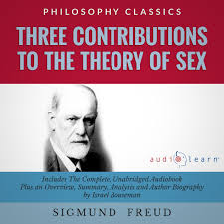

Slide 90
V. GROUNDED IN A BIBLICAL WORLDVIEW
Then one might imagine that sexual immorality was essential to mental health as did Sigmund Freud.
Or one might imagine that sexual immorality was essential to a peaceful society and an easy transition into adulthood, as did Margaret Mead.
And remember, both claimed to scientists and that their findings were based on science and to dispute them would be anti-science, even though they offered no verifiable evidence, and in Mead’s case, her conclusions were actually against the evidence!
Were their conclusions true?
Were they ‘scientific’?
If not, then why should we believe them?

Slide 91
CONCLUSION
The Roman statesman Cicero noted: “Many wrongdoers have turned evidence against themselves.”
Proverbs 28:1 says: “The wicked flee when no one pursues, but the righteous are bold as a lion.”
It was Margaret Mead’s guilty conscience that wrote her book.
It was a flight from reality, from moral responsibility that she was duly attempting to escape.

Slide 92
CONCLUSION
In light of Proverbs 7 which I read at the beginning of this talk, Margaret Mead was that adulterous woman coaxing a naïve culture into her deadly den of sin.
Of course the culture didn’t need much of a push.
My sister has a miniature Australian sheepdog.
It will sit upon command. You can put a treat on the ground right in front of it and it will not budge, even though it focuses all attention on that treat.
And then with the slightest command, it makes a break for it.

Slide 93
CONCLUSION
Margaret Mead was one of the “experts” who gave the signal, the okay.
The 1920s of her day, the “roaring twenties” was war-weary and ready to roll, ready to roar.
The churches had been deeply damaged by the modernist controversy that sought to strip away the Bible’s authority.
Darwinian evolutionary theory declared that we are mere animals. Animals in nature or on the farm reproduce all the time. Nobody criticizes them.
The enlightened Western world was ready to break for sexual license. Margaret Mead gave the signal. And the Western world went for the treat with a vengeance

Slide 94
CONCLUSION
E. Michael Jones writes: “The fact of the matter is that large segments of the intelligentsia of the West in the twentieth century were dissatisfied with the sexual mores of their culture and were looking for some kind of rationalization to justify their violation of these norms. Mead, with her unerring sense of what was current and popular, provided them with this rationalization and was rewarded handsomely for it.” (39)

Slide 95
CONCLUSION
By comparing Margaret Mead to the adulterous woman of Proverbs 7 I am not being sexist.
Remember, of the four unindicted co-conspirators I’m naming as the pioneers of the sexual revolution, three of them are men. And remember, she literally committed adultery on multiple occasions. She actually was an adulteress by her own admission.
And through her theories, she enticed others to follow her example, which millions upon millions dutifully did.
“²¹ With much seductive speech she persuades him; with her smooth talk she compels him. ²²All at once he follows her, as an ox goes to the slaughter, or as a stag is caught fast ²³ till an arrow pierces its liver; as a bird rushes into a snare; he does not know that it will cost him his life.”

Slide 96
CONCLUSION
All of this is outrageous!
We’ve been had! But as I studied and researched this matter, the overwhelming feeling that came over me was neither outrage nor anger.
It was sadness.
How many of my friends haven’t rushed into that trap, believing the soft, pink lie of the adulterous women and men who coax and plead: “Come join us! All is well! There is no tomorrow, no day of reckoning.” And they are lying, deceived and being deceived.

Slide 97
CONCLUSION
The second half of Proverbs 28:1 says:
“The wicked flee when no one pursues, but the righteous are bold as a lion.”
Now you know the truth.
The supposedly “scientific” foundation of the sexual revolution is a forgery, a fraud, a hoax by those who were hoodwinked into believing it. So we can be courageous and bold, assured of the truth, and live thriving lives of righteousness.

Slide 98
CONCLUSION
And we must be bold in gospel outreach.
Passing one more law or getting one more of the right justices on the Supreme Court is not the answer (as we discovered just last week).
The gospel of Jesus Christ is the answer.
For only the gospel can make a person new and create a new principle within that loves Christ and his holiness and hates sin and self.
And that is the answer.
It has always been the answer.
It will always be the answer.
And the tragedy is that so few are sharing that answer today.

Slide 99
Hospers PCA Summer Seminars 2020
“The Roots of the (Moral) Revolution”
June 9: “Sigmund Freud’s Complicated Oedipus Complex” (Psychology)
June 23: “Margaret Mead’s Fantasy Island” (Anthropology)
July 21: “Alfred Kinsey’s Wild Ride (or Bogus Adventure?)” (Biology)
August 11: “Karl Barth’s Neo-Unorthodox Arrangement” (Theology)
(All Seminars on Tuesdays at 7:00 p.m.)

