Slide 1
MISSION TRIPS:
Helping Others
or Helping Ourselves?

Slide 2
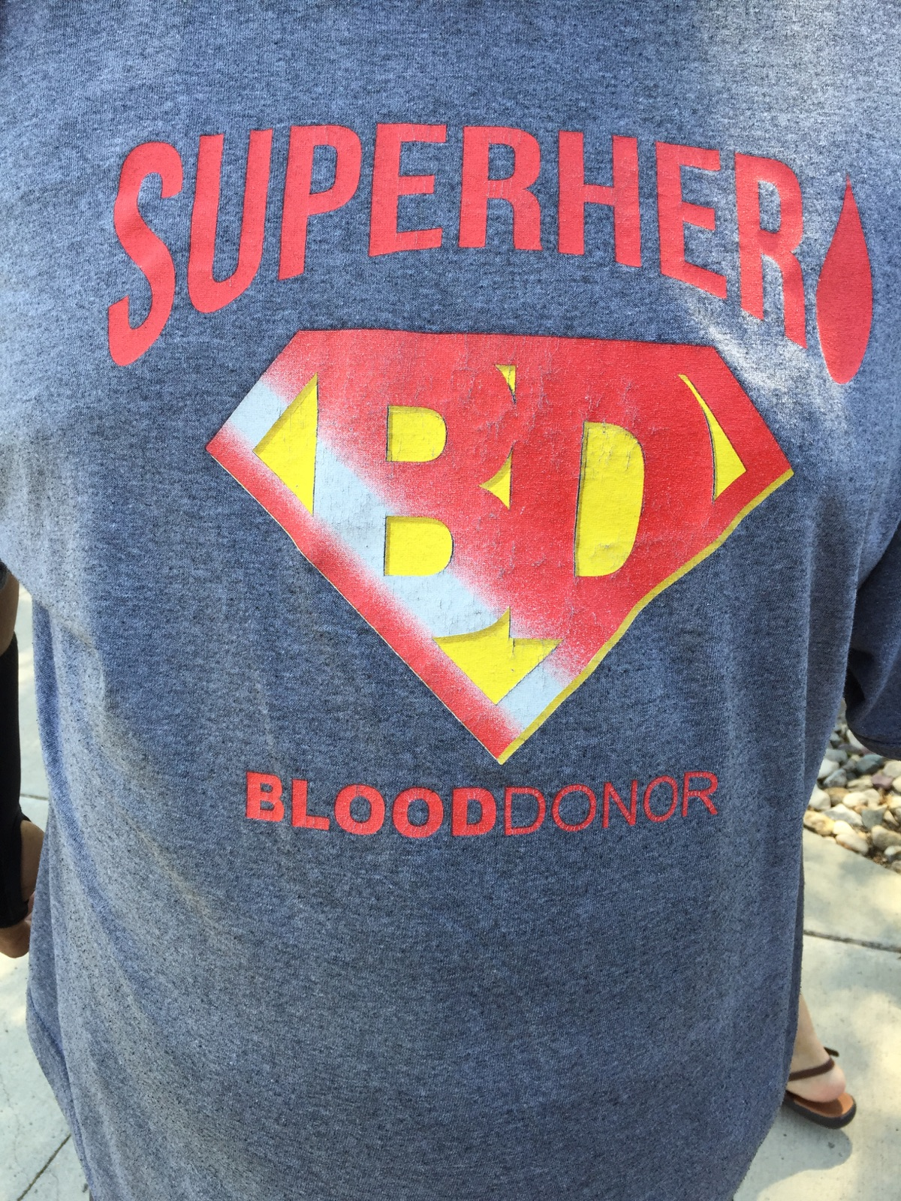

Slide 49
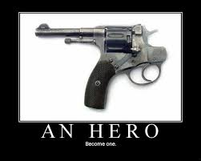

Slide 50
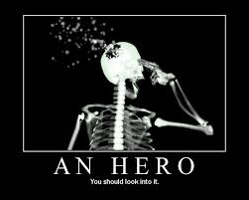

Slide 52
Aristotle’s Means of Persuasion
Logos— “Logic”—This is right, this makes sense.”
Ethos— “Ethics”— “These people are trustworthy/ this is my duty.”
Pathos— “Sympathy”– “These people are suffering, I must help.”

Slide 54
WHAT QUESTIONS OR CONCERNS HAVE YOU HEARD ABOUT MISSION TRIPS?

Slide 55
Three Basic Concerns
Motive: What is the reason or justification for this trip?
Honesty: How is this trip being “sold” to others?
Effectiveness: What will be the long-range results of this trip? What unintended side-effects may occur?

Slide 56
Reasons for Mission Trips
1. DISASTER RESPONSE
2. ROAD TRIP
3. GROUP BUILDING
4. SELF-VALIDATION
5. TO ENCOURAGE MISSIONARIES
6. PATERNALISM

Slide 57
Reasons for Mission Trips
7. GUILT-ALLEVIATION
8. PERSONAL DEVELOPMENT OR SELF-EXPLORATION
9. PERSONAL EDUCATION
10. INTER-CHURCH COMPETITION
11. TO SPARK INTEREST IN MISSIONS IN THE LOCAL CHURCH.
12. JUSTICE.

Slide 58
HARD TRUTHS
“Contrary to popular belief, most mission trips and service projects do not:
-empower those being served
-engender healthy cross-cultural relationships
-improve local quality of life
-relieve poverty
-change the lives of participants
-increase support for long-term mission work

Slide 59
HARD TRUTHS
“Contrary to popular belief, most mission trips and service projects do:
-weaken those being served
-foster dishonest relationships
-erode recipients’ work ethic
-deepen dependency.”
Robert Lupton, Toxic Charity, 15-16

Slide 60
SUMMER SEMINAR #5
“ISIS, Islam, and the Love of Christ”
Tuesday, August 18
7:00 p.m.
Dr. Walker Cosgrove
Assistant Professor of History
Dordt College

Slide 61
HARD QUESTIONS
1. Is this trip really necessary and why?
2. What alternatives to this mission trip might better achieve its goals?
3. Are we being completely honest in promoting this trip and justifying its expense?
4. What percentage of the cost of this trip will we expect participants themselves to pay?
5. In what specific ways will you honor those whom you serve?
6. What lasting commitment and relationship will you maintain when the trip is over?

Slide 62
SUMMER SEMINAR #6
“Biblical Mercy Ministry:
Dependency or Development”
Tuesday, August 25
7:00 p.m.
Dr. Brian Janssen

Slide 63
SUMMER SEMINAR #5
“ISIS, Islam, and the Love of Christ”
Tuesday, August 18
7:00 p.m.
Dr. Walker Cosgrove
Assistant Professor of History
Dordt College

